Slide 1

Wireless Networks
CSE 453
Dr. Md. Imdadul Islam
Professor, Department of Computer Science and Engineering
Jahangirnagar University
www. juniv.edu
1

Slide 2
Personal
802.15.3
Bluetooth
60 GHz
UWB
WAN
GSM, CDMA,
UMTS…
3GPP
MAN
Wide
(ultra-wide band)
LAN
TVWS
PAN
RAN
802.22
Regional
802.11
Wi-Fi
Metro
Local
802.16 WiMAX
TV White Spaces (TVWS) are frequencies made available for unlicensed use at locations where the spectrum is not being used by licensed services, such as television broadcasting. This spectrum is located in the VHF and UHF bands.

Slide 3
Cognitive Radio the IEEE 802.22 Standard
IEEE 802.22, is a standard for wireless regional area network (WRAN) using white spaces (vacant TV channels) in the television (TV) frequency spectrum (in the VHF and UHF bands).
Operates in the range of frequencies between 54 MHz and 862 MHz.
Operates in lower population density areas.
The development of the IEEE 802.22 WRAN standard is aimed at using cognitive radio (CR) techniques to allow sharing of geographically unused spectrum allocated to the television broadcast service.

Slide 4
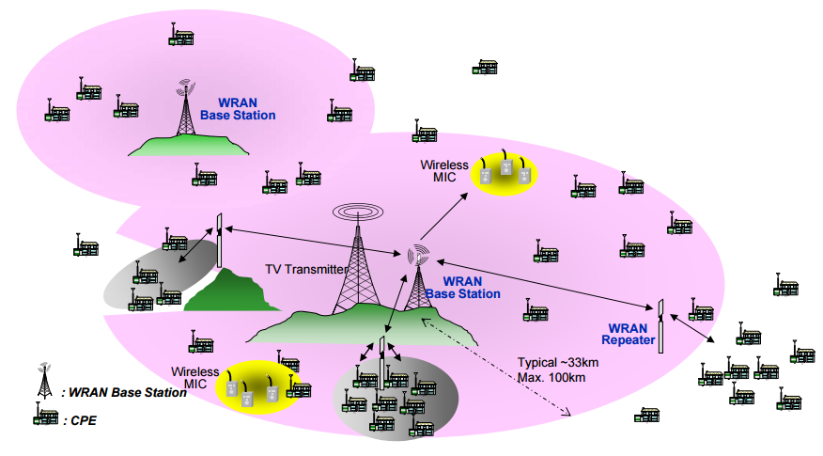
Overview of IEEE 802.22 Standard
Basic concept is like WLL (Wireless Local Loop)
Customer-Premises Equipment (CPE)

Slide 5
WAN (Mobile Cellular Network)
History of Mobile Cellular Network

Slide 6
Since the late 1970s when the cellular era started, mobile communication has gone through an evolutionary change every decade in terms of technology and usage. Japan took the lead in the development of cellular technology, which resulted in the deployment of the first cellular networks in Tokyo.
Within a couple of years Nordic Mobile Telephony (NMT) started cellular operations in Europe. Along with it, systems such as AMPS (Advanced Mobile Phone Service) started in the USA, while TACS (Total Access Communication System) started in the UK. These formed a part of what was called ‘First Generation Mobile Systems’, which catered for speech services and were based on analogue transmission techniques.

Slide 7
Second Generation Cellular Networks

Slide 8
In the early 1990s, digital transmission technology came into force, bringing with it the next generation system, called the ‘Second Generation Mobile System’. Digitization means that the sound of the speaker’s voice was processed in a way that imitated a human ear through techniques such as sampling and filtering. This made it possible for many more mobile users to be accommodated in the radio spectrum.
D-AMPS (Digital Advanced Mobile Phone System)
CDMA (Code Division Multiple Access)
GSM (Global System for Mobile Communication)

Slide 9
Limitations of 2G Networks
Low transfer rates. The 2G networks are primarily designed to offer voice services to the subscribers. Thus the transfer rates offered by these networks are low. Though the rates vary across technologies, the average rate is of the order of tens of kbps.
Low efficiency for packet switched services. There is a demand for Internet access, not just at home or the office but also while roaming. Wireless Internet access with the 2G networks is not efficiently implemented.

Slide 10
GPRS (General Packet Radio Service)
GPRS is a non voice, i.e. data, value added service to the GSM network. This is done by overlaying a packet based air interface on the existing circuit switched GSM network. In infrastructure terms, the operator just needs to add a couple of nodes and some software changes to upgrade the existing voice GSM system to voice plus data GPRS system. The voice traffic is circuit switched while data traffic is packet switched.
Packet switching enables the resources to be used only when the subscriber is actually sending and receiving the data. This enables the radio resources to be used concurrently while being shared between multiple users. The amount of data that can be transferred is dependent upon the number of users. Theoretical maximum speeds of up to 171.2 kilobits per second (kbps) are achievable with GPRS using all eight timeslots at the same time.

Slide 11
EDGE (Enhanced Data Rate for GSM Evolution)
The limitation of the GPRS network was eliminated to a certain extent by the introduction of the EDGE technology. EDGE works on TDMA and GSM systems.
In EDGE, 3G services can be given at a lower but similar data rate as UMTS, with the data rates going up to 500 kbps (theoretically). This is done by introducing a new modulation scheme 8-PSK (phase-shift keying) and will coexist with the GMSK that is used in GPRS.

Slide 12
Third Generation Cellular Networks (3G)

Slide 13
The third generation cellular networks were developed with the aim of offering high speed data and multimedia connectivity to subscribers.
The International Telecommunication Union (ITU) under the initiative IMT-2000 has defined 3G systems as being capable of supporting high speed data ranges of 144 kbps to greater than 2 Mbps. A few technologies are able to fulfill the International Mobile Telecommunications (IMT) standards, such as CDMA-2000, UMTS and some variation of GSM such as EDGE.

Slide 14
The Universal Mobile Telecommunications System (UMTS) is one of the third generation (3G) mobile phone technologies. It uses W-CDMA as the underlying standard.
UMTS uses a pair of 5 MHz channels, one in the 1900 MHz range for uplink and one in the 2100 MHz range for downlink. The specific frequency bands originally defined by the UMTS standard are 1885–2025 MHz for uplink and 2110–2200 MHz for downlink.

Slide 15
Cell and Cell Cluster
Concept of mobile cellular communication system has arises from cell. Cell is the unit coverage of mobile cellular network. The hexagonal cells (like honey cell) are arranged in a continuous fashion to cover the entire service are.
Hexagonal cell

Slide 16
Basic of Mobile Cellular Network
Break the metropolitan area into small areas
Each area is approximated with a hexagonal cell.
A base station is located at the center of each cell.
Each cell is assigned only a fraction of the total number of channels.
Cells that are sufficiently far apart can reuse the same frequency.

Slide 17
Antenna
Up link
Time slot
Down link
Switch
BS
MS
TS and carrier forms a physical channel
f_{DL}- f_{UL} = 45MHz

Slide 18
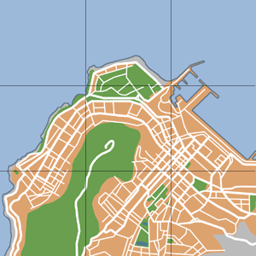
2
3
7
2
1
3
7
4
6
1
2
5
4
6
3
7
2
5
1
3
7
2
4
6
1
3
7
5
4
6
1
2
5
4
6
3
7
2
5
1
3
7
4
6
1
5
4
6
5

Slide 19
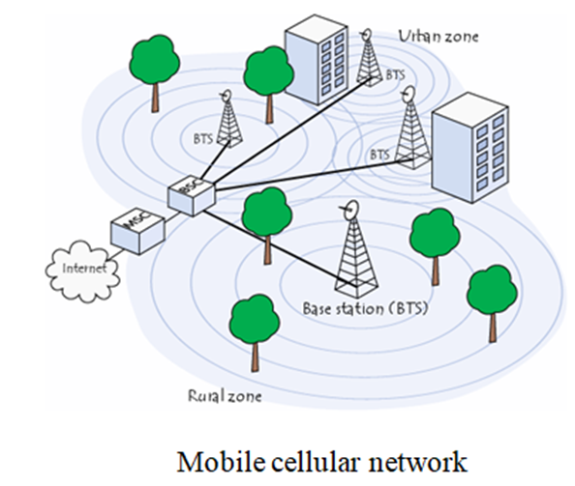

Slide 20
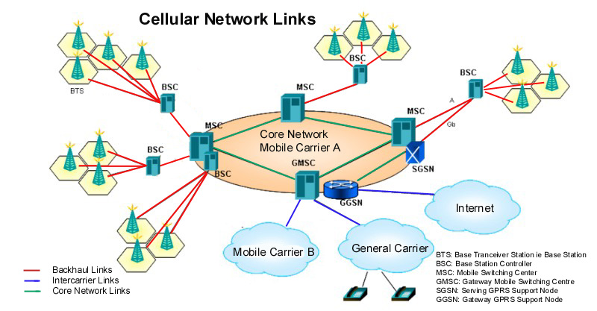
RBS→BTS →Node B (NB) →Evolve Node B (eNB)
1G 2G 3G 4G
Mobile cellular network

Slide 21
Hexagonal Cells in a continuous fashion

Slide 22
Why Hexagonal Cell?
Hexagonal-shaped communication cells are artificial and that such a shape cannot be generated in the real world. Engineers draw hexagonal-shaped cells on a layout to simplify the planning and design of a cellular system because it approaches a circular shape that is the ideal power coverage area. The circular shapes have overlapped or unoccupied areas which make the drawing unclear.
The hexagonal shaped cells fit the planned area nicely with no gap and on overlap between the cells. The real cell has irregular shape because of natural, and man made obstacle in service area.

Slide 23
Cell Shape
R
R
R
Cell
R
R
(a) Ideal cell
(b) Actual cell
(c) Different cell models
Factitious
Why hexagonal cell is used by a network planar?

Slide 24
Factitious
Idealized Coverage
Footprint
Reality!

Slide 25
Cell Clusters/Patterns
Service areas are normally divided into clusters of cells to facilitate system design and increased capacity.
Cell clusters are used in frequency planning for the network
The pattern of cluster is repeated throughout the network.
Entire BW is used within a cluster.
Coverage area of cluster called a ‘footprint’

Slide 26
Definition
Cells in a cellular network are generally “grouped” together into cell clusters. Cellular networks are generally designed as a repeated cluster pattern The number of cells in a cluster (typically 4,7, 12 or 21) is a trade-off between the traffic capacity in the cluster and its interference with the adjacent cluster of cells (where the same frequencies will be re-used)

Slide 27
2
3
7
2
1
3
7
4
6
1
2
5
4
6
3
7
2
5
1
3
7
2
4
6
1
3
7
5
4
6
1
2
5
4
6
3
7
2
5
1
3
7
4
6
1
5
4
6
5

Slide 28
Frequency Reuse
Cluster-2
2
2
1
5
Cluster-1
1
5
4
4
3
7
3
7
6
6
2
1
5
N = 7
4
3
7
6
Cluster-3

Slide 29
Cell Pattern N = 4
2
1
3
2
4
2
1
3
1
3
4
2
4
1
3
4

Slide 30
Frequency Reuse Distance
The minimum distance which allows the same frequency to be reused will depend on many factors such as the number of co-channel cells in the vicinity of the center cell, the type of geographic terrain contour, antenna height and the transmitted power at each cell site.

Slide 31
Frequency Reuse
F7
F2
F7
F2
F6
F1
F3
F1
F6
F1
F3
F1
F5
F4
F7
F2
F5
F4
F7
F2
F6
F1
F3
F1
F6
F1
F3
F1
F5
F4
Reuse distance D
F5
F4
7 cell reuse cluster

Slide 32
Reuse Distance
R
Cluster
For hexagonal cells, the reuse distance is given by
F7
F2
F6
F1
F3
F1
where R is cell radius and N is the reuse pattern (the cluster size or the number of cells per cluster).
F5
F4
F7
F2
F3
Reuse factor is
F6
F1
F1
Reuse distance D
F5
F4
Q. N = 7, R = 2Km determine frequency reuse distance and reuse factor

Slide 33
Cell Sectoring by Antenna Design
c
c
120º
120º
a
b
a
b
(a). Omni
(b). 120º sector
(c). 120º sector (alternate)
d
f
90º
e
60º
a
a
c
d
b
b
c
(d). 90º sector
(e). 60º sector

Slide 34
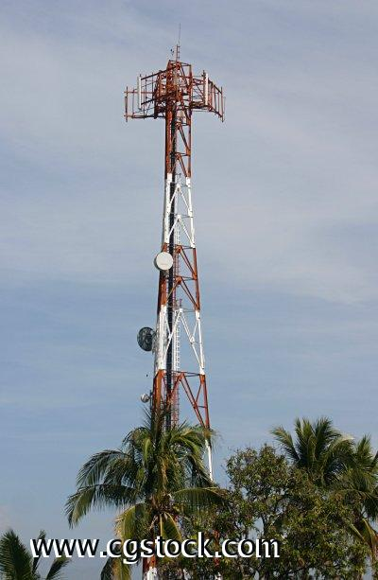
Sectorized Antennas
Further interference reduction by using sectorized antennas.

Slide 35
Cell Clustering with sectored cells
A₁
B₁
A₂
A₃
B₂
B₃
C₁
C₂
C₃
3/9 Cell Pattern

Slide 36
A₁
B₁
A₂
A₃
B₂
B₃
C₁
D₁
C₂
C₃
D₂
D₃
4/12 Cell Pattern

Slide 37
Interferences In Mobile Cellular Network
Co-site Channel Interferences
Adjacent Channel Interferences
Co-channel Channel Interferences

Slide 38
Co-site Channel Interferences
Mutual interferences created by the users inside a cell is called co-site channel interferences. Since users are very closed in cell therefore separation between carries within a cell should be wide enough to avoid interferences. At the same time uplink and down link carriers of an user are separated by 45MHz.

Slide 39
Co-channel Interferences
Interferences created by the users of two co-channel cells are called co-channel interferences. Because of use of same carries, huge interference is created despite of long distance between to co-cell. The distance between co-cell increases with increase in N, the of cells in a cluster.
Co-channel and adjacent channel interferences can be reduced using sectored cells.

Slide 40
Adjacent Channel Interferences
Interferences created by the users of two adjacent cells are called adjacent channel interferences. Because of small distance between adjacent cells an wide band gap should be maintained between carries of adjacent cell to avoid interferences.

Slide 41
Handover (Handoff)
Hand-off is the process of switching from one traffic channel to another by the user in midst of a communication. Hand-off takes place when a user crosses the cell boundary. It Provides continuity of communication across cells. Handoffs must be performed successfully and as infrequently as possible, and be imperceptible to the users.
Process
  Received signal weakens as mobile moves out of cell (Minimum usable signal level is normally set to be between -90 dBm and -100 dBm).
  A slightly save signal level is used as a threshold at which a handoff is made.
  Cell site at some point requests handover to cell with stronger signal strength.
  MSC switches call to new cell after allocating channels, and informing the two mobiles of the new channels (voice and control channels).

Slide 42
Handoff Region
Signal strength due to BS_{i}
Signal strength due to BS_{j}
P_{i}(x)
P_{j}(x)
E
P_{min}
BS_{i}
MS
BS_{j}
X₁
X₃
X₅
X_{th}
X₄
X₂
By looking at the variation of signal strength from either base station it is possible to decide on the optimum area where handoff can take place.

Slide 43
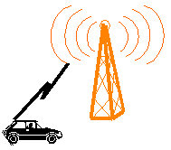
A B
Level at A
Improper handoff situation
Handoff Threshold
Received Signal level
Min^{n} acceptable signal to maintain the call
Level at B
Time
Level at B
Proper handoff situation
Received Signal level
Level at which handoff is made
Time

