Slide 1

Wireless Networks
CSE 453
Dr. Md. Imdadul Islam
Professor, Department of Computer Science and Engineering
Jahangirnagar University
www. juniv.edu
1

Slide 2
Books
5G Wireless Systems: Simulation and Evaluation Techniques (Wireless Networks),
Yang yang, Jing Xu, Guang Dhi, Cheng-Xiang Wang, Springer
Fundamentals of WiMAX: Understanding Broadband Wireless Networking
Jeffrey G. Andrews, Arunabha Ghosh, Rias Muhamed. Pearson Education
An Introduction to LTE: LTE, LTE‐Advanced, SAE and 4G Mobile Communications, Christopher Cox, John Wiley & Sons, Ltd
Computer and Communication Networks, Nader F. Mir, Pearson Education

Slide 3
Network Traffic
Traffic Parameters of a network:
Average call or packet arrival rate (λ calls/min)
Average call or packet duration (t_{h} mim)
Offered traffic or traffic intensity (A= λt_{h} Erlangs)
Number of channels (n)
Blocking probability or QoS (B) or GoS (B)
Length of queue
Mean delay

Slide 4
Blocking probability,
Offered traffic (A Erlangs)
Number of channels (n)
Blocking Probability (B)

Slide 5
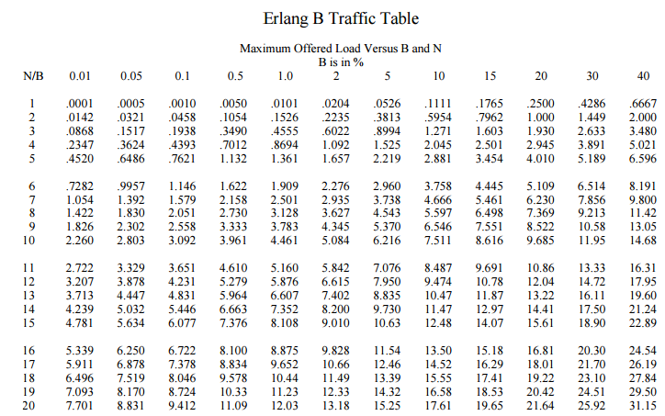
A→ Offered Traffic, B → Blocking Probability, n → Number of channel

Slide 6
Example-1
A city has a population of 3×10⁶. A mobile cellular service provider has 500 cells with 15 channels (Traffic channel) each to serve the people. On an average each user generates 1 call/hour with duration of 1.5 minutes. Determine market penetration of the service provider. Given the GoS (grade of service) of the network is 5%.
(Grade of service is synonymous to blocking probability)
Ans.
Traffic intensity/user = λ.t_{h}=1×(1.5/60) = 0.025Erl/user
For each cell, n = 15, B = 5%
From Erlang’s table, The offered traffic, A=10.63Erls.
Number of users/cell = 10.63/0.025 = 425
Total number of users = 500×425 = 425212500
Penetration rate = (Number of users/Total population) ×100
=(425212500/(3× 10⁶)) 100
=7.08%

Slide 7
%This code determine offered traffic A when n and B are given
%here n = 15 and B=0.05 then determine offered traffic A=?
%instead of using Erlang's table
Bexp = 0.05; %expected Blocking Probability
A = 5; % initial assumed offered traffic
n = 15;%number of channel
e=2;% Initial value of error
while e>0.0001
s=1;
for i=1:n;
s=s+(A.^i)./factorial(i);
end
B = ((A.^n)./factorial(n))/s; %blocking probability
e = abs(B-Bexp);
A=A+0.001;
end %end of while loop
B(n, A)

Slide 8
Lamda =1/60; %arrival rate per user
th = 1.5; %holding time of each user
a = Lamda*th; %offered traffic per user
N = A/a ; %Nunber of user per cell
Nt = N*500; %Total user of the network
P = 3*10^6; %Total population of the city
Rp = (Nt/P)*100; %penetration rate
Home work:
Plot n vs. penetration rate
Plot GoS vs. penetration rate
Plot B vs. A

Slide 9
clear all
close all
for j=1:10,
Bexp = 0.05; %expected Blocking Probability
A = 5; % initial assumed offered traffic
n = 8+j*4;%number of channel
e=2;% Initial value of error
while e>0.0001
s=1;
for i=1:n;
s=s+(A.^i)./factorial(i);
end
B = ((A.^n)./factorial(n))/s;
%blocking probability
e = abs(B-Bexp);
A=A+0.001;
end %end of while loop
Lamda =1/60; %arrival rate per user
th = 1.5; %holding time of each user
a = Lamda*th; %offered traffic per user
N = A/a ; %Nunber of user per cell
Nt = N*500; %Total user of the network
P = 3*10^6; %Total population of the city
Rp(j) = (Nt/P)*100; %Store penetration rate
m(j) =n; %store number of channel
Ao(j)=A; %store offered traffic
end %end of first loop
plot(m,Rp,'--rs', m, Ao,'--b>')
xlabel('n')
ylabel('A and P')
legend('Penetration rate', 'Offered Traffic')
grid on

Slide 10



In a mobile cellular network there are two types of offered traffics: newly originating call and hand over call.
Offered traffic of newly originating call, A₁
Offered traffic of handover call, A₂

Slide 11
Tabular solution of combined traffic for n = 3 channels; where the offered traffic of newly originating call is A₁ and that of handover call is A₂.
A₁³/3! | 3 | (0, 3) | (1, 3) | (2, 3) | (3, 3)
A₁²/2! | 2 | (0, 2) | (1, 2) | (2, 2) | (3, 2)
A₁ | 1 | (0,1) | (1, 1) | (2, 1) | (3, 1)
1 | 0 | (0, 0) | (1,0) | (2,0) | (3,0)
x₁ x₂ | Channels 0 |  | 1 | 2 | 3
 | 1 |  | A₂ | A²₂/2! | A³₂/3!

Slide 12
Tabular solution of combined traffic for n = 3 channels; where the offered traffic of newly originating call is A₁ and that of handover call is A₂.
A₁³/3! | 3 | (0, 3) | (1, 3) | (2, 3) | (3, 3)
A₁²/2! | 2 | (0, 2) | (1, 2) | (2, 2) | (3, 2)
A₁ | 1 | (0,1) | (1, 1) | (2, 1) | (3, 1)
1 | 0 | (0, 0) | (1,0) | (2,0) | (3,0)
x₁ x₂ | Channels 0 |  | 1 | 2 | 3
 | 1 |  | A₂ | A²₂/2! | A³₂/3!

Slide 13
Tabular solution of combined traffic for n = 3 channels; where the offered traffic of newly originating call is A₁ and that of handover call is A₂.
A₁³/3! | 3 | A₁³/3!
A₁²/2! | 2 | A₁²/2! | A₂A₁²/2!
A₁ | 1 | A₁ | A₂ A₁ | A₁A²₂/2!
1 | 0 | 1 | A₂ | A²₂/2! | A³₂/3!
x₁ x₂ | n ↑→ 0 |  | 1 | 2 | 3
 | 1 |  | A₂ | A²₂/2! | A³₂/3!

Slide 14
Complete occupied states
A₁³/3! | 3 | A₁³/3!
A₁²/2! | 2 | A₁²/2! | A₂A₁²/2!
A₁ | 1 | A₁ | A₂ A₁ | A₁A²₂/2!
1 | 0 | 1 | A₂ | A²₂/2! | A³₂/3!
x₁ x₂ | Channels 0 |  | 1 | 2 | 3
 | 1 |  | A₂ | A²₂/2! | A³₂/3!
B(n, A) = (Complete occupied states)/(sum of all states)

Slide 15
Example-2
A₁ = 3 and A₂ = 2, n = 8
The probability states before normalization
8 | 0.1622 | 0.162
7 | 0.433 | 0.433 | 0.867
6 | 1.0125 | 1.0125 | 2.025 | 2.025
5 | 2.025 | 2.025 | 4.05 | 4.05 | 2.7
4 | 3.375 | 3.375 | 6.75 | 6.75 | 4.5 | 2.25
3 | 4.5 | 4.5 | 9 | 9 | 6 | 3 | 1.2
2 | 4.5 | 4.5 | 9 | 9 | 6 | 3 | 1.2 | 0.4
1 | 3 | 3 | 6 | 6 | 4 | 2 | 0.8 | 0.26 | 0.076
0 | 1 | 1 | 2 | 2 | 1.33 | 0.666 | 0.266 | 0.08 | 0.025 | 0.0063
 |  | 1 | 2 | 2 | 1.33 | 0.66 | 0.266 | 0.08 | 0.025 | 0.0063
n→↑ |  | 0 | 1 | 2 | 3 | 4 | 5 | 6 | 7 | 8
The sum of entire sampling space, S= 138.307
The sum of complete occupied state, O = 9.6863
Blocking probability, B = O/S =9.6863/138.307 = 0. 07 = 7%

Slide 16
Example-3
Let us assume bandwidth of each arrival of A₁ is 2kbps and that of A₂ is 3kbps. Given A₁ = 1 and A₂ = 2 Erls. If total Bandwidth supported by the network is 9kbps, then probability state will be with the condition: 0 ≤ D₁x₁+D₂x₂ ≤ 9. Determine QoS of each traffic.
Possible Probability States
4 | A⁴₁/4! | (0,4)
3 | A₁³/3! | (0,3) | (1,3)
2 | A₁²/2! | (0,2) | (1,2)
1 | A₁ | (0,1) | (1,1) | (2,1)
0 | 1 | (0,0) | (1,0) | (2,0) | (3,0)
A₁=1 A₂=2 | 1 |  | A₂ | A²₂/2! | A³₂/3!
 | 0 |  | 1 | 2 | 3

Slide 17
The probability states before normalization
A⁴₁/4! | 4 | 1/24
A₁³/3! | 3 | 1/6 | 1/3
A₁²/2! | 2 | 1/2 | 1
A₁ | 1 | 1 | 2 | 2
1 | 0 | 1 | 2 | 2 | 4/3
A₁=1 A₂=2 | 0 |  | 1 | 2 | 3
 | 1 |  | A₂ | A²₂/2! | A³₂/3!
The sum of entire sample space, S = 13.375

Slide 18
A³₁/4! | 4 | 1/24
A₁³/3! | 3 | 1/6 | 1/3
A₁²/2! | 2 | 1/2 | 1
A₁ | 1 | 1 | 2 | 2
1 | 0 | 1 | 2 | 2 | 4/3
A₁=1 A₂=2 | 0 |  | 1 | 2 | 3
 | 1 |  | A₂ | A²₂/2! | A³₂/3!
The blocking probability of A₁ traffic,
B₁= (1/24+1/3+2+4/3)/13.375 = 3.708/13.375 = 0.277
The blocking probability of A₂ traffic,
B₂= (1/24+1/3+1+2+4/3)/13.375 = 4.708/13.375 = 0.352

Slide 19
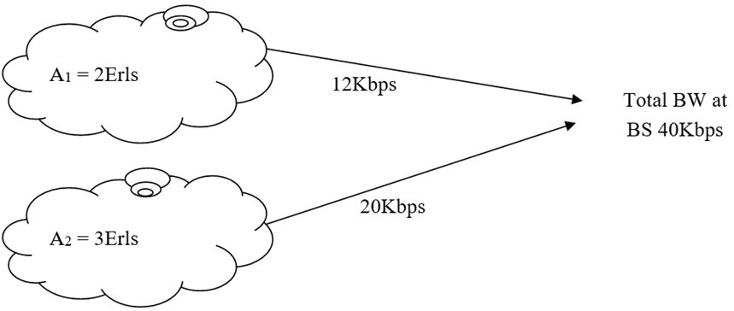
Q1. For the traffic of dissimilar bandwidth of figure below determine the blocking probability of individual traffic.
Narrowband call
Wideband call

Slide 20
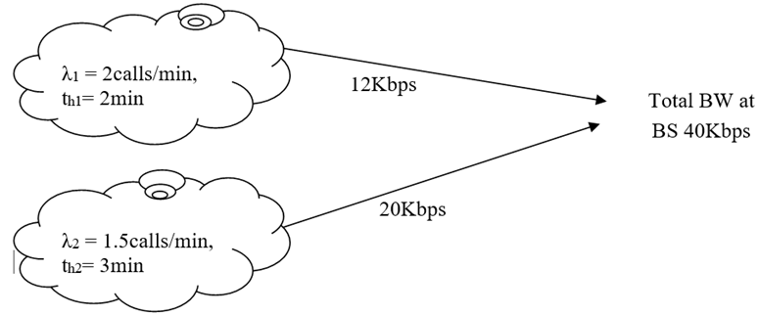
Q2. For the traffic of dissimilar bandwidth of figure below determine the blocking probability of individual traffic.
Narrowband call
Wideband call

Slide 21
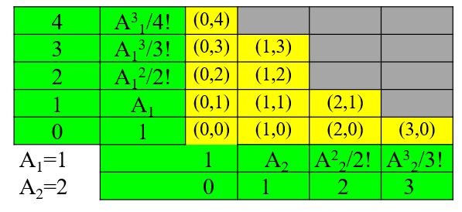
%Probability states before normalization in matrix form
A1=1; A2=2;
x1=2; x2=3;
BW=9; M=ceil(BW/x1); %size of the matrix is M by M
for i=1:M
for j=1:M
e = (i-1)*x1+(j-1)*x2;
if e <= 9
S(i, j)= ((A1^(i-1))/factorial(i-1))* ((A2^(j-1))/factorial(j-1));
else
S(i, j)=0;
end
end
end

Slide 22
% rows should be made reversed to cope with Cartesian co-ordinate system
for i=1:M
for j=1:M
k=M-i+1;
S1(i, j)=S(k, j); %sates are now S1(x,y)
end
end
% Normalized states
T=sum(sum(S1));
Sn=S1/T;

Slide 23
% open states of roof
B1= 0;
for i = 2:M
%index of row with k = i-1 cannot be 0
for j=1:M
k=i-1;
if Sn(i, j)>0 && Sn(k, j)==0
B1= B1+Sn(i, j);
end
end
end
% Sn(1,1) is the default open state of roof
B1=B1+Sn(1,1);
%Side open states
B2=0;
for i=1:M
for j=1:M
k=j+1;
if Sn(i, j)>0 && Sn(i, k)==0
B2= B2+Sn(i, j);
end
end
end

Slide 24
S1 =
0.0417 0 0 0 0
0.1667 0.3333 0 0 0
0.5000 1.0000 0 0 0
1.0000 2.0000 2.0000 0 0
1.0000 2.0000 2.0000 1.3333 0
Sn =
0.0031 0 0 0 0
0.0125 0.0249 0 0 0
0.0374 0.0748 0 0 0
0.0748 0.1495 0.1495 0 0
0.0748 0.1495 0.1495 0.0997 0
B1 = 0.2773
B2 = 0.3520

Slide 25
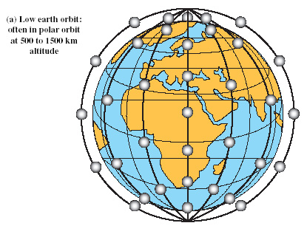
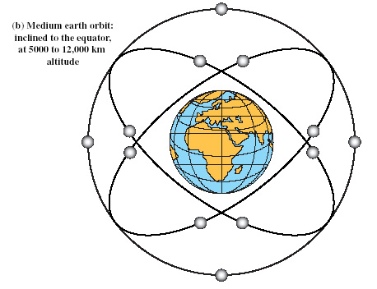
Global Mobile Satellite System
To support a wide range of services and provide superior service quality comparable to that available from terrestrial wireless and wired networks, constellations of satellites operating in low earth orbit (LEO) or medium earth orbit (MEO) are considered more suitable.

Slide 26
The Iridium System
In Iridium 66 satellites are grouped in six orbital planes; there are 11 active satellites in each plane with uniform nominal spacing 31.6⁰. The satellites have circular orbits at an altitude of 783Km.
31.6⁰
Plane-1
22⁰
Plane-6
NP
Plane-5

Slide 27
Each Iridium satellite uses a 48-beam antenna pattern, and each beam, which has minimum diameter of 600 Km, can be individually switched.
Only about 2/3 of the beams will be active at any given time because some of the beams will be switched off when the satellites are in the vicinity of the poles, where beam patterns tend to overlap, or when the satellites are over countries or region in which, Iridium does not have regulatory management to operate.

Slide 28




Ka band
Ka band
Ka band
Ka band
L band
TT &C (Telemetry tracking and control)
SS7
ISU
Iridium Subscriber Unit
Earth Station
GSM
PSTN
High level network architecture for Iridium system

Slide 29
The Globalstar System
Globalstar is a global mobile satellite system based on constellation of 48 MEO satellites. Unlike the Iridium system, Globalstar system does not use intersatellite links but rather depends on a large number of interconnected earth stations or gateway for efficient call routing and delivery over the terrestrial network.
Globalstar’s constellation of 48 LEO satellites is designed to orbit at an altitude of 1414 Km above earth’s surface in eight orbital planes inclined at 52⁰.
Each satellite supports a 16-beam antenna patterns with an average beam diameter of 2250km. To mitigate blocking and shadowing, Globalstar will deploy path diversity, whereby multiple satellites may be used to complete a call.

Slide 30

The network architecture for the Globalstar mobile satellite system shown below is very similar to the Iridium system except that Globalstar does not support ISLs.
L/S band
C band
C band
L/S band
C band
TT &C (Telemetry tracking and control
Globalstar Subscriber Unit
GSU
Globalstar Gateway
Globalstar Gateway
Globalstar Subscriber Unit
GSU
ANSI-41
PSTN
GSM

Slide 31
Wireless MAN
WiMAX is an IP based, wireless broadband access technology that provides performance similar to 802.11/Wi-Fi networks with the coverage and QoS (quality of service) of cellular networks. WiMAX is also an acronym meaning “Worldwide Interoperability for Microwave Access” (WiMAX).

Slide 32
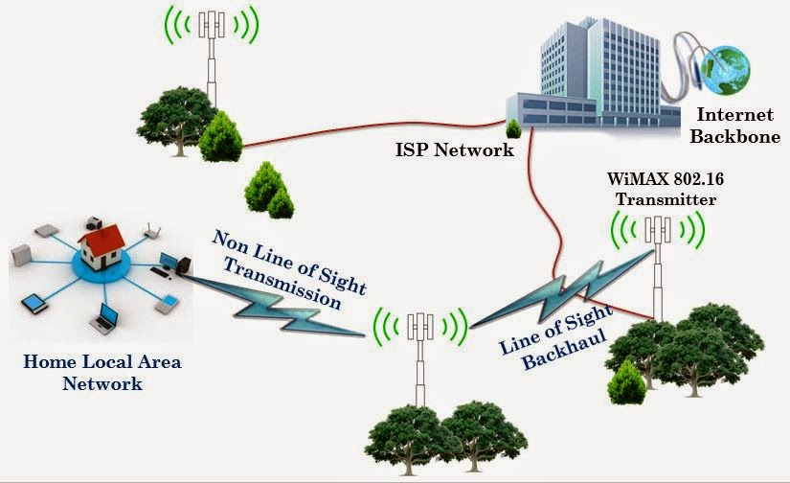
WiMAX and WiFi integration (example-1)

Slide 33
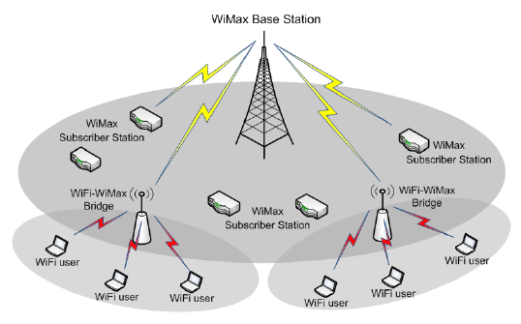
An architecture based on WiMAX and WiFi networks as shown in Fig. 1. In this architecture there is a WiMAX base station encompassing multiple WiFi hotspots (access point).
The WiMAX BS connects to the Internet and acts as the backbone to the WiFi network. The WiMAX subscribers referred to as subscriber stations (SS), communicate directly to the WiMAX Base Station (BS) whereas the WiFi users have to use a special access point (AP) to communicate with the WiMAX BS called WiFi - WiMAX Bridge.
Fig.1 Model of WiMAX and WiFi integration

Slide 34
Wireless LAN

Slide 35
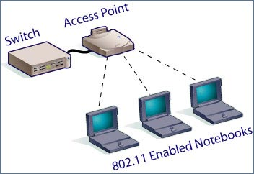
Benefits of Wireless LANs
People can access the network from where they want; they are no longer limited by the length of the cable.
Some cities have started to offer Wireless LANs. This means that people can access the internet even outside their normal work environment, for example when they ride the train.
Setting up a wireless LAN can be done with one box (called Access point). This box can handle a varying number of connections at the same time. Wired networks require cables to be laid. This can be difficult for certain places.
Access points can serve a varying number of computers using DHCP.

Slide 36
Major Problems with Wireless network

Slide 37
First Problem: A computer on Ethernet always listen to the ether before transmitting. Only if the ether is idle does the computer begin transmitting. With wireless LANs, that idea does not work so well.

Slide 38
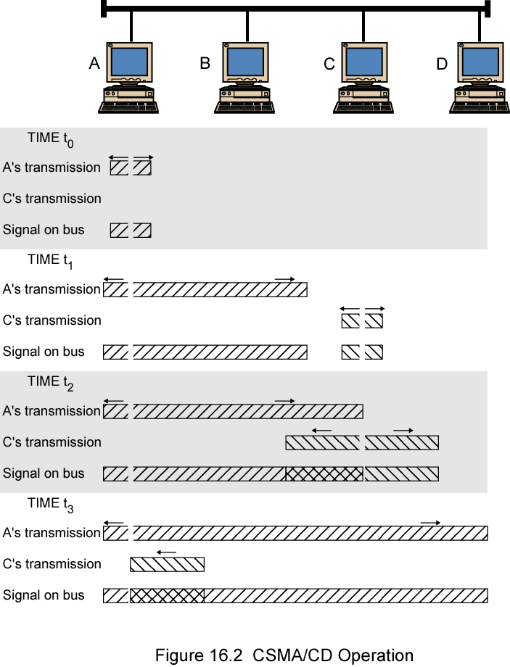
CSMA/CD Operation
In wireless communication the situation is cumbersome since the received power is too small compared to transmitted power.
C detects a collision!
A detects a collision!

Slide 39
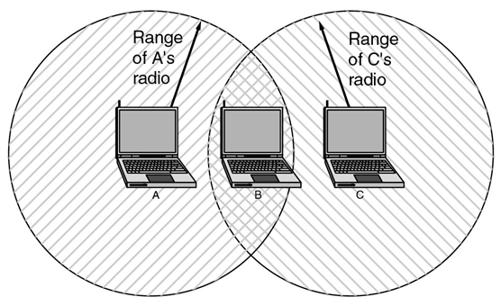
Suppose that computer A is transmitting to computer B (one way), but the radio range of A is too short to reach computer C. If C wants to transmit to B it can listen to the ether before starting, but the fact that it does not hear anything (since it is outside the coverage of A) does not mean that its transmission will succeed. The 802.11 standard had to solve this problem (CSMA/CA).

Slide 40
The problem we mentioned here is called Hidden Terminal Problem
A and B can hear each other. B and C can hear each other. But A and C cannot hear each other.
When A is sending data to B, C cannot sense this activity and hence C is allowed to send data to B at the same time. This will cause a collision at B.
collision
A
B
C
Consider the effect of RTS/CTS:
RTS alerts all stations within range of source (i.e., A) that exchange is under way;
CTS alerts all stations within range of destination (i.e., B).

Slide 41
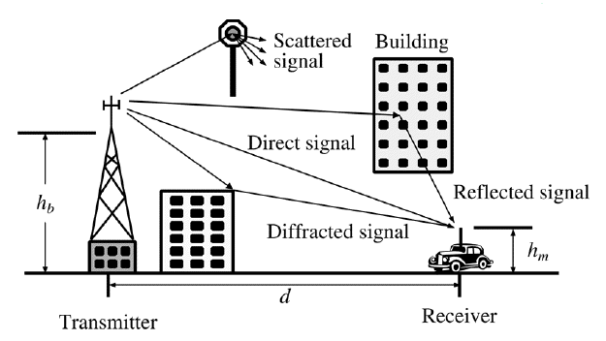
Second Problem: Multipath propagation (Multipath fading) due to presence of reflecting and refracting and scatterers hence cause multiple versions of the signal arrive at the receiver.
With small variation of distance and time cause wide variation of received signal called small scale fading experienced in a dense city.

Slide 42
Handoff Region
Third Problem: Handoff is necessary like mobile communications
Signal strength due to BS_{i}
Signal strength due to BS_{j}
P_{i}(x)
P_{j}(x)
E
P_{min}
BS_{i}
MS
BS_{j}
X₁
X₃
X₅
X_{th}
X₄
X₂
By looking at the variation of signal strength from either base station it is possible to decide on the optimum area where handoff can take place.

Slide 43
Fourth Problem: Some times software is not aware of mobility. For example many word processors have a list of printers that users can choose to print a file. When the computer on which the word processor runs is taken into a new environment, the built-in list of printer becomes invalid.

Slide 44
Wireless LAN requirements:
Throughput
Number of nodes
Connection to backbone LAN
Battery power consumption
Transmission robustness and security
License free operation
Handoff/roaming
Dynamic Configuration

Slide 45
Wireless LAN Technologies
Wireless LAN technologies can be classified into five types:
Infrared/LiFi
Narrowband RF
Spread-spectrum
OFDMA/MIMO
Mobile Ad-hoc network (network without access point)

Slide 46
Infrared LANs
Each signal-covering cell in an infrared LAN is limited to one room. Coverage is small, since the infrared rays cannot penetrate through wall and other opaque obstacles.
Three alternative transmission techniques are used for infrared data transmission: direct beam (point-to-point connection), omni-directional configuration consists of a single BS that is normally used on ceilings, and diffused configuration (the transmitter directs the signal to a diffused reflecting ceiling. The signal is reflected in all directions from the ceiling. The receiver then pick up the transmitted signal)

Slide 47
Light-Fidelity (LiFi) networking
The room is lit by several light fixtures, which provide illumination. Each light is driven by a LiFi modem or a LiFi chip and, therefore, also serves as an optical base station or access point (AP).
The optical base stations are connected to the core network by high speed backhaul connections. The light fixtures also have an integrated infrared detector to receive signals from the terminals.

Slide 48
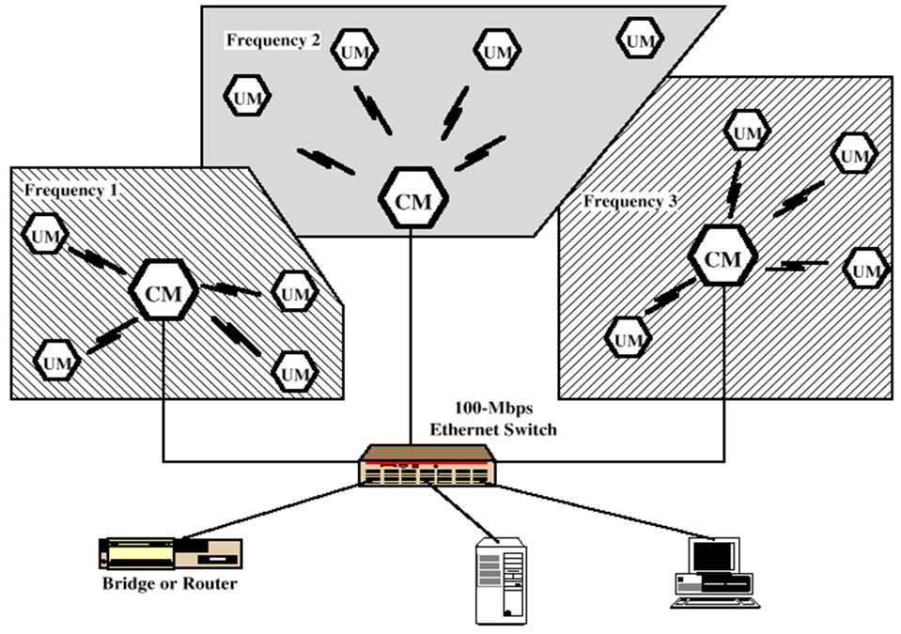
Narrowband RF LANs
Narrowband RF LANs use very narrow bandwidth. Adjacent cells use different frequency bands. The transmissions are encrypted to prevent attacks.
UM→ User Module

Slide 49
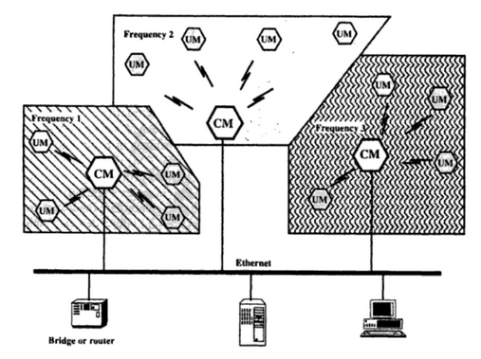
There are several Control Module (CM) to interface wireless LAN to the backbone Ethernet (wired LAN).In previous figure each cell has its own CM and connected by a switch to route traffic among them.
UM→ User Module

Slide 50
Spread Spectrum LANs
The idea behind spread spectrum is to spread the signal over a wider frequency band than normal in such a way as to minimize the impact of interference from other devices. Frequency hopping is a spread spectrum technique that involves transmitting the signal over a random sequence of frequencies, that is, first transmitting at one frequency, then a second, then a third, and so on.

Slide 51
IEEE 802 Activities
The Institute of Electrical and Electronics Engineers (IEEE, read I-Triple-E) is a Professional association headquartered in New York City that is dedicated to advancing technological innovation and excellence. It has more than 400,000 members in more than 160 countries, about 51.4% of whom reside in the USA.

Slide 52
IEEE 802 Activities
Wired
  802.3: Ethernet
  802.17: Packet Ring (new)
Wireless
  802.11: Wireless LAN
    Local Area Network
  802.15: Wireless PAN
      Personal Area Network (e.g. Bluetooth^{TM)}
  802.16: WirelessMANTM
      Metropolitan Area Networks

Slide 53
There are several specifications in the 802.11 family:
IEEE has defined the specifications for WLAN, called IEEE 802.11, which covers physical and data-link layer. Public uses the term WiFi (Wireless Fidelity) for WLAN.
802.11 — applies to wireless LANs and provides 1 or 2 Mbps transmission in the 2.4 GHz band using either frequency hopping spread spectrum (FHSS) which uses 2 or 4 level FSK or direct sequence spread spectrum (DSSS) which uses BPSK or QPSK.
802.11 Infrared uses infrared light in the range of 800 to 950 nm. The modulation technique is called PPM (Pulse Position Modulation).

Slide 54
802.11a— an extension to 802.11 that applies to wireless LANs and provides up to 54-Mbps in the 5GHz band. 802.11a uses an orthogonal frequency division multiplexing (OFDM) scheme rather than FHSH or DSSS. Here PSK and QAM modulation scheme is used.
802.11b (also referred to as 802.11 High Rate or Wi-Fi) — an extension to 802.11 that applies to wireless LANS and provides 11 Mbps transmission (with a fallback to 5.5, 2 and 1-Mbps) in the 2.4 GHz band.

Slide 55
802.11e — a wireless draft standard that defines the Quality of Service (QoS) support for LANs, and is an enhancement to the 802.11a and 802.11b wireless LAN (WLAN) specifications. 802.11e adds QoS features and multimedia support to the existing IEEE 802.11b and IEEE 802.11a wireless standards, while maintaining full backward compatibility with these standards.
802.11g — applies to wireless LANs and is used for transmission over short distances at up to 54-Mbps in the 2.4 GHz bands.
802.11n — 802.11n builds upon previous 802.11 standards by adding multiple-input multiple-output (MIMO). The additional transmitter and receiver antennas allow for increased data throughput through spatial multiplexing and increased range by exploiting the spatial diversity through coding schemes like Alamouti coding. The real speed would be 100 Mbit/s (even 250 Mbit/s in PHY level), and so up to 4-5 times faster than 802.11g.

Slide 56
802.11ac — 802.11ac builds upon previous 802.11 standards, particularly the 802.11n standard, to deliver data rates of 433Mbps per spatial stream, or 1.3Gbps in a three-antenna (three stream) design. The 802.11ac specification operates only in the 5 GHz frequency range and features support for wider channels (80MHz and 160MHz) and beamforming capabilities by default to help achieve its higher wireless speeds.
802.11ac Wave 2 — 802.11ac Wave 2 is an update for the original 802.11ac spec that uses MU-MIMO technology and other advancements to help increase theoretical maximum wireless speeds for the spec to 6.93 Gbps.
802.11ad— 802.11ad is a wireless specification under development that will operate in the 60GHz frequency band and offer much higher transfer rates than previous 802.11 specs, with a theoretical maximum transfer rate of up to 7Gbps (Gigabits per second).

Slide 57
802.11r - 802.11r, also called Fast Basic Service Set (BSS) Transition, supports VoWi-Fi handoff between access points to enable VoIP roaming on a Wi-Fi network with 802.1X authentication.
802.1X — Not to be confused with 802.11x (which is the term used to describe the family of 802.11 standards) 802.1X is an IEEE standard for port-based Network Access Control that allows network administrators to restricted use of IEEE 802 LAN service access points to secure communication between authenticated and authorized devices.

Slide 58
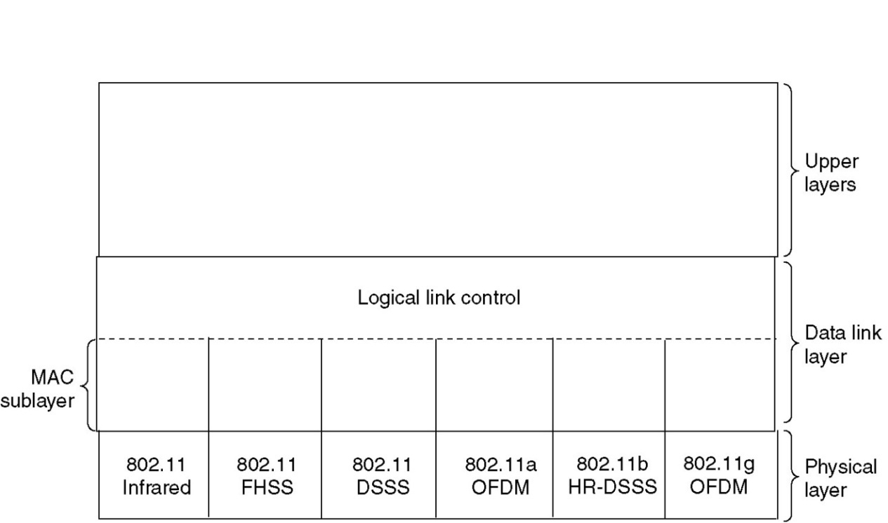
The 802.11 Protocol Stack
A partial view of the 802.11 protocol stack is given in fig. below. The physical layer corresponds to the OSI physical layer fairly well, but the data link layer in all the 802 protocols is split into two or more sublayers.
In 802.11, the MAC (Medium Access Control) sublayer determines how the channel is allocated, that is, who gets to transmit next. Above it is the LLC (Logical Link Control) sublayer, whose job it is to hide the differences between the different 802 variants and make them indistinguishable as far as the network layer is concerned.

Slide 59
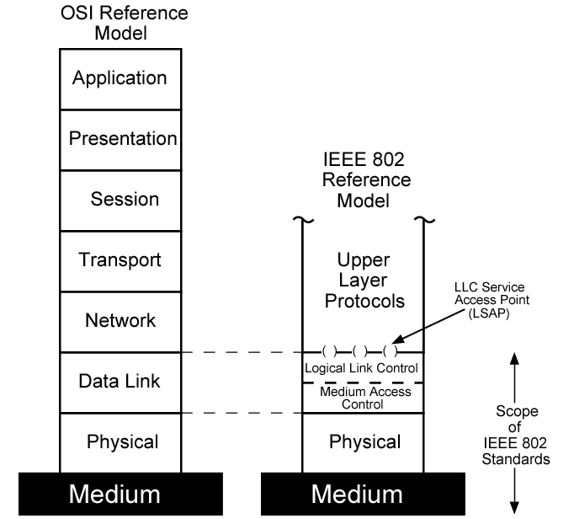
IEEE 802 v OSI

Slide 60

The 802.11 Physical Layer
Infrared with PPM scheme
FHSS (Frequency Hopping Spread Spectrum)
DSSS (Direct Sequence Spread Spectrum)
OFDM (Orthogonal Frequency Division Multiplexing)
HR-DSSS (High Rate DSSS)

Slide 61

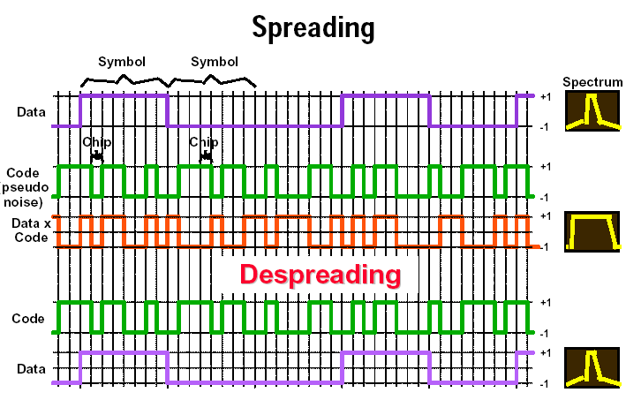
DS Spectrum Spreading Technique
Spread spectrum involves the use of a much wider BW than actually necessary to support a given data rate. The result of using wider BW is to minimize interference and drastically reduce BER. It operates in 2.4GHz band at data rate of 1Mbps and 2Mbps.

Slide 62
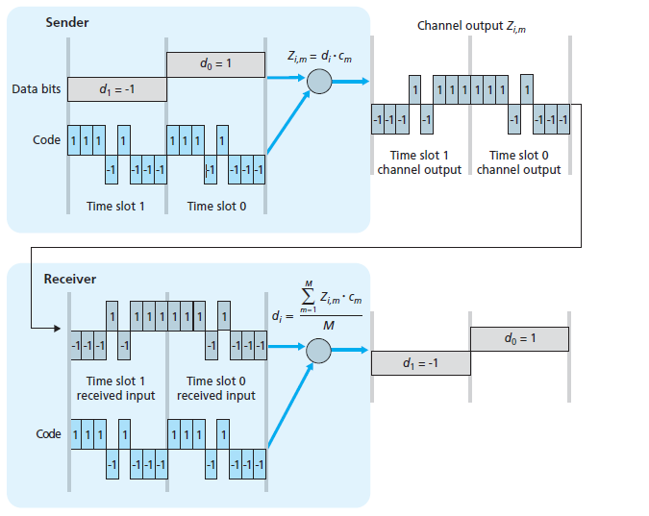
A simple CDMA example: sender encoding, receiver decoding

Slide 63

Frequency Hopping Spread Spectrum
In case of FHSP, spread spectrum is achieved by frequently jumping from one carrier frequency to another; thus if there is interference or performance degradation at a given frequency, it only affects a small fraction of transmission.
The amount of time spent at each frequency, the dwell time, is an adjustable parameter but must be less than 400 ms.
Operates at 2.4 GHz band at data rate of 1Mbps and 2Mbps

Slide 64

Orthogonal Frequency Division Multiplexing IEEE 802.11a and 802.11g
Orthogonal Frequency Division Multiplexing (OFDM) is a multi-carrier modulation scheme that transmits data over a number of orthogonal subcarriers. A conventional transmission uses only a single carrier modulated with all the data to be sent.
OFDM breaks the data to be sent into small chunks, allocating each sub-data stream to a sub-carrier and the data is sent in parallel orthogonal sub-carriers. As illustrated in Figure 1, this can be compared with a transport company utilizing several smaller trucks (multi-carrier) instead of one large truck (single carrier).
Fig.1 Single carrier vs. multi-carrier transmission

Slide 65
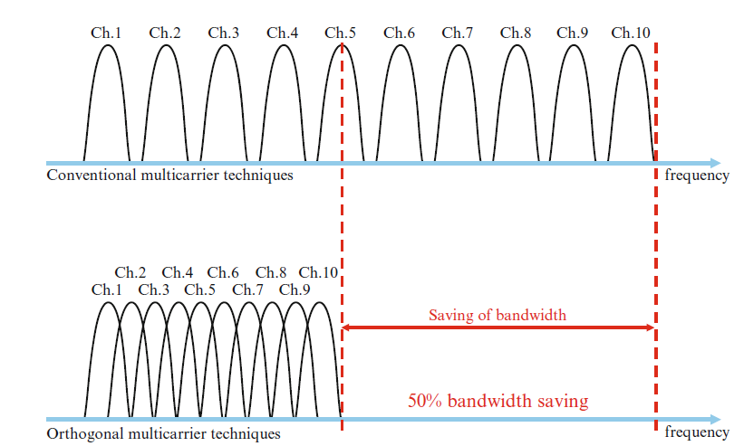
OFDM Versus FDM

Slide 66
OFDM offers many advantages over single-carrier modulations:
1. It elongates the symbol period so that the signal is more robust against intersymbol interference caused by channel dispersions and multipath interference.
2. It divides the entire frequency band into narrow bands so that it is less sensitive to wide-band impulse noise and fast channel fades.
3. Splitting the channel into narrowband channels enables significant simplification of equalizer design in multipath environments.

Slide 67
4. Different modulation formats and data rates can be used on different subcarriers depending on the noise level of individual subbands (the symbol periods are kept the same). In serial transmission, certain types of noise (such as timevarying tone interference) may cause an entire system to fail; the parallel OFDM system can avoid this problem by adaptively reducing the data rate of the affected subbands or dropping them.
5. OFDM can be implemented digitally using an inverse discrete Fourier transform and discrete Fourier transform (IDFT/DFT) pair (via the efficient fast algorithm IFFT/FFT pair), which greatly reduces the system complexity.

Slide 68
Subcarrier-0
Δ τ ɛ …
S/P
Or
D
M
U
X
MOD
Σ
Noise
Subcarrier-1
Δ O … ↗ τ × … τ ɛ Ψ…Φ
x(t)
O × Ψ …
Channel
………
MOD
Subcarrier-N_{c}-1
↗ τ Φ …
MOD
Subcarrier-0
Δ τ ɛ …
P/S
Or
MUX
D-MOD
Subcarrier-1
r(t)
Δ O … ↗ τ × … τ ɛ Ψ…Φ
O × Ψ …
D-MOD
Subcarrier-N_{c}-1
↗ τ Φ …
D-MOD
OFDMA Communication System

Slide 69
IDFT
A₀
P/S
S/P
A₁
………………
x(t)
………
D/A
Channel
0
……
A_{N-1}
0
r(t)
P/S
r₀
DFT
P/S
r₁
………………
………
A/D
r_{N-1}
……
Useless
Fig.4 Transmitter and receiver by using FFT processing

Slide 70
Data Link Layer of IEEE 802.11
The Data Link layer of IEEE 802.11 has two parts: LLC and MAC sublayer. This layer provides several key functionalities: reliable data delivery, media access control and security features.

Slide 71
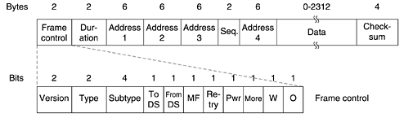
The frame format of IEEE 802.11
The frame control (FC) field provides information on the type of frame has 11 subfields.
The first of these is the Protocol version, two bits representing the protocol version. Currently used protocol version is zero. Other values are reserved for future use.
Then come the Type of 2 bits (data, control, or management); where ‘Type of information: management (00), control (01), or data (10)’.

Slide 72
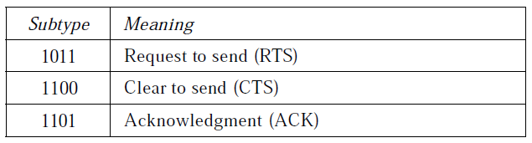
A node wishing to send data initiates the process by sending a Request to Send frame (RTS). The destination node replies with a Clear To Send frame (CTS). Subtype fields indicates like the following category.
Values of subfields in control frames

Slide 73
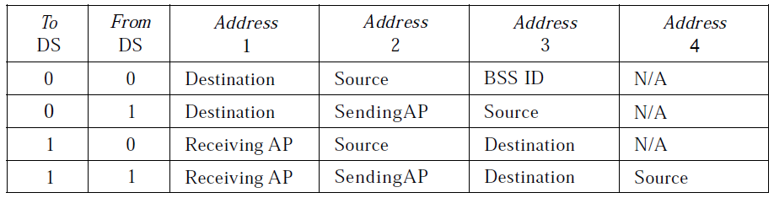
The IEEE 802.11 addressing mechanism specifies four cases, defined by the value of the two flags in the FC field, To DS and From DS. Each flag can be either 0 or 1, resulting in four different situations. The interpretation of the four addresses (address 1 to address 4) in the MAC frame depends on the value of these flags, as shown in Table below.

Slide 74
The MF bit means that more fragments will follow. The Retry bit marks a retransmission of a frame sent earlier. The Power management bit is used by the base station to put the receiver into sleep state or take it out of sleep state. The More bit indicates that the sender has additional frames for the receiver.
The W bit specifies that the frame body has been encrypted using the WEP (Wired Equivalent Privacy) algorithm. Finally, the O bit tells the receiver that a sequence of frames with this bit on must be processed strictly in order.

Slide 75
Duration field refers to the time allotted for the successful transmission of the frame. How long the frame and its ack will occupy the channel.
The address field denotes the 6-byte (MAC address of 48 bits) source and destination address fields. The source and destination addresses are obviously needed and the other two addresses are used for source and destination BSs for intercell traffic. Since frame may enter or leave a cell via a BS.
The sequence control (SC) field consists of 4 bits reserved for fragmentation and reassembly and 12 bits for a sequence number of frames between a particular Tx and Rx.
The frame body/Data contains a MAC service data unit or control information.
The CRC field is used for error detection.

Slide 76
IEEE 802.11 at MAC sublayer uses CSMA/CA as the access method.
Standard 802.11 typically uses the carrier Sense Multiple Access with collision avoidance (CSMA/CA) method.
  Carrier sense (CS) means: hardware capable of sensing whether transmission taking place in vicinity (for cognitive radio).
With this method, each user listens for traffic coming from other users (a node can sense a traffic channel like combination of carrier and TS) and transmits data if the channel is idle.
If the channel is busy, the user waits until the channel becomes idle. The user then transmits data after a random back-off time.

Slide 77
Carrier Sense Multiple Access/ Collision Avoidance (CSMA/CA)
The wireless LAN system cannot detect collisions because the power of the transmitting device is much stronger than the receiver’s power.
In this situation collision detection is not practical, it makes sense to try to devise a system that can help prevent collisions. Thus the CA is CSMA/CA refers to ‘collision avoidance’.
When a device detects that the transmission media is idle, the device must wait for a specific time before it can contend for access to the media. This specific time is called interframe spacing (IFS) time.
The IFS time can also be used for prioritizing transmissions. If a device is given a smaller IFS , then it has more chances of gaining access to the transmission media.

Slide 78
If the sender does not receive an ACK then the device assumes that a collision has occurred. Sender usually uses binary exponential backoff.

Slide 79
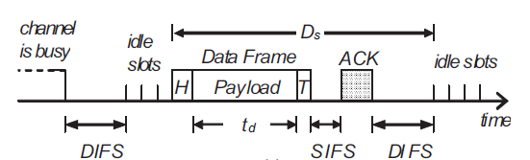
Distributed Binary Exponential Backoff Algorithm
To reduce the packet dropping probability or to enhance throughput of wireless LAN exponential binary backoff algorithm is widely used. The access method of MAC protocol of IEEE 802.11 based on exponential binary backoff algorithm can be explained with the following steps.
Step: 1
The transmitting node first senses the status of the channel. If the channel is found busy then the Tx node continues to monitor the channel.
Step:2
If the channel is found idle for a fixed duration know as DIFS (Distributed Inter-frame Space), the Tx chooses a random number according to the binary exponential back off algorithm. The random number is used as a back off timer.

Slide 80
Step:3
Time immediately after the DIFS (Distributed Inter-frame Space) is slotted known as idle slots where the duration of a slot is considered as the sum of the time required to sense a station and to switch the Tx from sensing / listening mode to transmitting mode.
Step:4
Elapsing of each idle slot the back off timer is decreased by one. If the channel is found busy before the back off timer reaches to zero then repeat the steps 1 to 3. The transmission of data from begins only if the back off timer reaches to zero.

Slide 81
Step:5
To determine whether a data frame transmission is successful, after its completion, a positive acknowledgement (ACK) is transmitted by the receiver. ACK is transmitted after a short interframe space (SIFS) period upon receiving the entire data frame successfully.
If ACK is not detected within an SIFS period after the completion of the data frame transmission, the transmission is assumed to be unsuccessful, and a retransmission is required.

Slide 82
Bianchi Model
The main contribution of Bianchi’s model is the analytical calculation of saturation throughput in a closed-form expression. The model also calculates the probability of a packet transmission failure due to collision.
Bianchi uses a two-dimensional Markov chain of m + 1 backoff stages in which each stage represents the backoff time counter of a node, see Figure below.
A transition takes place upon collision and successful transmission. If collision takes place probability state moves to to a “higher” stage e.g., from stage i-1 to stage i. When a successful transmission occurs then state goes to the lowest stage i.e., stage 0.
Each state of this bidimensional Markov process is represented by {s(t), b(t)}, where b(t) is the stochastic process representing the backoff time counter for a given station and s(t) is the stochastic process representing the backoff stage (0, 1, · · · ,m) of the station at time t.

Slide 83
1-p
1/CW₀
(0,0)
1
(0,1)
1
(0,2)
………
1
(0,CW₀-2)
1
(0,CW₀-1)
p/CW₁
……………………………………………………….
(i-1, 0)
p/CW_{i}
(i,0)
1
(i,1)
1
(i,2)
………
1
(i,CW_{i}-2)
1
(i,CW_{i}-1)
p/CW_{i+1}
……………………………………………………….
(m-1, 0)
p/CW_{m}
(m,0)
1
(m,1)
1
(m,2)
……….
1
(m,CW_{m}-2)
1
(m,CW_{m}-1)
p
1/CW_{m}
Two-dimensional Markov chain where CW stands for contention window. CW_{i} = 2^{i}(CW_{min}+1)

Slide 84
Carrier Sense Multiple Access/ Collision Detection (CSMA/CD)
A collision detection mechanism compares the amount of energy on the media after a packet is transmitted. If the value is greater than the the energy used by the transmitting device, then a collision has occurred. If there is no difference the two measured values, then a collision has not occurred.

Slide 85
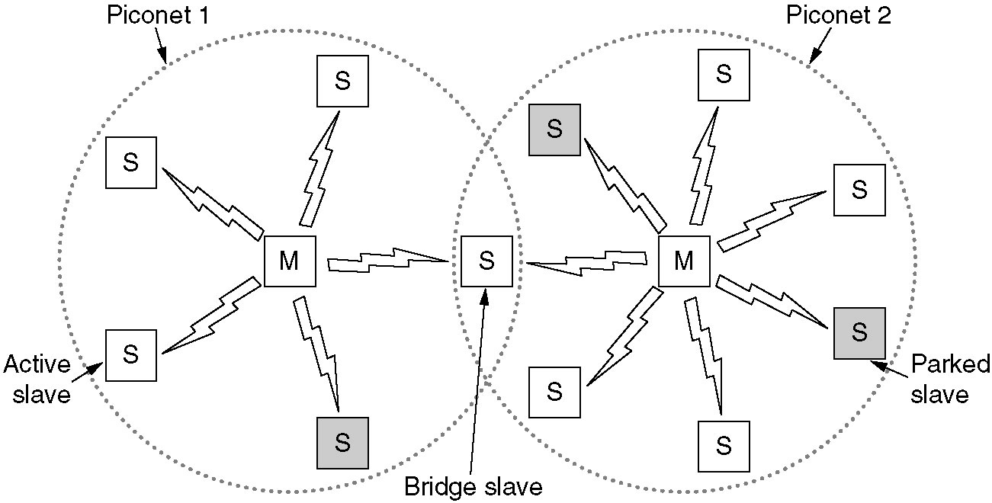
Home RF and Bluetooth
Home RF is used to interconnect the various home electronic devices such as, desktops, laptops, telephone, notebooks, cameras, and printers. Home RF supports data rates of about 2Mbps and has range of about 50m.
The basic Bluetooth network configuration, called a piconet, consists of a master device and up to seven slave devices, as in Fig. above. Any communication is between the master and a slave; the slaves do not communicate directly with each other. A Bluetooth device has a built-in short range radio transmitter.

Slide 86
All the secondary/slave stations synchronize their clocks and hopping sequence with the primary. Bluetooth uses frequency-hopping spread spectrum (FHSS) in the physical layer to avoid interference from other devices or network.
Bluetooth defines two types of networks called: piconet and scatternet.

Slide 87
Piconets can be combined to form scatternet where a secondary user of one piconet acts as bridge to another piconet. The bridge secondary/slave acts as a primary in receiving packets from the original primary of first piconet then deliver the packet to secondaries of the second piconet.
Although a piconet can have maximum 7 secondaries , additional seconaries can be in parked state. A seconadry in parked state is synchronized with the primary, but can not take part in communication until it is removed from parked state to the active state.

Slide 88
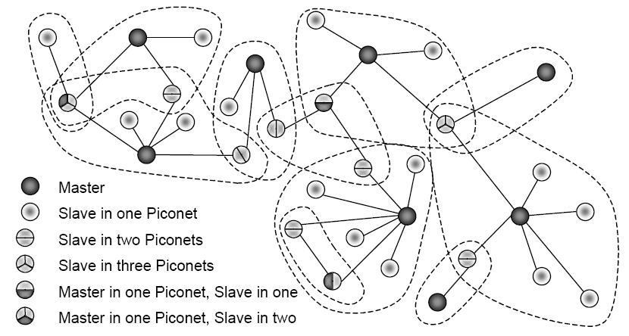
No central network structure: “Ad-hoc” network.

Slide 89
Two types of links can be created between primary and secondary:
A synchronous connection-oriented (SCO) link is used when avoiding latency (delay in data delivery) is more important than integrity (error free delivery) for example real time audio. In this case physical link is created primary and secondary by reserving specific slots at regular intervals. The basic unit of connection is two slots, one for each direction. If a packet is damaged it is never retransmitted.
An asynchronous connectionless link (ACL) is used when data integrity is more important than avoiding latency. In this type link if payload encapsulated in the frame is lost/ corrupted, it is retransmitted.

Slide 90
Layers of Bluetooth
Application Layer
L2CAL layer
Baseband layer
Radio Layer
Radio layer is like physical layer of Internet. Uses FHSS, GFSK modulation.
Baseband layer is like MAC sublayer uses TDMA slot as the physical channel.
Logical Link Control and Adaption Protocol (L2CAP) is like LLC sublayer.

Slide 91
CT-1
16/2/2018

Slide 92
1. Let us assume bandwidth of each arrival of A₁ is 4 kbps and that of A₂ is 5 kbps. Given A₁ = 1 and A₂ = 2 Erls. If total Bandwidth supported by the network is 12kbps, then probability state will be with the condition: 0 ≤ D₁x₁+D₂x₂ ≤ 9. Determine QoS of each traffic.
2. A city has a population of 4×10⁶. A mobile cellular service provider has 600 cells with 12 channels each to serve the people. On an average each user generates 1 call/hour with duration of 1.5 minutes. Determine market penetration of the service provider. Given the GoS (grade of service) of the network is 3%.

