Slide 1

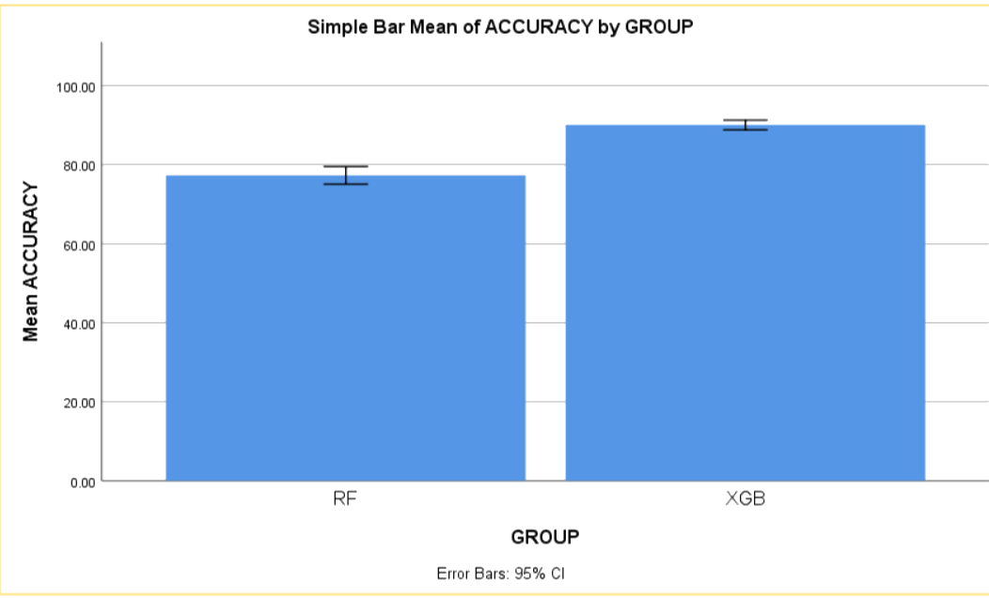
.
.
Name: Shaik Towhid Hussain Register Number: 192111049
Guided by Dr. C.Sivasankar
Ms. Poorani.S
Guided by Dr. Mary Valantina. G
A Prominent technique for enhancing rainfall prediction involves utilizing a XG Boost classifier over Random forest algorithm for better accuracy of rainfall prediction
INTRODUCTION
The primary goal of the study is to use the machine learning algorithms to improve accuracy in predicting the rainfall.
Rainfall prediction is one of the more crucial for the country's economic growth , agriculture and resources management.
Over the years, predicting the amount of rain on Earth has proven to be the most hard and difficult task and its leads to difficulty in agriculture practices.so in this study we are going to improve the prediction of rainfall .
In this study XG Boost is compared with Random forest algorithm in order to improve the accuracy.
When XG Boost is compared to other machine learning algorithms , it has shown to have more advantages and better accuracy.
The dataset was collected from Kaggle which has 401 rows and 14 columns.
Rainfall Prediction
zz
MATERIALS AND METHODS
Test data
Rainfall Data Collection/ Pre-processing
Identify Patterns
Training Machine Learning Models
Performance evaluation of machine learning model
Forecast rainfall
RAINFALL PREDICTION USING MACHINE LEARNING ALGORITHMS
s
RESULTS
Table.2.Showing the Equal Variance values With T test
Table.1. Mean for data consumption
 | Independent Sample T-Test
 | Levene’s Test for Equality of Variances |  |  |  |  | T-test for Equality of Means
Accuracy | F | Sig | t | df | Sig (2-tailed) | Mean Difference | Std. Error Difference | 95% Confidence Interval of the Difference
 |  |  |  |  |  |  |  | Lower | Upper
Equal variances assumed | 33.502 | .000 | 8.251 | 38 | .000 | 8.75000 | 1.06047 | 6.60318 | 10.89682
Equal variances not assumed |  |  | 8.251 | 24.008 | .000 | 8.75000 | 1.06047 | 6.56133 | 10.93867
 | Group Statistics
Accuracy | Groups | N | Mean | Std deviation | Std. Error Mean
 | XGB | 20 | 96.3500 | 1.63111 | .36473
 | RF | 20 | 87.6000 | 4.45327 | .99578
Fig. 2. SPSS Analysis XGB and RF
The research study proves that the XG Boost (XGB) algorithm produces better accuracy (93.00%) compared with Random Forest (RF) accuracy (85.00%).
DISCUSSION AND CONCLUSION
Based on T-test Statistical analysis, the significance value of p=0.001 (independent sample T - test p<0.05) is obtained and shows that there is a statistical significant difference between the group 1 and group 2.
The research study proves that the accuracy for predicting rainfall using XG Boost (XGB) algorithm looks to be higher when compared with Random Forest.
It is found that XGB performs significantly better than RF in predicting effective rainfall.
Therefore, the report concluded that the XG Boost (XGB) algorithm produces better accuracy (93.00%) compared with Random Forest (RF) accuracy (85.00%).
Rainfall prediction using XG Boost and Random Forest algorithms shows promise for improving accuracy and efficiency. XG Boost provides speed and simplicity, while Random Forest excels at managing complexity. These developments might lead to better prediction of rainfall and useful for agriculture and resources management adjustments.
h
BIBLIOGRAPHY
Nari, Sanam, Muhammad Moazzam Jawaid, Shahnawaz, Rizwan Baloch, and Eros Gian Alessandro 2021. “Multi-Step Rainfall Forecasting Using Deep Learning Approach.” Peer Computer Science 7. https://doi.org/10.7717/peerj-cs.514.
Rudra . 2021. “Machine Learning Models Applied for Rainfall Prediction.” Revision e technology . https://doi.org/10.47059/revistageintec.v11i3.1926.
Nikhil Kumar B . 2018. “Analysis of Rainfall Prediction Using Machine Learning Data Mining and Satellite Techniques.” International Journal of Engineering & Technology 7 (4): 4362–67.
Dash, Saroj K. Mishra, and Vijaya K. 2019. “Predictability Assessment of Northeast Monsoon Rainfall in India Using Sea Surface Temperature Anomaly through Statistical and Machine Learning Techniques.” Environment. https://doi.org/10.1002/env.2533.

