Slide 1


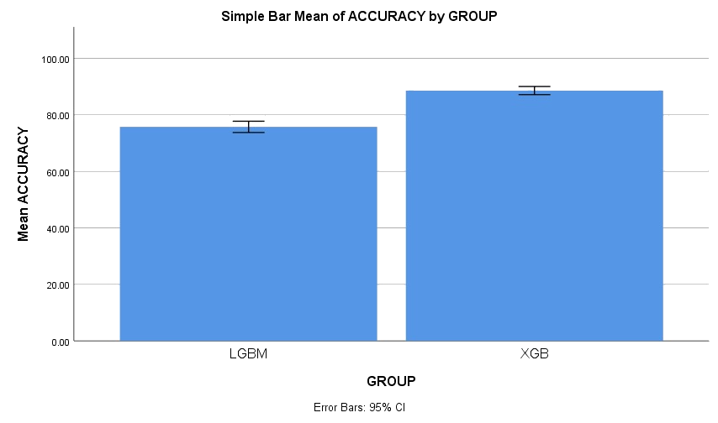
Name: Mr. Shaik Towhid hussain Register Number: 192111049
Guided by Dr.C.Sivasankar
Ms. Poorani.S
Guided by Dr. Mary Valantina. G
An efficient prediction of rainfall using XG Boost algorithm over Light GBM Classifier for improvement of accuracy.
INTRODUCTION
Since agriculture has been the main industry in practically every state, it plays a major role in the economy of our nation
Over the years, predicting the amount of rain on Earth has proven to be the most hard and difficult task and its leads to difficulty in agriculture practices.so in this study we are going to improve the prediction of rainfall
The aim of this study is to improve accuracy in predicting rainfall using different machine learning algorithms
In this research study , XG Boost is compared with Light GBM to enhance accuracy.
The advantage of XG Boost has proven that it is depicts better accuracy and more advantages when compared with any other machine learning algorithms
The dataset was collected from Kaggle which has 401 rows and 14 columns.
Rainfall prediction using machine learning algorithms
MATERIALS AND METHODS
Test data
Rainfall Data Collection/ Pre-processing
Identify Patterns
Training Machine Learning Models
Performance evaluation of machine learning model
Forecast rainfall
Rainfall prediction using machine learning algorithms
It is found that XGB performs significantly better than LGBM in predicting effective rainfall. Therefore, the report concluded that the XG Boost (XGB)
algorithm produces better accuracy (88.50%) compared with Light GBM (LGBM) accuracy (83.60%).
RESULTS
Table.2.Showing the Equal Variance values With T test
Table.1. Mean for data consumption
 | Independent Sample T-Test
 | Levene’s Test for Equality of Variances |  |  |  |  | T-test for Equality of Means
Accuracy | F | Sig | t | df | Sig (2-tailed) | Mean Difference | Std. Error Difference | 95% Confidence Interval of the Difference
 |  |  |  |  |  |  |  | Lower | Upper
Equal variances assumed | 2.133 | .152 | 10.916 | 38 | .000 | 12.85000 | 1.17714 | 10.46701 | 15.23299
Equal variances not assumed |  |  | 10.916 | 34.604 | .000 | 12.85000 | 1.17714 | 10.45930 | 15.24070
 | Group Statistics
Accuracy | Groups | N | Mean | Std deviation | Std. Error Mean
 | XGB | 20 | 88.6000 | 3.08477 | .68977
 | LGBM | 20 | 75.7500 | 4.26584 | .95387
Fig. 2. SPSS Analysis XGB and RF
DISCUSSION AND CONCLUSION
Based on T-test Statistical analysis, the significance value of p=0.001 (independent sample T - test p<0.05) is obtained and shows that there is a statistical significant difference between the group 1 and group 2.
By altering the test size, two groups XG Boost (XGB) and Light GBM (LGBM) performed experimental work. Based on the SPSS experimental results XGB has an accuracy of 88.50%, while Light GBM offers an accuracy of 83.60%.
According to the SPSS, the developed XG Boost algorithmic classification model outperformed the Light GBM in terms of accuracy comparison
Rainfall prediction using XG Boost and Random Forest algorithms shows promise for improving accuracy and efficiency. XG Boost provides speed and simplicity, while Random Forest excels at managing complexity. These developments might lead to better prediction of rainfall and useful for agriculture and resources management adjustments.
BIBLIOGRAPHY
Gian Alessandro 2021. “Multi-Step Rainfall Forecasting Using Deep Learning Approach.” Computer Science 7. https://doi.org/10.7717/peerj-cs.514.
Muhammad Moazzam Jawaid, Shahnawaz. 2008. “Machine Learning Techniques for Short-Term Rain Forecasting System in the Northeastern Part of Thailand.” https://www.semanticscholar.org/paper/Machine-Learning-Techniques-for-Short-Term-R /559d0ebab46656f64c6eb5e347de891be2170b1d.
Achilleas D.. 2014. Wavelet Neural Networks: With Applications in Financial Engineering, Chaos, and Classification. John Wiley & Sons.
Zhang ,Jia, J. Gao, Wei Song, and H. Leung. 2020. “Short-Term Rainfall Forecasting Using Multi-Layer Perceptron.” http://ieeexplore.ieee.org/stamp/stamp.jsp?tp=&arnumber=8468083.

