Slide 1

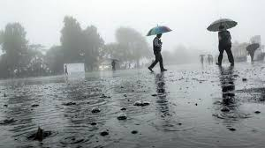
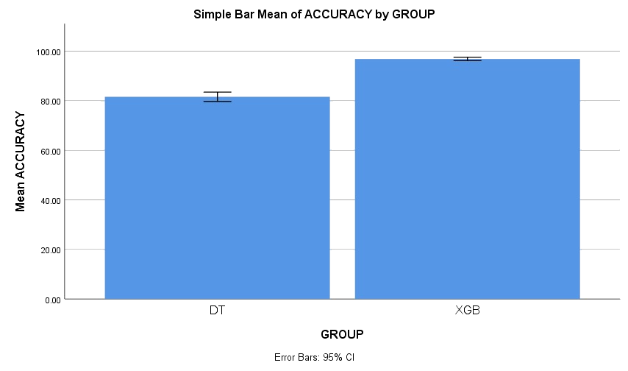
.
.
Name: Shaik Towhid Hussain Register Number: 192111049
Guided by Dr. C.Sivasankar
Ms. Poorani.S
Guided by Dr. Mary Valantina. G
The foremost technique for enhancing Rainfall forecasting using a XG Boost classifier over decision tree classifier to improve the accuracy of forecasts.
INTRODUCTION
The main aim of this study is to improve accuracy in predicting the rainfall using machine learning algorithms
Predicting the rainfall is one of the most important factor for the development of country economy as the prediction of rainfall helps for agriculture and resources management and more.
Over the years, predicting the amount of rain on Earth has proven to be the most hard and difficult task and its leads to difficulty in agriculture practices.so in this study we are going to improve the prediction of rainfall .
In this study XG Boost is compared with decision tree algorithm in order to improve the accuracy.
When XG Boost is compared to other machine learning algorithms , it has shown to have more advantages and better accuracy.
The dataset was collected from Kaggle which has 401 rows and 14 columns.
Rainfall Prediction
MATERIALS AND METHODS
Test data
Rainfall Data Collection/ Pre-processing
Identify Patterns
Training Machine Learning Models
Performance evaluation of machine learning model
Forecast rainfall
RAINDFALL PREDICTION USING MACHINE LEARNING ALGORITHMS
RESULTS
Table.1. Mean for data consumption Table.2.Showing the Equal Variance values With T test
 | Group Statistics
Accuracy | Groups | N | Mean | Std deviation | Std. Error Mean
 | XGB | 20 | 96.8500 | 1.42441 | .31851
 | DT | 20 | 81.6000 | 4.01838 | .89854
 | Independent Sample T-Test
 | Levene’s Test for Equality of Variances |  |  |  |  | T-test for Equality of Means
Accuracy | F | Sig | t | df | Sig (2-tailed) | Mean Difference | Std. Error Difference | 95% Confidence Interval of the Difference
 |  |  |  |  |  |  |  | Lower | Upper
Equal variances assumed | 13.758 | .001 | 15.997 | 38 | .000 | 15.25000 | .95332 | 13.32011 | 17.17989
Equal variances not assumed |  |  | 15.997 | 23.701 | .000 | 15.25000 | .95332 | 13.28113 | 17.21887
It is discovered that when it comes to effective rainfall prediction, XGB outperforms DT by a significant margin. As a result, the study came to the conclusion that the XG Boost (XGB) algorithm yields higher accuracy (97%) than the Decision Tree (DT) algorithm (87.00%).
Fig. 2. SPSS Analysis XGB and DT
DISCUSSION AND CONCLUSION
Based on T-test Statistical analysis, the significance value of p=0.001 (independent sample T - test p<0.05) is obtained and shows that there is a statistical significant difference between the group 1 and group 2.
A machine learning classifier called XG Boost makes use of decision trees to increase accuracy. The study demonstrates that, in comparison to DT, the XG Boost (XGB) algorithm appears to have a higher accuracy rate for rainfall prediction
It is discovered that when it comes to effective rainfall prediction, XGB outperforms DT by a significant margin.
As a result, the study came to the conclusion that the XG Boost (XGB) algorithm yields higher accuracy (97%) than the Decision Tree (DT) algorithm (87.00%).
Rainfall prediction using XG Boost and Decision tree algorithms shows promise for improving accuracy and efficiency. XG Boost provides speed and simplicity, while Decision tree excels at managing complexity. These developments might lead to better prediction of rainfall and useful for agriculture and resources management adjustments.
BIBLIOGRAPHY
Gian Alessandro . 2021. “Multi-Step Rainfall Forecasting Using Deep Learning Approach.” Computer Science 7. https://doi.org/10.7717/peerj-cs.514.
Rudra . 2021. “Machine Learning Models Applied for Rainfall Prediction.” Revision e technology . https://doi.org/10.47059/revistageintec.v11i3.1926.
Muhammad Moazzam Jawaid, Shahnawaz. 2008 2008. “Machine Learning Techniques for Short-Term Rain Forecasting System in the Northeastern Part of Thailand.” https://www.semanticscholar.org/paper/Machine-Learning-Techniques-for-Short-Term-R/559d0ebab46656f64c6eb5e347de891be2170b1d
Dash, Saroj K. Mishra, and Vijaya K. 2019. “Predictability Assessment of Northeast Monsoon Rainfall in India Using Sea Surface Temperature Anomaly through Statistical and Machine Learning Techniques.” Environment. https://doi.org/10.1002/env.2533

