Slide 1

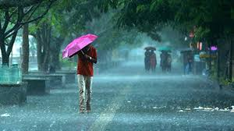
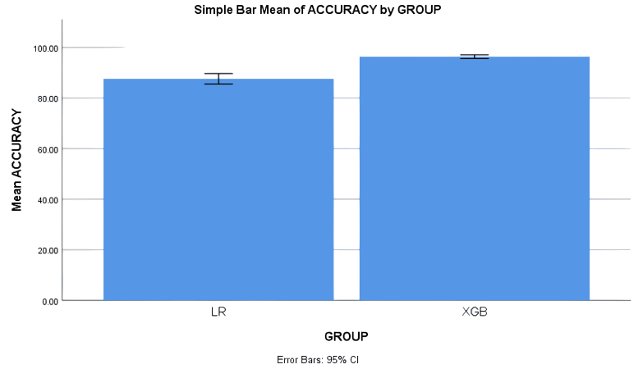
.
.
Name: Shaik Towhid Hussain
Register Number: 192111049
Guided by Dr. C.Sivasankar
Ms. Poorani.S
Guided by Dr. Mary Valantina. G
Improving the efficiency of anticipating the rainfall using XG
Boost in comparison with logistic regression.
INTRODUCTION
This study aims to improve accuracy in predicting rainfall using machine learning techniques .
Rainfall prediction has been one of the most challenging and difficult tasks in the world. India has a population of over a billion people, agriculture is the primary income of more than 60% of the population
Over the years, predicting the amount of rain on Earth has proven to be the most hard and difficult task and its leads to difficulty in agriculture practices.so in this study we are going to improve the prediction of rainfall
In this study XG Boost is compared with logistic regression algorithm in order to improve the accuracy. When XG Boost is compared to other machine learning algorithms , it has shown to have more advantages and better accuracy.
The proposed study helps in effectively predicting the rainfall that helps the overall development of the country.
The dataset was collected from Kaggle which has 401 rows and 14 columns.
Rainfall Predicition
MATERIALS AND METHODS
Test data
Rainfall Data Collection/ Pre-processing
Identify Patterns
Training Machine Learning Models
Performance evaluation of machine learning model
Forecast rainfall
RAINFALL PREDICTION USING MACHINE LEARNING ALGORITHMS
RESULTS
Table.2.Showing the Equal Variance values With T test
It is found that XGB performs significantly better than LGBM in predicting effective rainfall. Therefore, the report concluded that the XG Boost (XGB)
algorithm produces better accuracy (88.50%) compared with Light GBM (LGBM) accuracy (83.60%).
Table.1. Mean for data consumption
 | Independent Sample T-Test
 | T Test for Equality of Variances |  |  |  |  | T-test for Equality of Means
Accuracy | F | Sig | t | df | Sig (2-tailed) | Mean Difference | Std. Error Difference | 95% Confidence Interval of the Difference
 |  |  |  |  |  |  |  | Lower | Upper
Equal variances assumed | 2.133 | .152 | 10.916 | 38 | .000 | 12.85000 | 1.17714 | 10.46701 | 15.23299
Equal variances not assumed |  |  | 10.916 | 34.604 | .000 | 12.85000 | 1.17714 | 10.45930 | 15.24070
 | Group Statistics
Accuracy | Groups | N | Mean | Std deviation | Std. Error Mean
 | XGB | 20 | 96.8500 | 1.42441 | .31851
 | LR | 20 | 81.6000 | 4.01838 | .89854
Fig. 2. SPSS Analysis XGB and LR
DISCUSSION AND CONCLUSION
Based on T-test Statistical analysis, the significance value of p=0.001 (independent sample T - test p<0.05) is obtained and shows that there is a statistical significant difference between the group 1 and group 2
A machine learning classifier called XG Boost makes use of logistic regression to increase accuracy. The study demonstrates that, in comparison to logistic regression, the XG Boost (XGB) algorithm appears to have a higher accuracy rate for rainfall prediction
It is discovered that when it comes to effective rainfall prediction, XGB outperforms logistic regression by a significant accuracy. As a result, the study came to the conclusion that the XG Boost (XGB) algorithm yields higher accuracy (97%) than the logistic regression (LR) algorithm (84.00%)
Rainfall prediction using XG Boost and logistic regression algorithms shows promise for improving accuracy and efficiency. XG Boost provides speed and simplicity, while logistic regression excels at managing complexity. These developments might lead to better prediction of rainfall and useful for agriculture and resources management adjustments
BIBLIOGRAPHY
Muhammad Moazzam Jawaid, Shahnawaz. 2008. “Machine Learning Techniques for Short-Term Rain Forecasting System in the Northeastern Part of Thailand.” https://www.semanticscholar.org/paper/Machine-Learning-Techniques-for-Short-Term-R /559d0ebab46656f64c6eb5e347de891be2170b1d.
Rudra . 2021. “Machine Learning Models Applied for Rainfall Prediction.” Revision e technology . https://doi.org/10.47059/revistageintec.v11i3.1926.
Anwar, M. T and M. Novita. 2021. “Rainfall Prediction Using Extreme Gradient Boosting.” Journal of Physics. Conference Series 1869 (1): 012078. Brownlee, Jason. 2020. “How to Use XG Boost for Time Series Forecasting.” August 4, 2020. https://machinelearningmastery.com/xgboost-for-time-series-forecasting.
Gian Alessandro . 2021. “Multi-Step Rainfall Forecasting Using Deep Learning Approach.” Peer Computer Science 7. https://doi.org/10.7717/peerj-cs.514.

