Slide 1
STAFF TRAINING · ACCOUNTING FIRMS
PART 1
Governance
AI basics, its associated risks, use cases, and the regulations that apply to accounting firms
PART 2
Prompt engineering
Introduction to AI tools and case studies, including when a client says no to AI
AI Training for Accounting Firms
Using AI with confidence, care and compliance
Delivered by Towobola Odukoya

Slide 2
PART 1 · GOVERNANCE
Roadmap
01
Significance of this training
05
Glossary: personal data
02
About me
06
Risks
03
Introduction to Artificial Intelligence
07
Regulators and penalties
04
Artificial Intelligence in accounting firms
Accounting Firms · AI Training
2

Slide 3
WHY THIS MATTERS
Let's work backwards: why is this training important?
01
02
03
Confidence
Competitive advantage
Client trust
AI is here to stay. Agree our risk appetite and the governance effort the firm needs.
Firms that use AI well work faster and offer more to clients.
Clients need to know their data and their work are handled responsibly.
04
05
06
No technological debt
Avoiding fines
A tailored approach
Good foundations now mean we are not paying for poor choices later.
Regulatory compliance protects the firm, our clients and our licence to practise.
Guidance built around how accounting firms actually work, not a generic checklist.
Accounting Firms · AI Training
3
Notes:
Pitch slide: objectives, or why should you care. What makes this worthwhile and not a waste of time?

Slide 4
YOUR TRAINER
About me
5
Regulatory compliance background
Not just interpreting regulations across different industries, but understanding what regulators expect too.
Sound judgement
years
A practical, risk-based view of what matters for small and mid-sized firms.
working with, learning and applying data protection rules, and watching the rise and risks of AI from a regulatory perspective.
Investigative approach
Seasoned analysis skills: asking the right questions before trusting an answer.
Accounting Firms · AI Training
4

Slide 5
INTRODUCTION TO AI
What is Artificial Intelligence?
01
Not new
DEFINITION
The “theory and technological developments” of computing that enable the performance of operations that mimic human intelligence. (House of Lords, 2023)
any system or machine that can perform human-like tasks by using Machine Learning (ML) models to identify and mimic patterns in the data it collects. Through continuous feedback loops, the system or machine gradually improves its performance. (Microsoft, 2024)
In use since the 1940s, when “black box” models would be used in credit scoring and other functions, but it has since undergone massive innovation.
02
There are different kinds of AI
Generative Artificial intelligence
Predictive Artificial Intelligence
Conversational Artificial intelligence
03
Generative AI
The difference between Gen AI and others– Generative AI's creative abilities to create text, music, images etc. mark a significant development in AI technology.
Accounting Firms · AI Training
5

Slide 6
Key Differentiator
Automation (traditional ‘AI’) vs Artificial Intelligence (Generative AI)
AUTOMATION
ARTIFICIAL INTELLIGENCE (Gen AI)
Follows the rules we set
Learns from data
Algorithmic processing, historical data, pattern recognition.
Mimics human intelligence– predicts, understands or creates something new.
EVERYDAY EXAMPLES
BOTH
AI
AI
AUTOMATION
BOTH
GPS navigation
Text to speech
Google search
Database tools
Chatbots
Fixed route rules, plus AI predicting traffic and arrival times
Natural voices learned from real human speech
Works out what you mean and ranks the best results
Rules, filters and scheduled reports, e.g. bank feed rules
“Press 1 for billing” is automation; answering free-text questions is AI
AI is not new, as demonstrated it is already all around us. What is new is that now anyone can now talk to it directly.
Accounting Firms · AI Training
6

Slide 7
INDUSTRY CONTEXT
What accountants use AI for today
77%
Drafting a client email chasing overdue year-end documents, in the right tone
Turning a technical HMRC update into a plain-English client message
Drafting a first pass of a difficult message (e.g. a fee increase) for a colleague to personalise
Communication
59%
First-draft meeting notes from a Teams call, with actions assigned
Prepping talking points for a client meeting from past accounts and correspondence
Turning a client call transcript into a follow-up email
Meeting notes & actions
58%
Summarising new legislation (e.g. an ECCTA update) before a team discussion
A starting point on a technical query, always checked against HMRC guidance
Brainstorming risk questions to ask before onboarding a new client
Research & problem solving
Source: Karbon, State of AI in Accounting 2026. Examples illustrative.
Accounting Firms · AI Training
7

Slide 8
GLOSSARY
What is personal data?
IN OUR WORK, THIS INCLUDES
UK GDPR DEFINITION
“Any information relating to an identified or identifiable natural person.”
Identity
Tax identifiers
Names, dates of birth, addresses, passport and ID copies
National Insurance numbers, UTRs, tax codes
A person is identifiable if they can be identified directly or indirectly, for example by a name, an ID number, location data or an online identifier.
Financial
Correspondence
Bank details, payslips, payroll files, income and pension figures
Client emails, meeting notes and engagement records
Source: ICO: What is personal data?
Accounting Firms · AI Training
8

Slide 9
RISKS
Risks associated with AI use
Biased decision making
Hallucinated results and errors
Cybersecurity risk of sensitive or client data
WHAT THIS MEANS FOR YOUR FIRM
AI tools can be confidently wrong, can reflect bias in their training data, and can expose client information if used carelessly.
Breach of client confidentiality
Over-reliance without human review
Regulatory and AML breaches
Each risk is manageable with the right tool, inputting the right data and a human check before anything leaves the firm.
Accounting Firms · AI Training
9

Slide 10
MINDSET
How should we think about AI?
AI should be viewed as an assistant, not an authority.
An amplifier
Look past the hype
Client data first
It amplifies what is already there: good or bad.
Judge tools on what they actually do for our work.
Choosing the right tools protects client data. Part 2 covers this.
Notes:
AI amplifies expertise, judgement and execution. This also means it amplifies shallow thinking, weak priorities and poor judgement.
Just like the time that

Slide 11
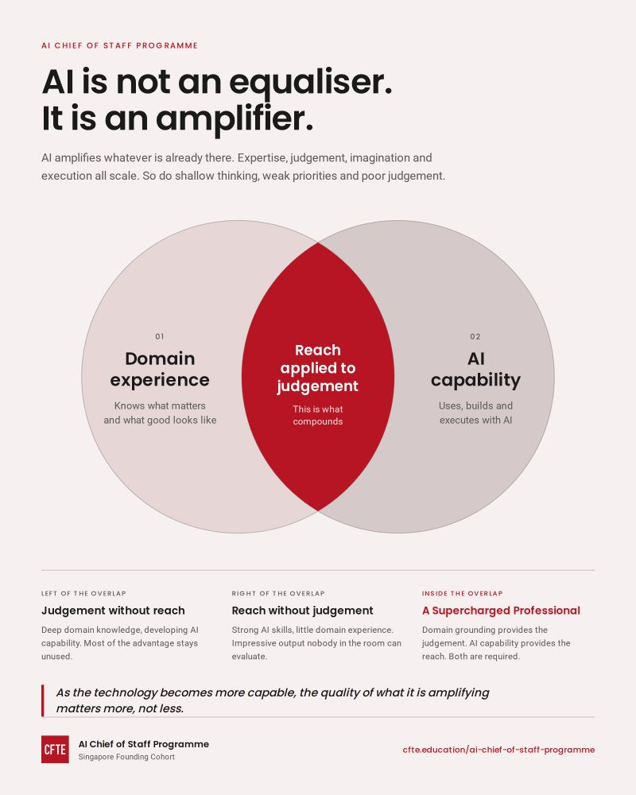

Slide 12
DATA PROTECTION
How AI can expose client data
The exposure starts before a prompt is submitted, and can persist after the task is complete.
01
02
03
04
INPUT
PROCESSING
RETENTION
OUTPUT
Client records, tax data or identifiers are copied into an unapproved AI tool.
Prompts and files leave the firm’s controlled environment and may pass through third-party systems.
Chat history, logs or model-improvement settings can preserve information longer than intended.
Generated content can reproduce confidential details or be sent to the wrong recipient.
HIGH-RISK DATA Tax identifiers · bank details · payroll files · engagement records
Default rule: minimise the data, remove identifiers, and use only firm-approved AI tools.
Accounting Firms · AI Training
11

Slide 13
BENEFITS AND LIMITS
The benefits of AI, and where they stop
WHAT AI DOES WELL
WHERE IT STOPS
Efficiency
A human stays in the loop
Automates repetitive manual tasks: analysing, collating and presenting data
Handles large volumes of data and returns
Supports research, report writing and client communications
It cannot do everything: firms are often too confident in AI
Unchecked output creates double work when errors have to be fixed later
It does not erase the need for training, e.g. on AML regulations
Source: PCRT topical guidance on the ethical use of AI tools (Jan 2026)
Accounting Firms · AI Training
12
Notes:
PCRT.

Slide 14
PUTTING IT INTO PRACTICE
How can the firm use AI?
01
02
03
04
05
Identify a process
Choose the right tool
Check the tool
Protect client data
Review the output
Pick a task to automate or speed up.
Find the right type of AI tool for the job.
Do due diligence on the tool’s transparency, data handling and terms.
Use it with confidentiality and data protection in mind.
A human checks every result before it is relied on.
Accounting Firms · AI Training
13

Slide 15
SECTION
Who regulates our use of AI?
The rules, the regulators and what is at stake for accounting firms

Slide 16
REGULATORS
Who regulates AI use?
In the UK there is no single AI law or AI regulator. Existing regulators apply existing rules to different aspects of AI use.
ICO
AMLS
HMRC
FCA
Information Commissioner’s Office
Your professional body (e.g. IFA, ICAEW, ACCA)
HM Revenue and Customs
Financial Conduct Authority
DATA PROTECTION
AML SUPERVISOR
TAX AGENTS
(FUTURE SUPERVISOR)
Accounting Firms · AI Training
15

Slide 17
REGULATORS AND PENALTIES
Who regulates our use of AI, and what is at stake
Regulator | Why it applies to our AI use | What’s at stake
ICO Data protection | Client data entered into AI tools is covered by UK GDPR, the Data Protection Act 2018 and the Data (Use and Access) Act 2025. If AI makes significant decisions about people on its own, they have the right to be told, to challenge the decision and to ask for a human review. | Fines of up to £17.5m or 4% of global turnover, whichever is higher. PECR fines (marketing emails and cookies) can now reach the same level.
Professional body AML supervisor | Your professional body’s code of ethics (e.g. IFA, ICAEW, ACCA) still applies when AI is used, including confidentiality, competence and due care. PCRT guidance on the ethical use of AI tools (Jan 2026) sets out what is expected. As your AML supervisor, it expects client checks done with AI tools to still meet the Money Laundering Regulations. | Disciplinary action, sanctions and fixed penalties under your professional body’s regulations.
HMRC Tax agents | We are responsible for the accuracy of every return we file, even if AI helped prepare it. The Standard for Agents was updated in February 2026, and mandatory tax adviser registration started rolling out on 18 May 2026. | HMRC can block our access to agent services, issue dishonest-conduct notices with penalties and publication, or open a criminal investigation.
FCA Coming later | It will take over AML supervision of accountants from the professional bodies. The transfer is expected to start around late 2028 and finish around 2030. | Nothing changes yet. Worth keeping an eye on.
Source: ICO penalties, GOV.UK: Data (Use and Access) Act 2025, professional body regulations, HMRC Standard for Agents, HM Treasury AML supervision reform
Accounting Firms · AI Training
16

Slide 18
PROFESSIONAL STANDARDS
What do your regulators expect of you, and why?
Integrity
Confidentiality
Objectivity
Be straightforward and honest about AI use. Be able to explain how a conclusion was reached, even if AI produced it.
Client data in public AI tools is likely to breach confidentiality without consent. Anonymise and keep inputs generic.
AI can carry bias from its training data. Watch for “automation bias”: favouring the machine’s answer despite doubts.
“The output from an AI tool should also be regarded as if it were prepared by a less experienced junior colleague and reviewed with appropriate scepticism.”
Source: PCRT topical guidance on the ethical use of AI tools (Jan 2026)
Accounting Firms · AI Training
17
Notes:
PCRT guidance

Slide 19
DISCUSSION
Use cases for AI in your firm
What are some ways we already use AI? New ideas welcome.
DIFFERENT TEAMS USE AI IN DIFFERENT WAYS
Bookkeeping
Tax
Payroll
Client services
Reading invoices and receipts, matching bank transactions
Summarising HMRC updates, sense-checking returns
Spotting unusual pay runs, drafting staff queries
Emails, meeting notes, onboarding and CDD checklists
Which tasks take up most of our week?
Where could a first draft save us effort?
What should never go into an AI tool?

Slide 20
FEEDBACK
Training impact survey
Identify your response for each statement. 1 = Strongly disagree · 5 = Strongly agree
1
2
3
4
5
01
I understand AI better.
02
I understand how AI is used in my industry.
03
I understand the risks of using AI irresponsibly.
04
I feel more secure about growing my use of AI
05
I feel more confident about AI in general.
SCORING Training success score = the average of all responses, reported out of 5.
Accounting Firms · AI Training
19

Slide 21
FURTHER READING
Sources and further reading
IFA
IFA conduct rules guidance on AI
ICAEW
AI and accountants (Sage and ICAEW guidance)
PCRT
PCRT topical guidance: ethical use of AI tools (Jan 2026)
ICO
What is personal data?
GOV.UK
Data (Use and Access) Act 2025: data protection changes
GOV.UK
HMRC Standard for Agents
Accounting Firms · AI Training
20

Slide 22
FURTHER READING
Sources and further reading (Contd.)
James Tobin, House of Lords Library, ‘Artificial intelligence: Development, risks and regulation’ (18 July 2023)
https://www.microsoft.com/en-gb/ai/ai-101/generative-ai-vs-other-types-of-ai#Definition
Karbon, ‘State of AI in Accounting Report 2026’ | https://karbonhq.com/resources/state-of-ai-accounting-2026/
Accounting Firms · AI Training
20

Slide 23
Q&A
?

