Slide 1

Sales Performance Dashboard
Power BI Data Analytics Project
Data Analyst Internship • Dashboard design & business insights

Slide 2






Project Objective
Design a Power BI dashboard that gives stakeholders an interactive, reliable view of sales performance across products, countries, deal sizes and order status.
Monitor overall sales
Track trends over time
Identify top product lines
Analyze sales by country
At-a-glance revenue and trend visibility.
Monthly and yearly comparisons with progressive reveal.
Rank products by sales and units sold.
Geographic comparison and market focus.
Understand deal-size distribution
Monitor order status
Shipped, pending and cancelled order views.
Segment sales by deal-size bands.

Slide 3
Key Performance Indicators
Total Sales
Total Units Sold
Total Orders
$10.03M
99,067
307
Average Order Value
YoY Sales Growth
$32.68K
34.33%
Key takeaway: Sales performance shows strong overall revenue generation with significant year-over-year growth.

Slide 4

Sales Trend Analysis
Monthly sales trend (2003–2005). 2004 shows clear improvement over 2003; 2005 contains partial-year data through May and is not directly comparable to full years.
May 2005
2004 Growth
Jan 2003
Insight: Sales increased significantly in 2004, indicating stronger business performance compared with 2003.

Slide 5
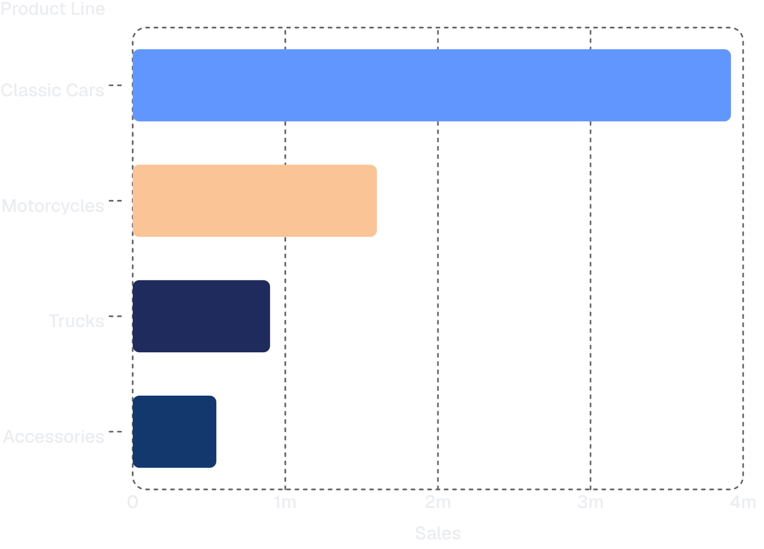
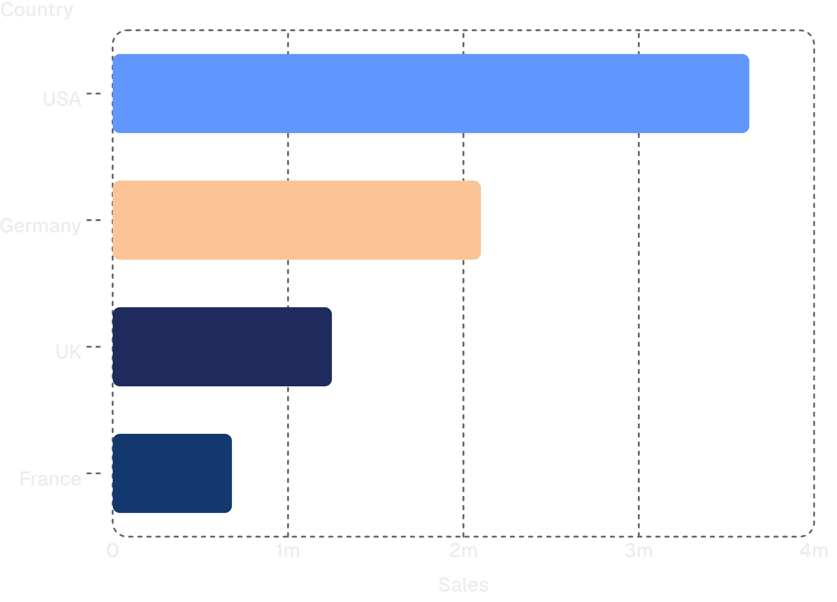
Product & Market Performance
Sales by Product Line
Sales by Country
Top product line: Classic Cars — ≈ $3.92M. Classic Cars bar is visually highlighted to draw attention.
Top country: USA — ≈ $3.63M. USA bar is visually highlighted to indicate market priority.
Product and geographic analysis helps prioritise inventory and go-to-market focus.

Slide 6
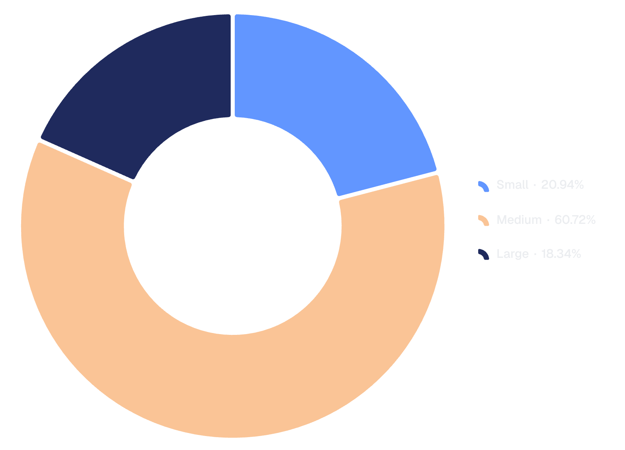
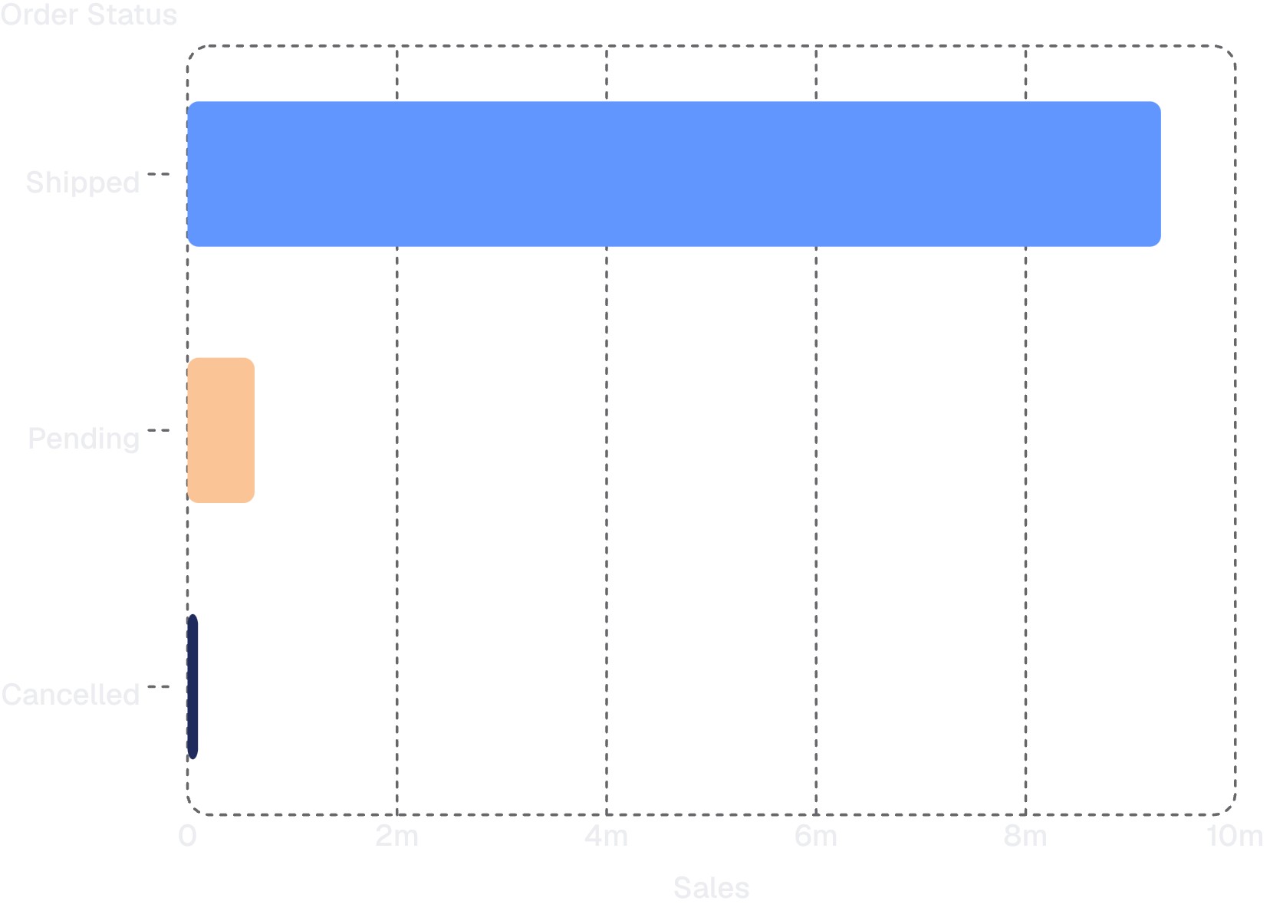
Sales Mix & Order Status
Sales by Deal Size
Sales by Order Status
Medium deal size: ≈ $6.09M — the largest contributor to sales.
Shipped orders: ≈ $9.29M — majority of recognised sales stem from shipped status.
These dimensions clarify which deal sizes and fulfilment stages drive realised revenue.

Slide 7








Dashboard Features & Business Takeaways
Interactive Features
Business Takeaways
Year filter
1
2
Country filter
1. Total sales
2. YoY growth
Reached approximately $10.03M across the dataset.
Sales grew ~34.33% from 2003 to 2004, a notable year-over-year uplift.
Product line filter
Deal size filter
3
4
3. Top product
4. Top market
Order status filter
Classic Cars is the highest-performing product line (~$3.92M).
USA is the largest market by sales (~$3.63M).
Interactive cross-filtering
5
6
5. Deal-size impact
6. Explore interactively
Medium deals delivered the largest sales contribution (~$6.09M).
Filters and cross-filtering let stakeholders test hypotheses and drill into segments.
Data-driven dashboards transform sales data into actionable business insights.

