Slide 1




consultUK
WHERE POLICY MEETS PEOPLE
PRESENTED BY:
INVICTUS

Slide 2
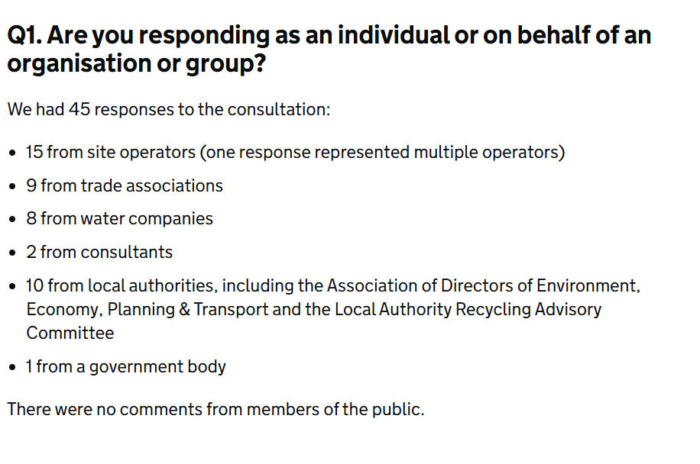
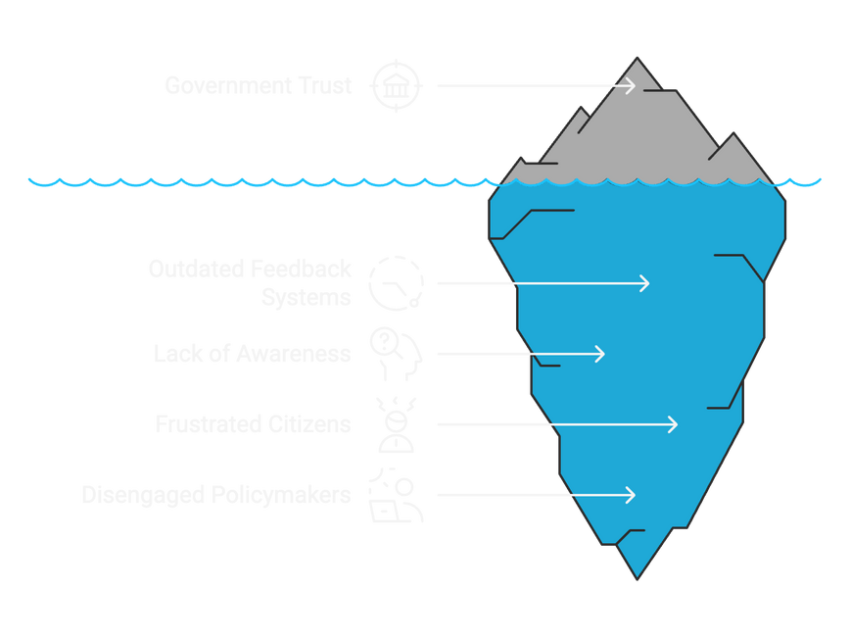
The Problem
01
Lack of public confidence
02
Slow Feedback mechanism
03
Limited outreach
Source: GOV.UK

Slide 3
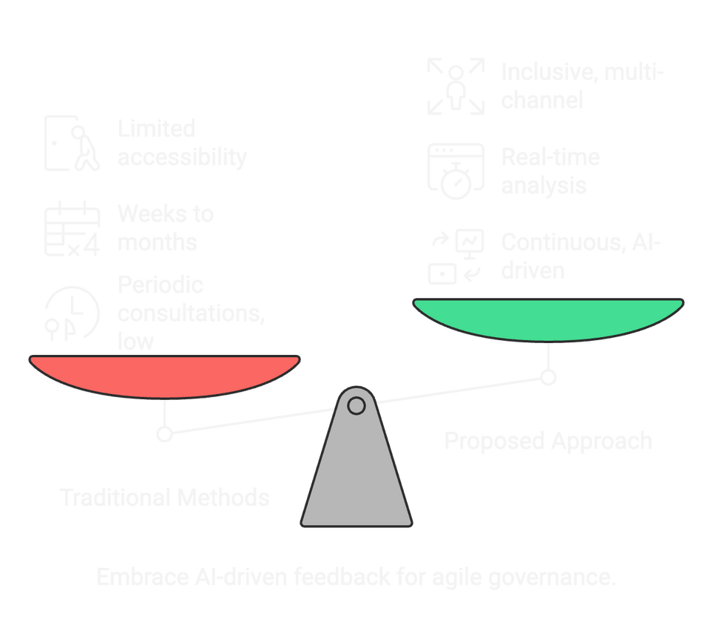
Our Approach
Faster Feedback Cycle
01
Direct feedback acquisition from public and real-time data-rich dashboard allows faster analysis.
02
Transparent Process
A fully transparent feedback loop that acknowledges the public, increasing trust.
Public Awareness
03
A one stop solution for all the information about policies and who they affect.
Embrace AI-driven feedback for agile governance

Slide 4
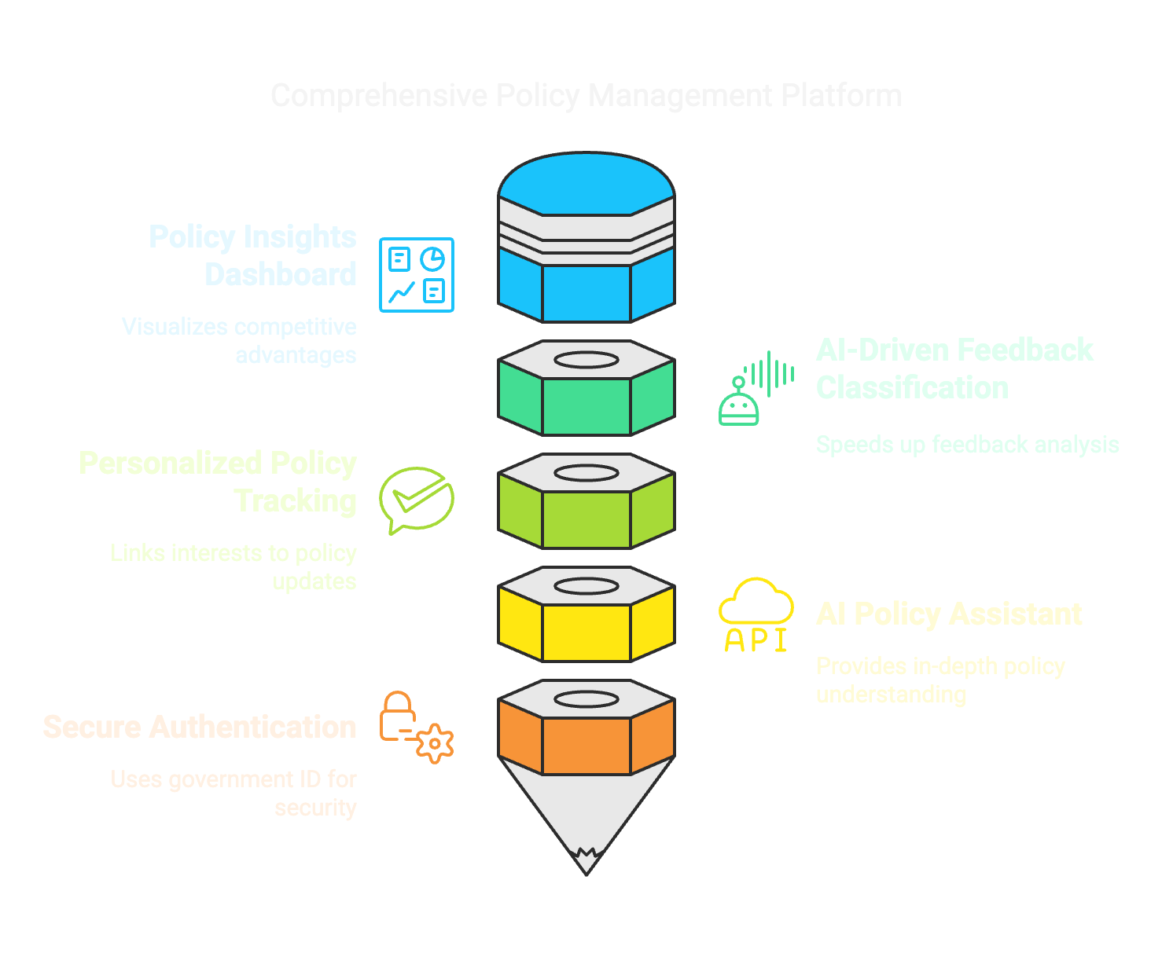
Key Features
01
02
03
04
05

Slide 5
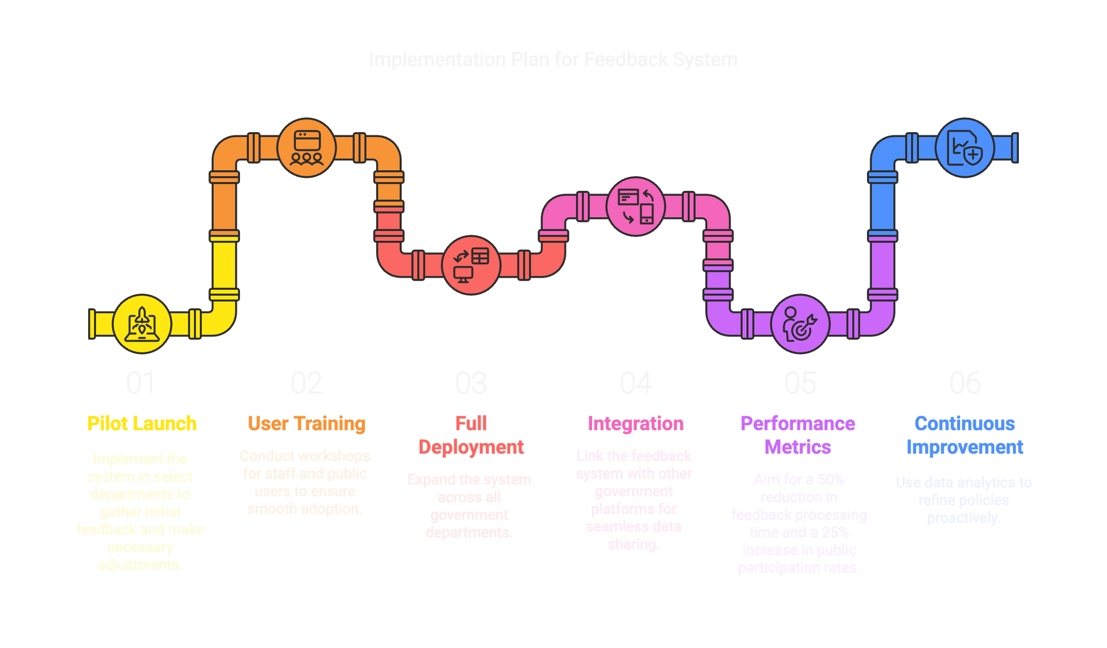
Implementation

Slide 6



Sustainability

Slide 7
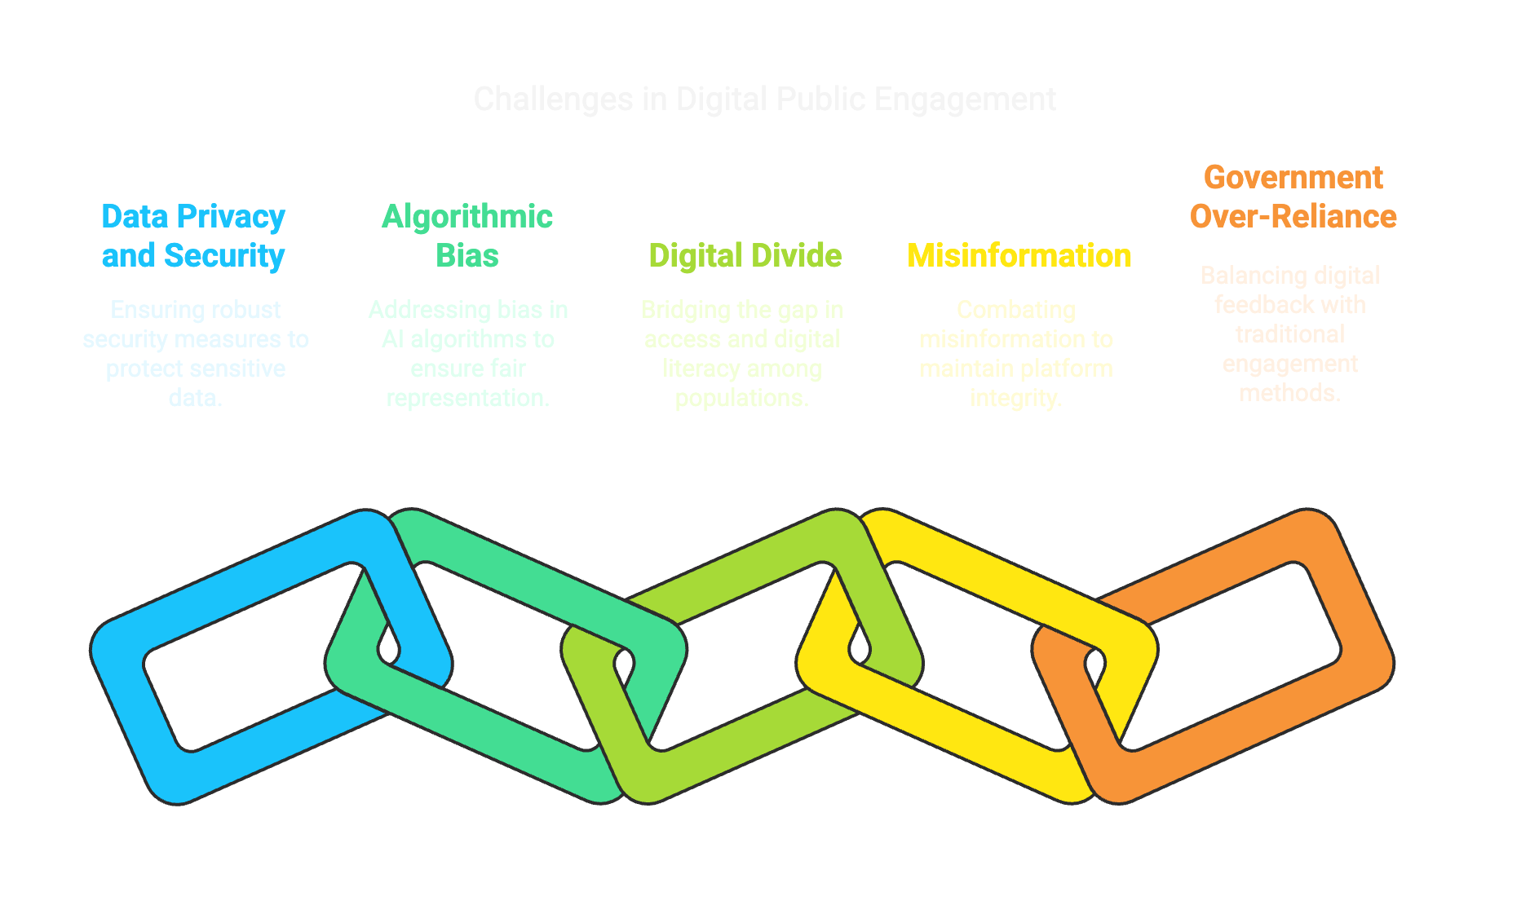



Limitations
05
01
02
03
04

Slide 8
Solutions
01
01
01
05
01
02
03
04

Slide 9

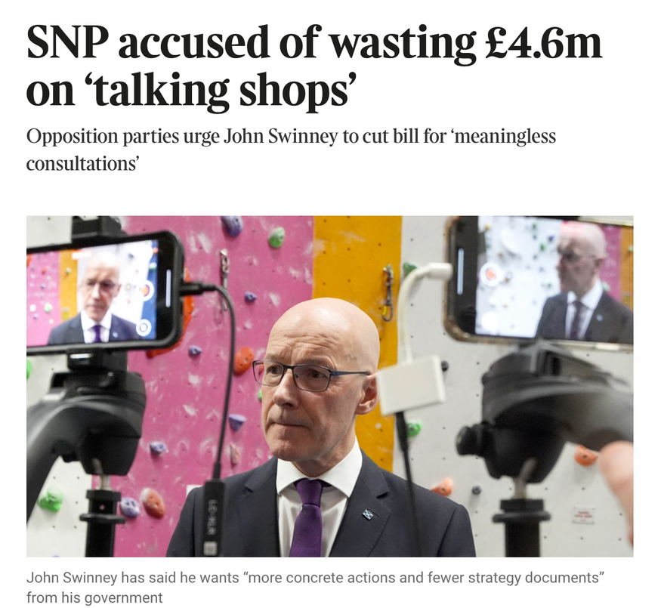
Cost Analysis
The Development & Implementation costs come in between 360K - 920K
Source: THE TIMES

Slide 10
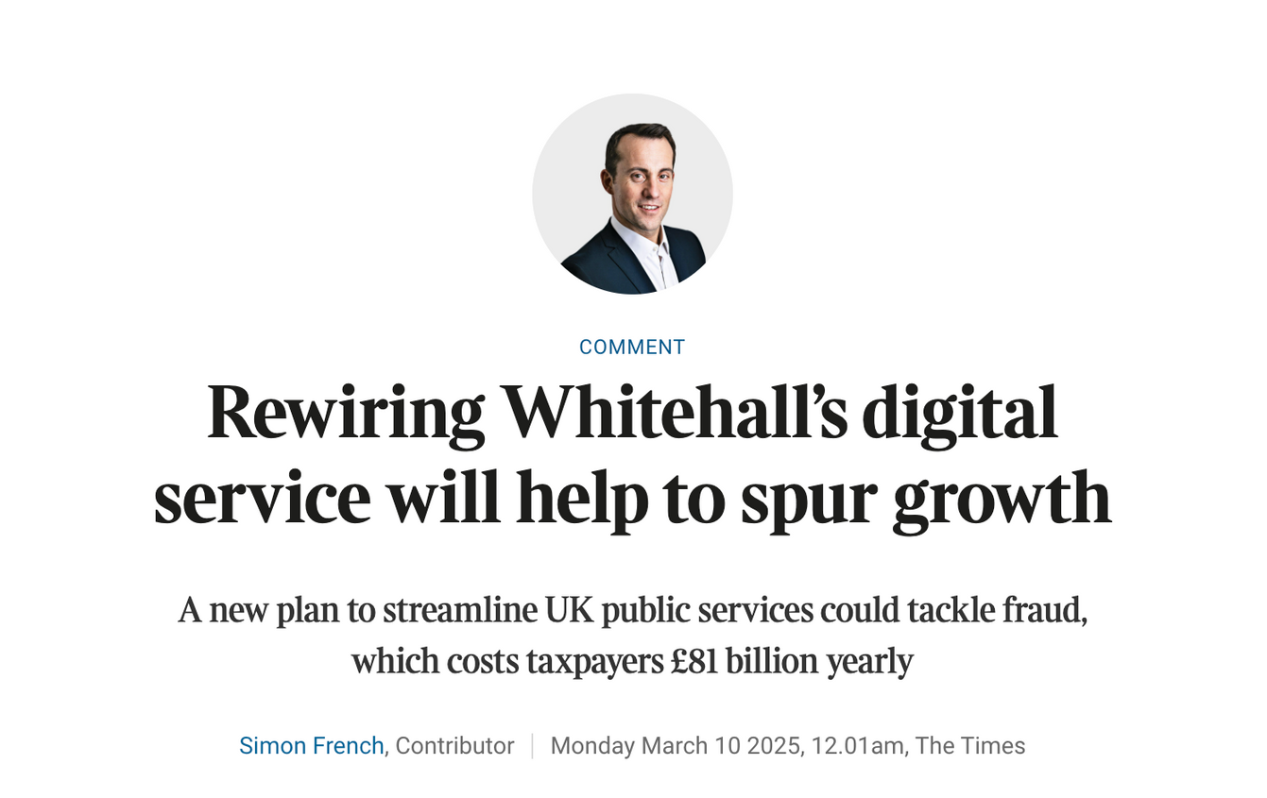
Future RoadMap
Source: THE TIMES

Slide 11
Thank You
FOR YOUR TIME

