Slide 1
How does ChatGPT work and do AI-powered chatbots “think” like us ?

Slide 2
Summary
Abstract
ChatGPT and chatbots
Large Language Models (LLMs)
Dependency
Criticism
Do they ‘think’ like humans ?

Slide 3
Abstract
Thomas-Alexandre MOREAU : How does ChatGPT work and do AI-powered chatbots “think” like us ?
ChatGPT is an AI-powered chatbot, like many others. It is an artificial intelligence capable of answering questions and maintaining a fluent discussion. These chatbots are composed of models known as large language models (LLMs). With LLM, they can absorb extensive data, enabling them to learn and make complex sentence structures to answer queries following extensive training. They have become an important part of our digital activity for the few last years, and raised a lot of questions, with one of them being about their possible ability to be sentient, like humans. However, it has been shown that they can’t, or not like we could imagine it. They have their own way of understanding things they learn from.
GENT E., (25th October 2023), How does ChatGPT work and do AI-powered chatbots “think” like us ?, New Scientist, https://institutions-newscientist-com.docelec.u-bordeaux.fr/article/2384030-how-does-chatgpt-work-and-do-ai-powered-chatbots-think-like-us/

Slide 4
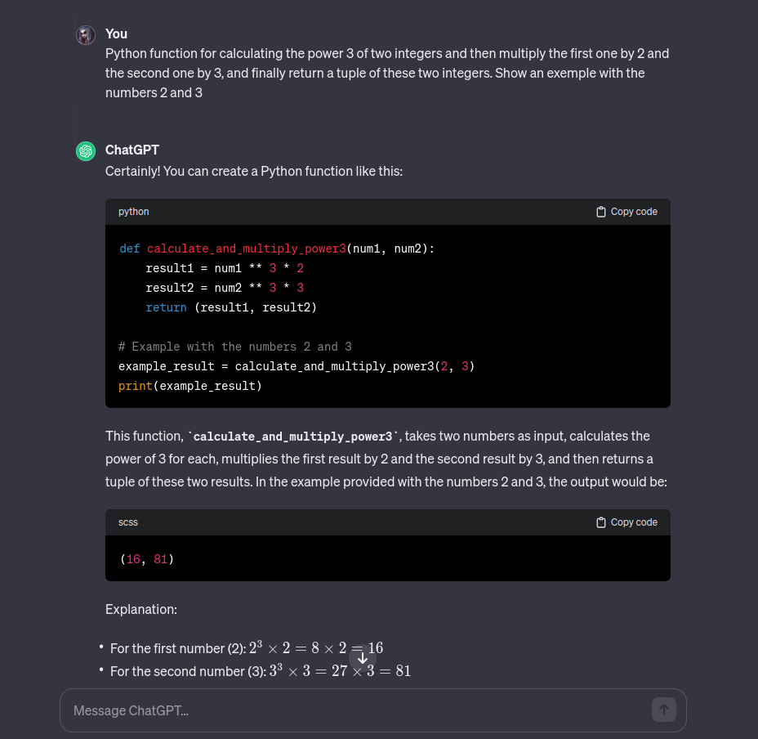
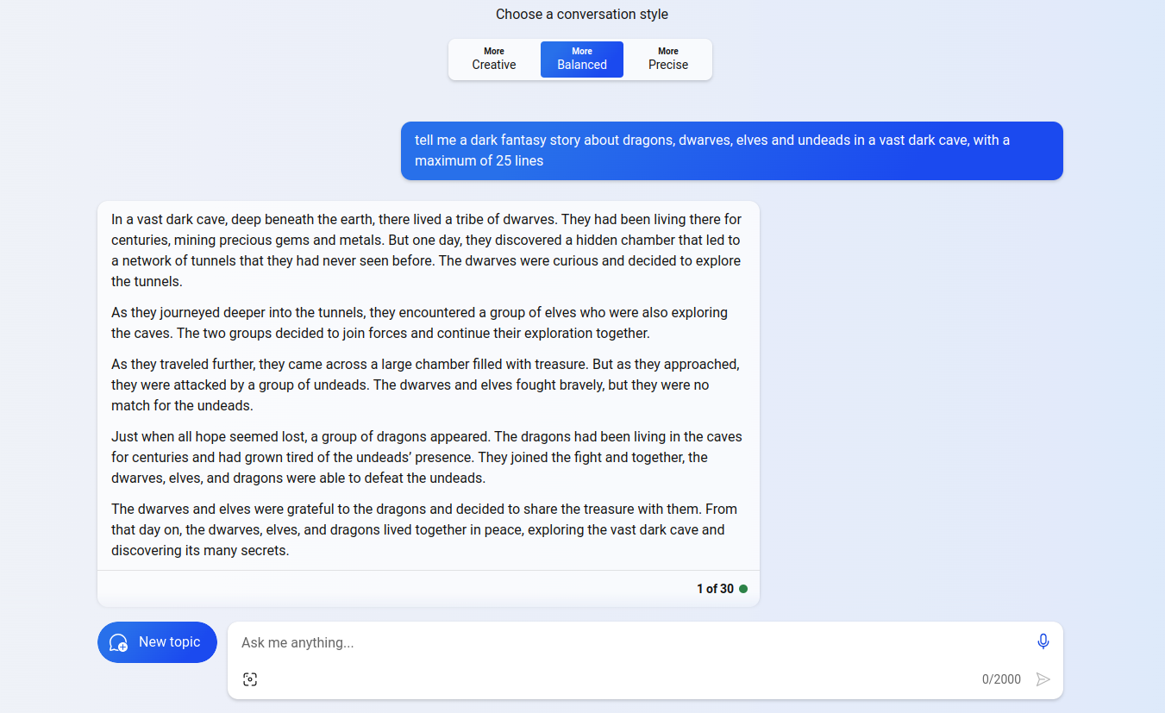
ChatGPT and chatbots

Slide 5
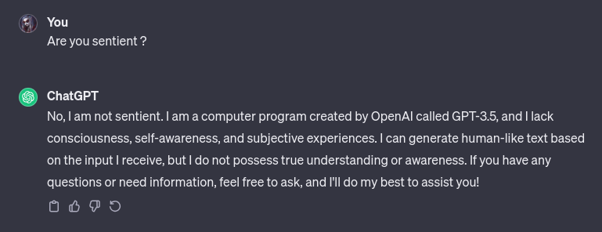
ChatGPT and chatbots

Slide 6
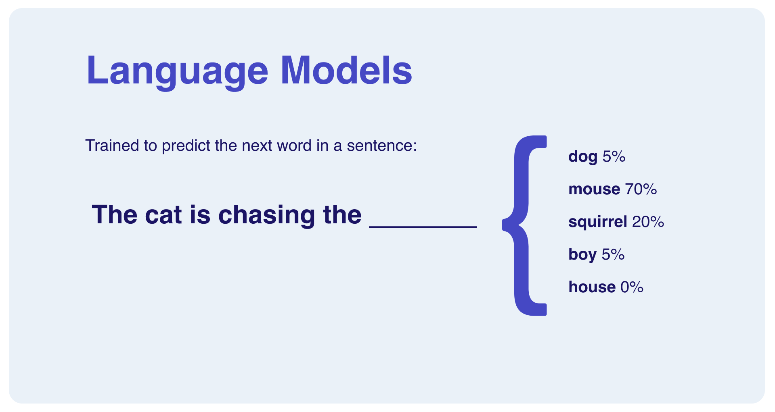
Large Language Models (LLMs)

Slide 7
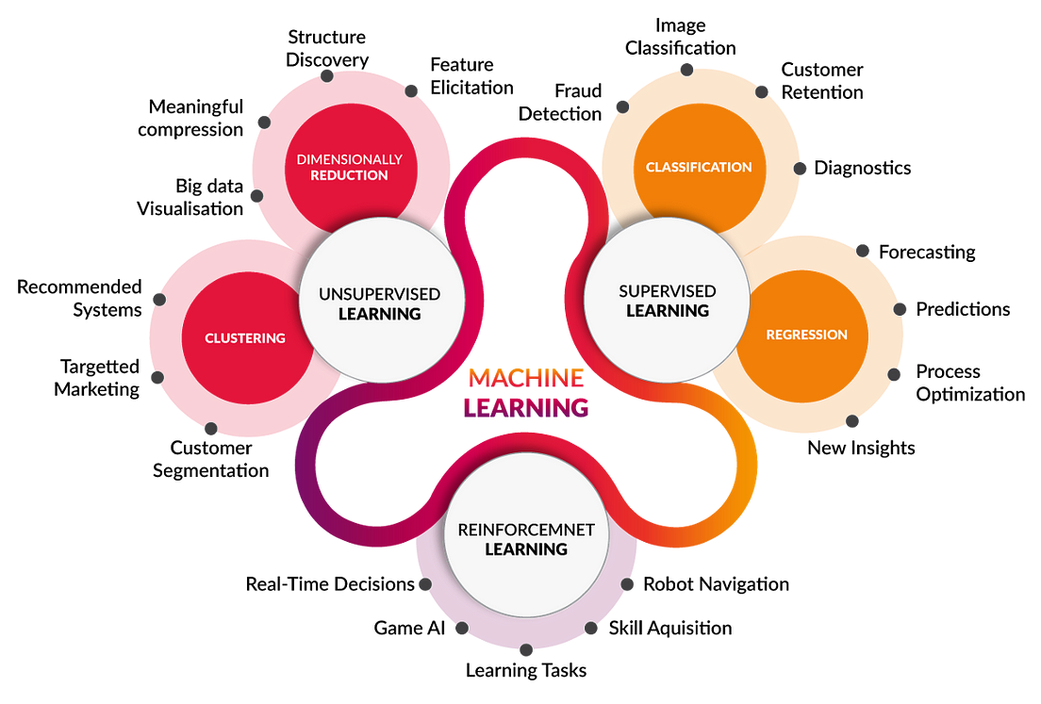
Dependency

Slide 8
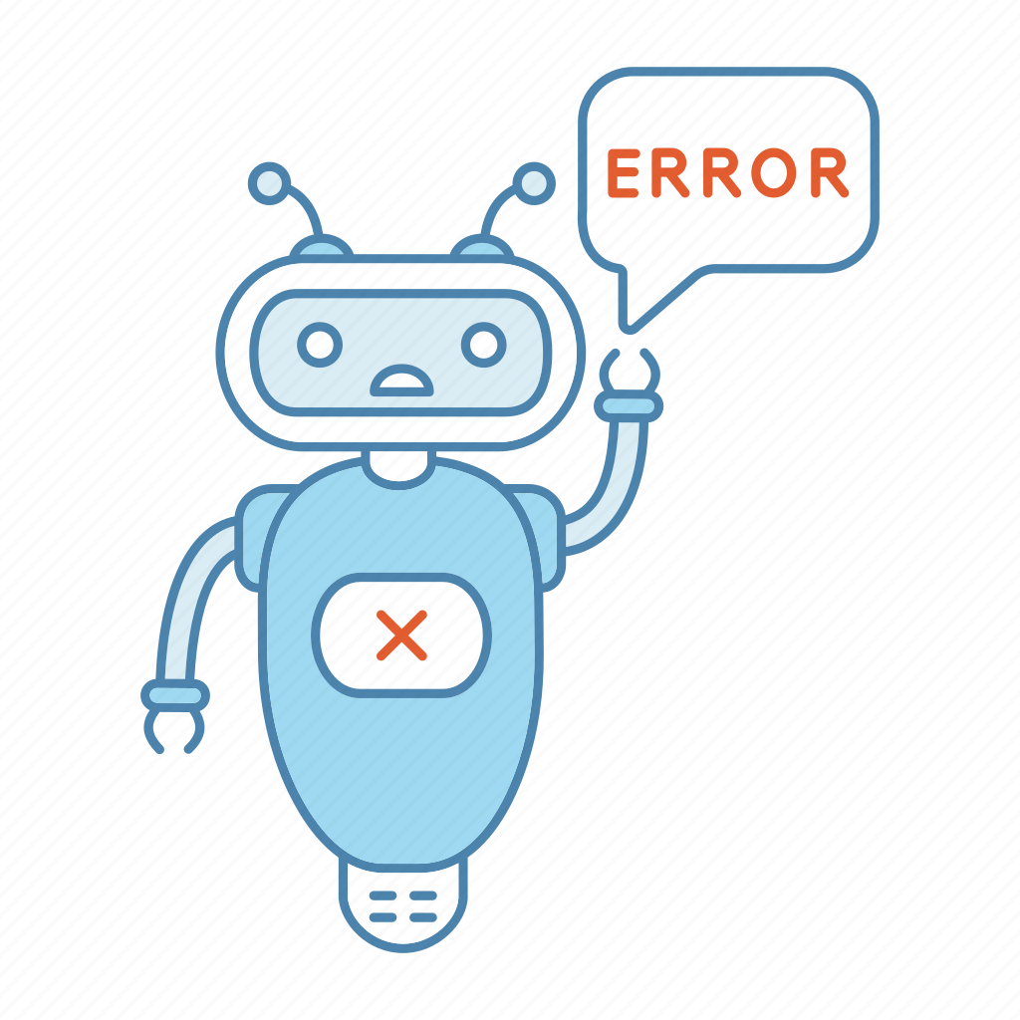
Criticism

Slide 9
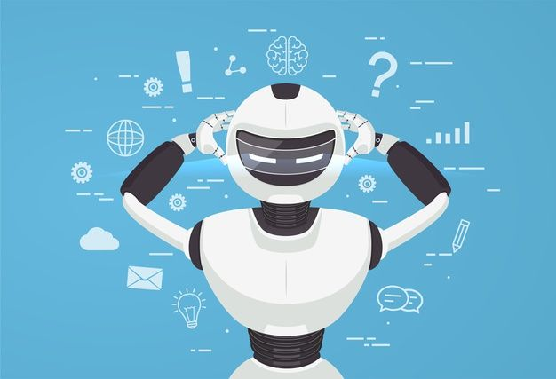
Do they ‘think’ like humans ?

