Slide 1

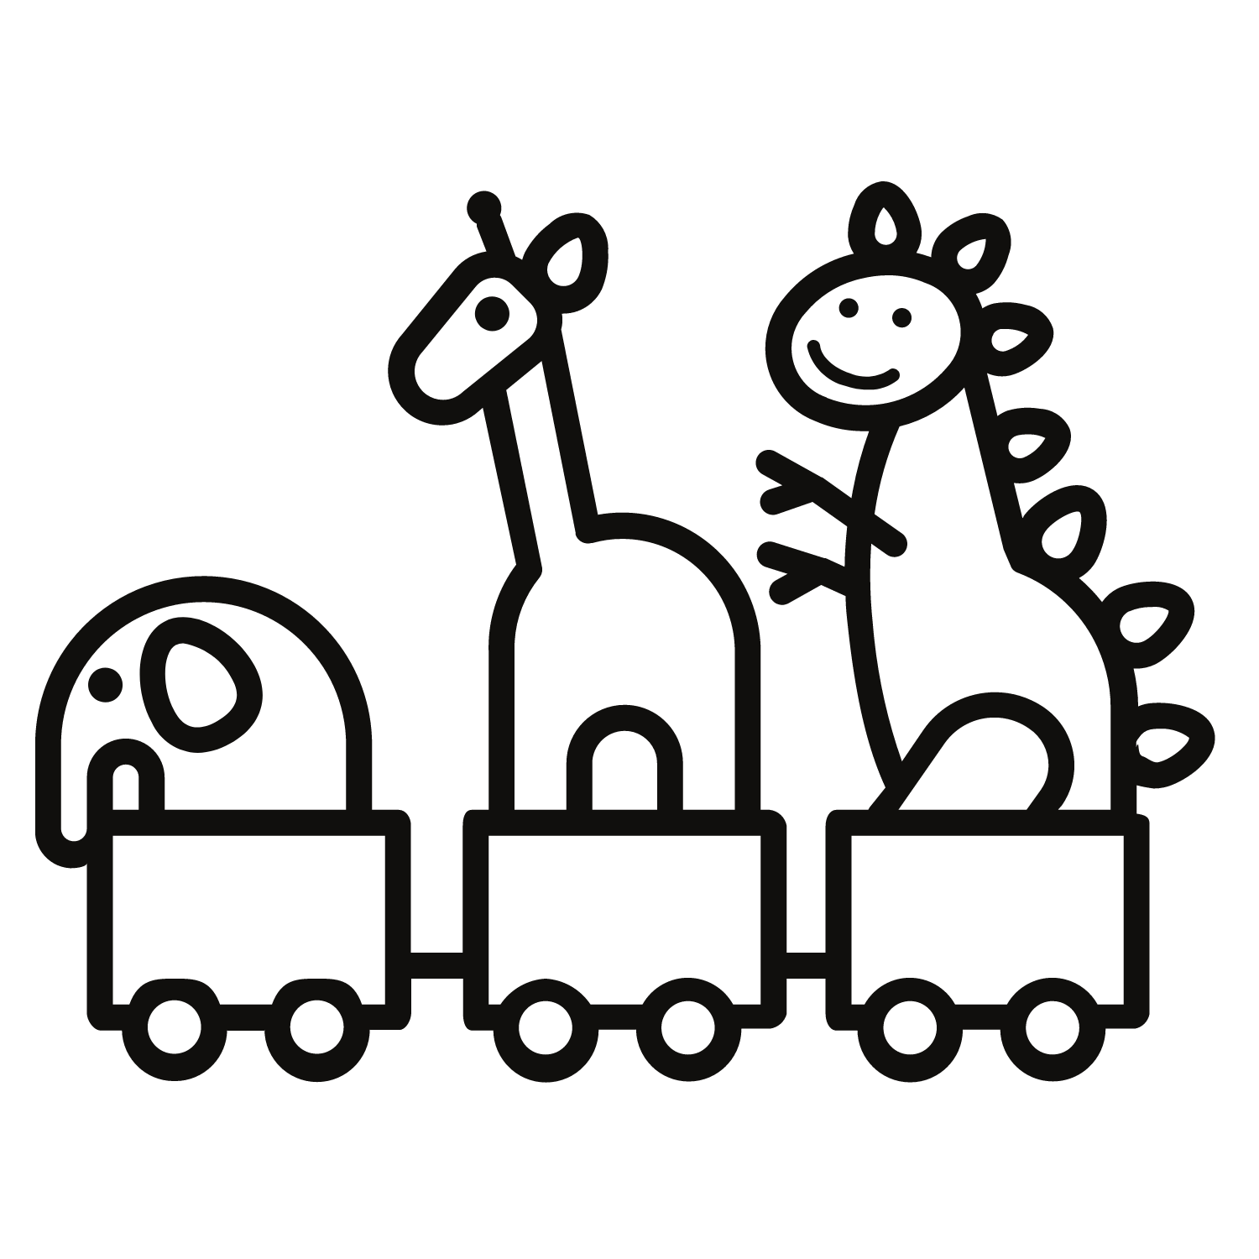
Colleen Corrigan, Joyce Fang, Tyler Green, Jody Sunray

Slide 2
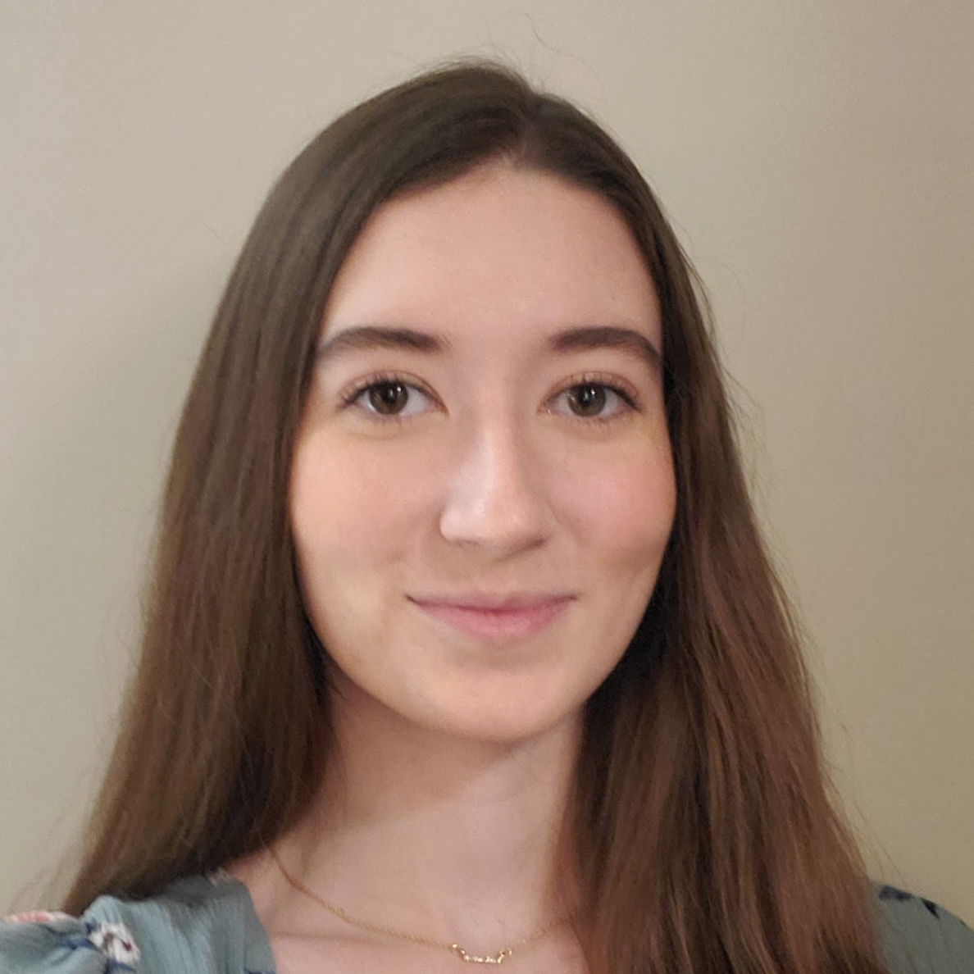
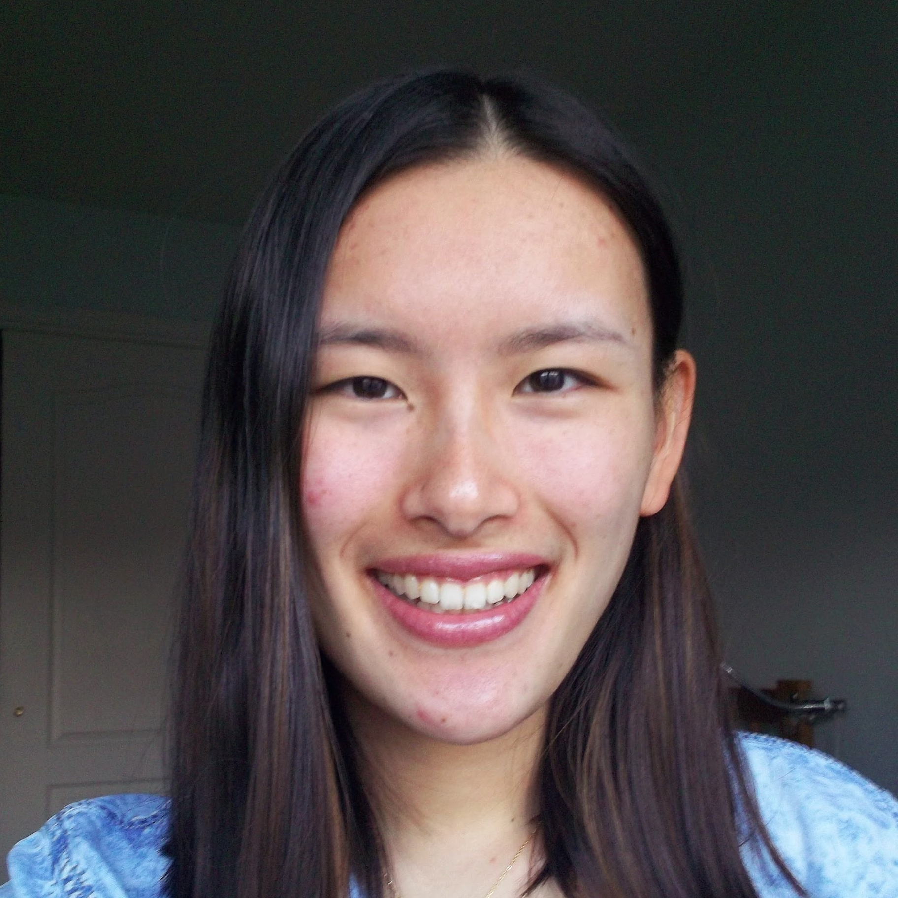
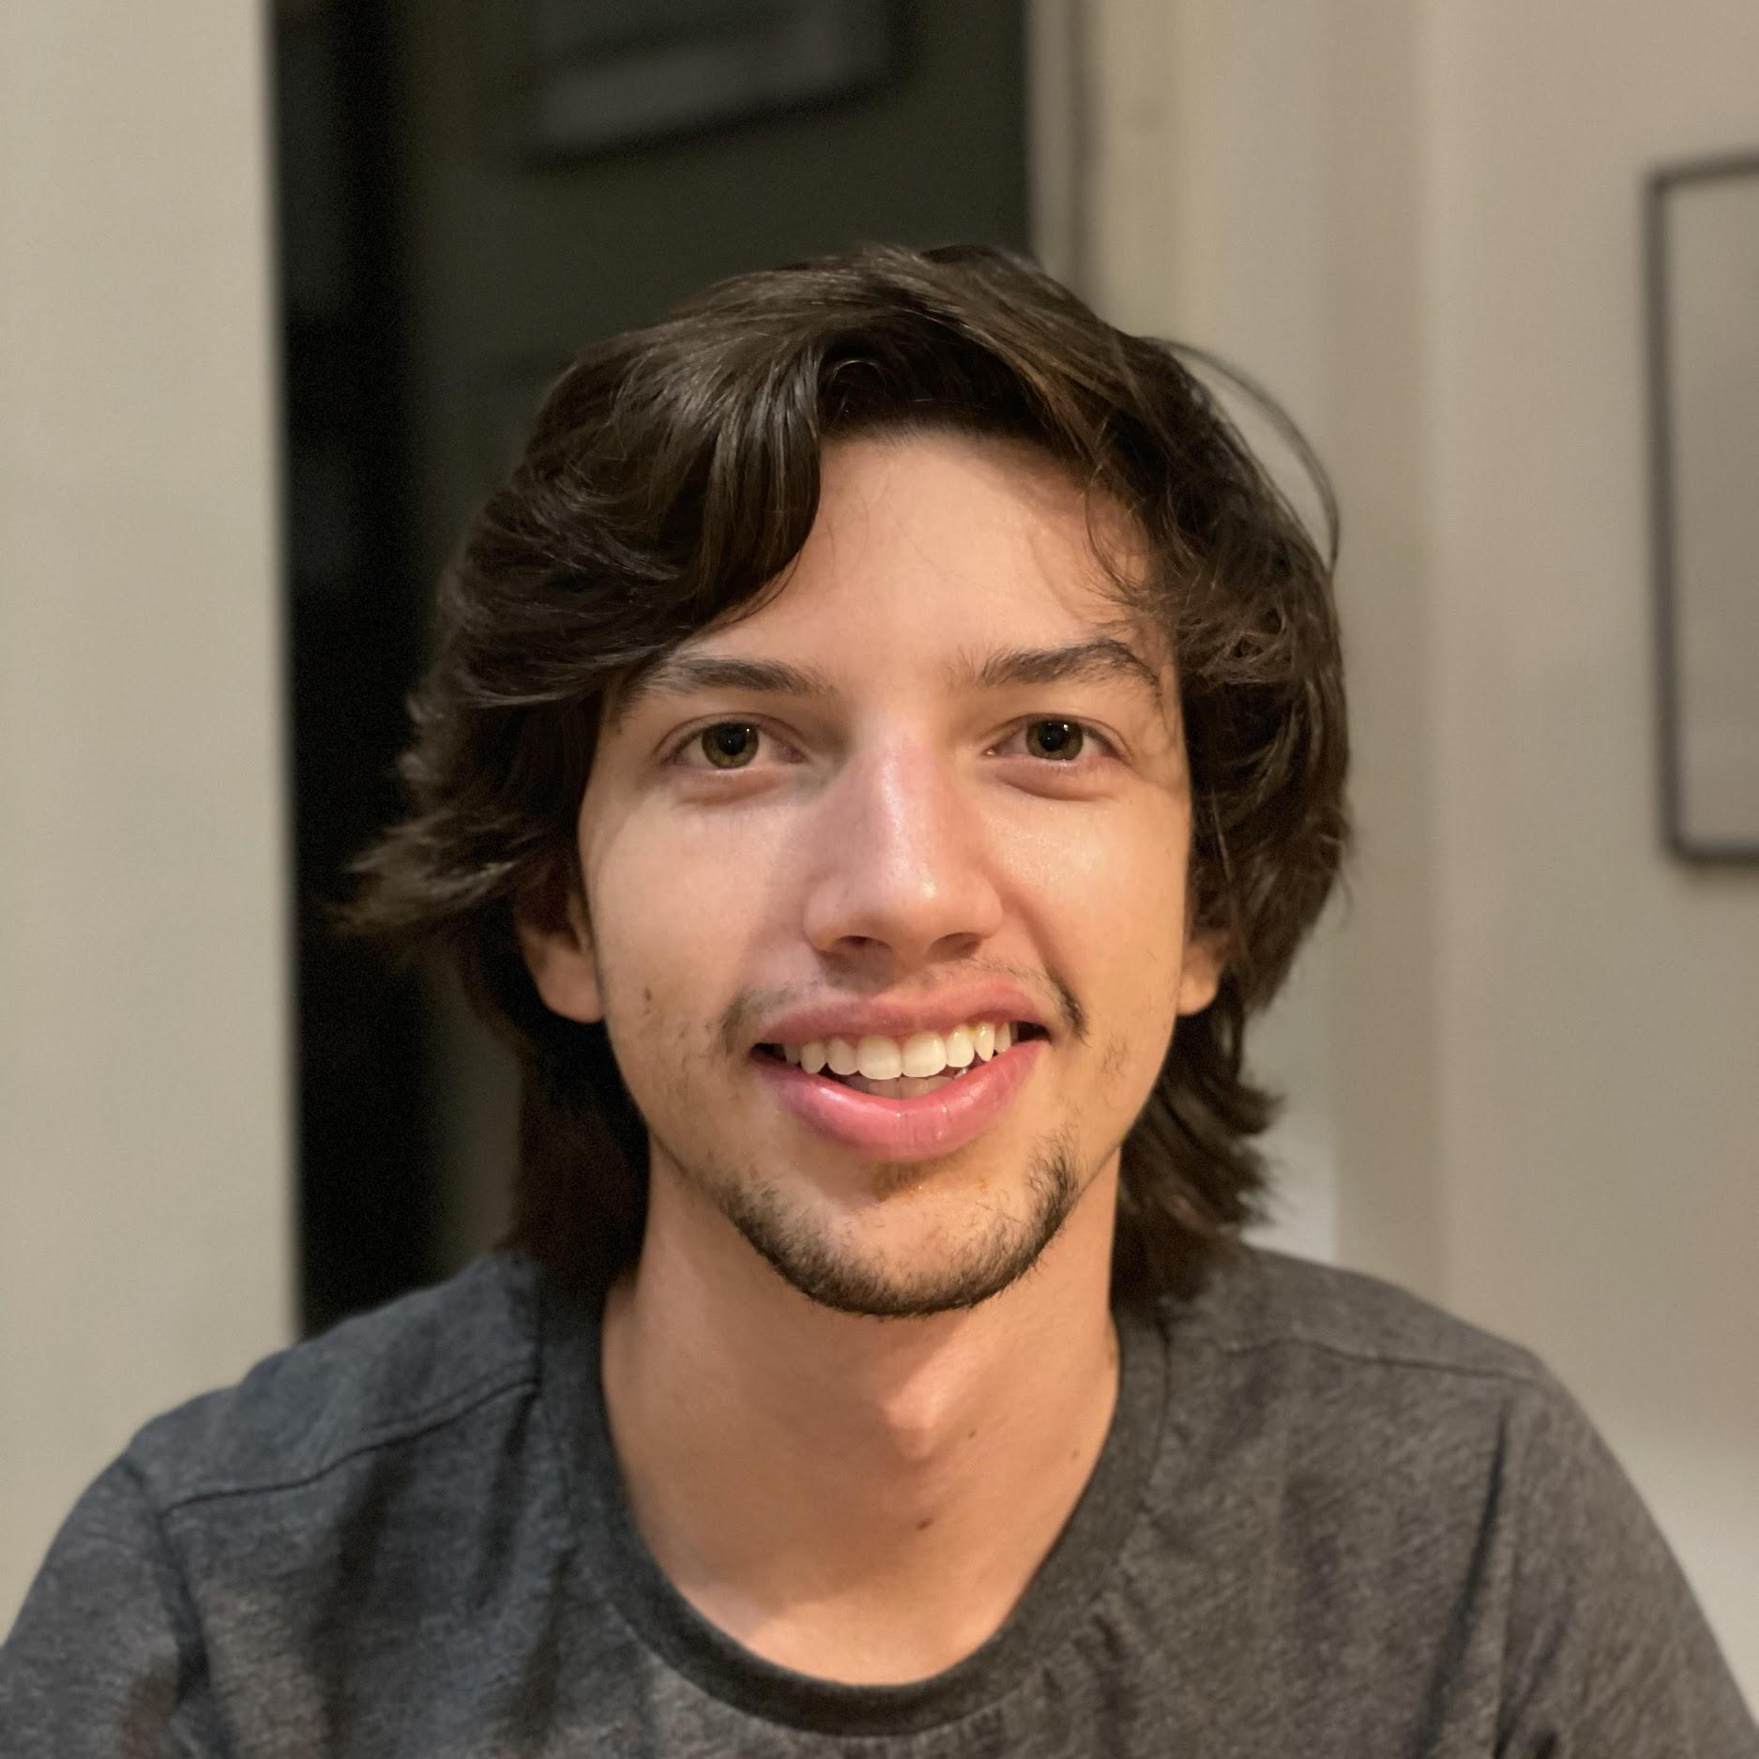
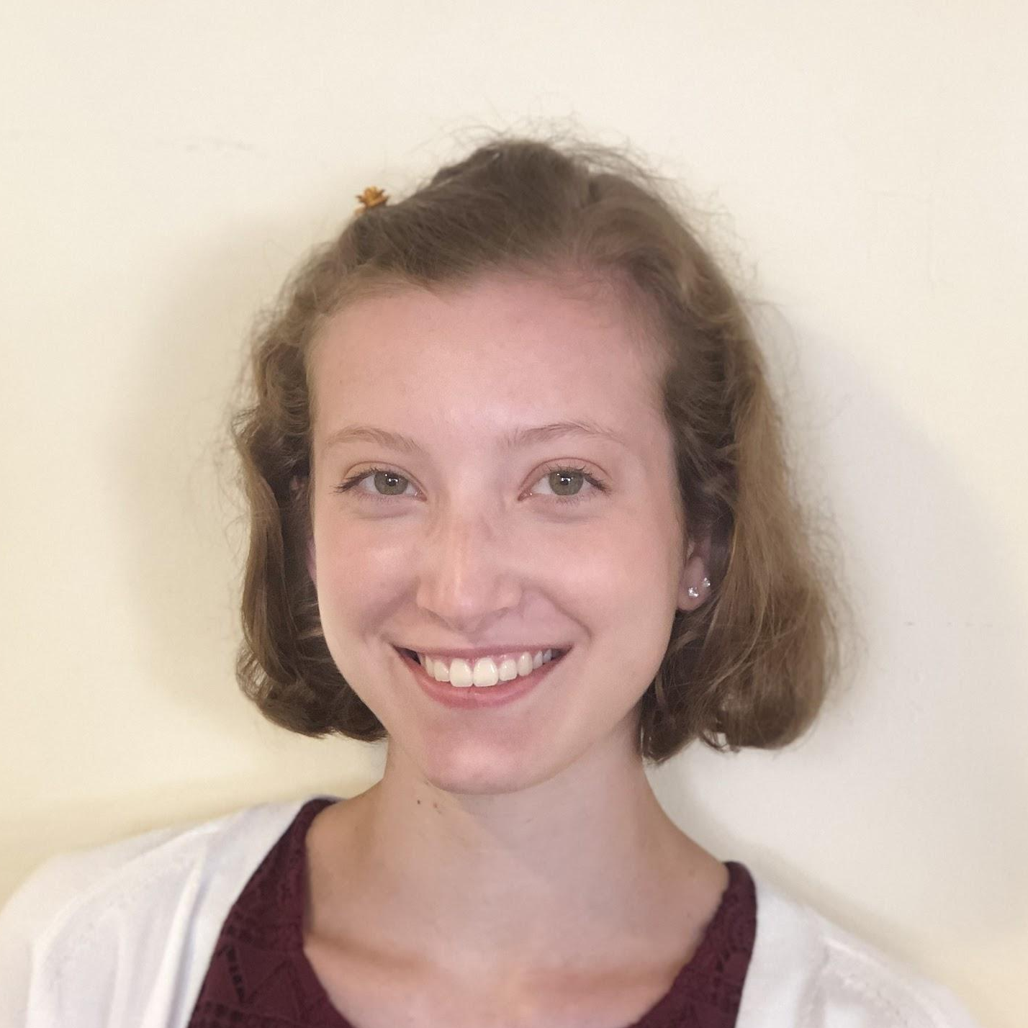
OUR TEAM
COLLEEN CORRIGAN
JOYCE FANG
TYLER GREEN
JODY SUNRAY

Slide 3
WHAT IS TOY TRADE?
Toy Trade is an application where users can browse toys that are available and coordinate exchanges with others.
Users will be able to set up their own profile along with a dashboard of all of the toys that they are willing to trade in.
The exchange will take place at a neutral third party location such as a library or public school.
Our site will feature filtered search and chatting capabilities.
Notes:
Tyler

Slide 4
PROBLEM
Children can quickly become bored of toys
Toys can be expensive, and consistently replacing them can add financial stress for parents
Constantly buying new toys supports mass production, which is environmentally unfriendly
Many existing services are known for having unsafe methods of in person exchange
Notes:
Colleen

Slide 5
SOLUTION
Online service that connects two users in a safe and secure manner
Exchange is non-monetary, relies on two users finding a toy in each other’s listings to exchange
Chat feature allows users to work out details
Filtering to find the exact toy type, price range, or brand
Exchange is contactless in a third party location
Unique identifier is provided to ensure identification for pickup
Notes:
Colleen

Slide 6
WHAT WE’VE ACCOMPLISHED
All Static HTML Pages
index.html
home.html
messaging.html
notifications.html
profile.html
addtoy.html
Google OAuth Sign-In
For authentication
Notes:
Joyce

Slide 7
WHAT’S NEXT?
Mid-March
Early April
End of April
Angular Frontend Framework
Set up MongoDB database
Final Presentation
Integrate Express.js framework
Fully Implement API Requests
End of March
Mid-April
Notes:
Joyce

Slide 8
CHALLENGES
Right now the user is unable to sign out of their Google account because we have multiple disconnected static pages
Refactoring our code to use Angular will likely eliminate this problem
Our application will be a single page instead of multiple
Flow of Transaction
Can only message someone if your request has been accepted
Notes:
Jody

Slide 9
DEMO
Notes:
Landing Page, Home page: Jody
Add Toy: Colleen
Messages: Tyler
Notifications, Profile: Joyce

Slide 10
THANKS!
Any questions?

