Slide 1

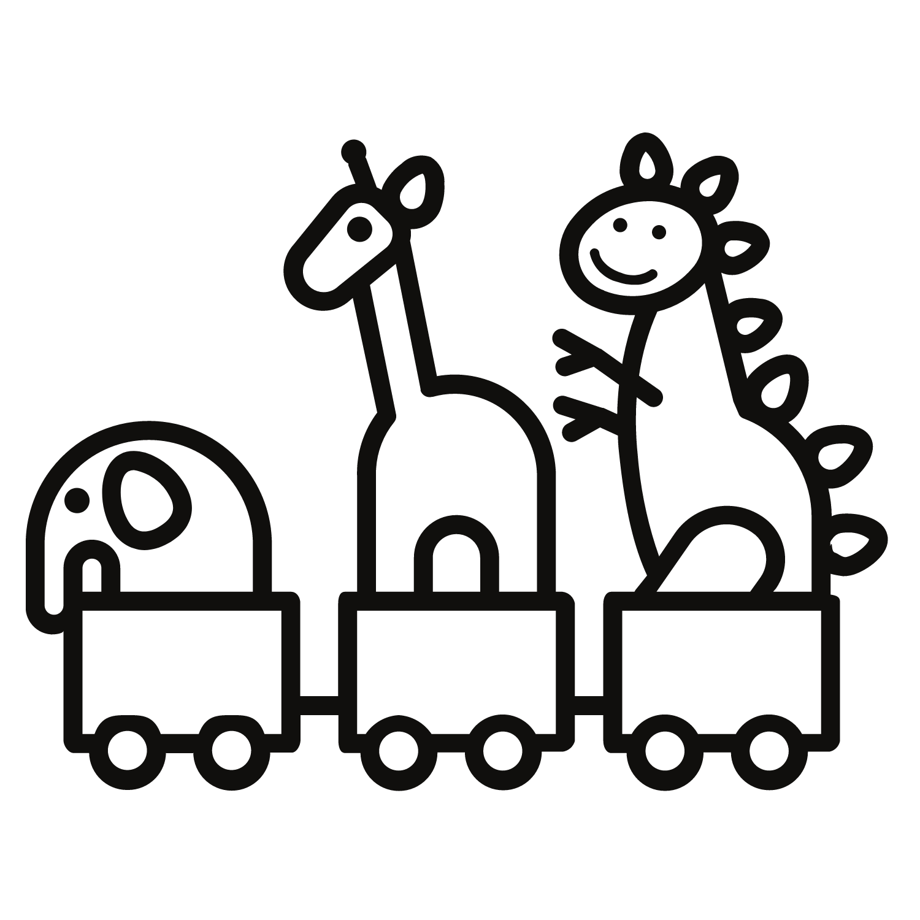
Colleen Corrigan, Joyce Fang, Tyler Green, Jody Sunray

Slide 2




OUR TEAM
COLLEEN CORRIGAN
JOYCE FANG
Full Stack Developer
Front End Developer
TYLER GREEN
JODY SUNRAY
Backend Developer
Full Stack Developer

Slide 3
WHAT IS TOY TRADE?
Toy Trade is an application where users can browse toys that are available and coordinate exchanges with others.
Users will be able to set up their own profile along with a dashboard of all of the toys that they are willing to trade in.
The exchange will take place at a neutral third party location such as a library or public school.
Our site will feature filtered search and chatting capabilities.

Slide 4
PROBLEM
Children can quickly become bored of toys
Toys can be expensive, and consistently replacing them can add financial stress for parents
Constantly buying new toys supports mass production, which is environmentally unfriendly
Many existing services are known for having unsafe methods of in person exchange

Slide 5
SOLUTION
Online service that connects two users in a safe and secure manner
Exchange is non-monetary, relies on two users finding a toy in each other’s listings to exchange
Chat feature allows users to work out details
Filtering to find the exact toy type, price range, or brand
Exchange is contactless in a third party location
Unique identifier is provided to ensure identification for pickup

Slide 6







COMPETITORS
DIGITAL MARKETPLACE
Buyers and sellers are responsible for arranging the exchange of items. Money does not have to be transacted via the Internet.
ECOMMERCE SITES
Transactions occur online and shipping is the only way to deliver items to the buyer.
TOY COMPANIES
Manufacture brand new toys with the latest designs and models.

Slide 7
STAKEHOLDERS
PARENTS
The average cost of a toy is about $14
Approx. 2 kids per family
$6,500 on toys per child before teens
MIDDLE MAN
Create event
Set up local community location
Connect with parents to be well organized
CHILDREN
Gain almost the most value
Social
Bored of old toys
Notes:
-----This cost quickly adds up as according to, mother.ly, the average kid will have between 70 and 200 toys at any given age and the average parent will spend $6,500 on toys per child before they even reach their teens.
----According to another study, the less toys children have, the better their social skills become. With our app limiting the number of toys children have doesn’t have to be the only solution to bettering their social skills.

Slide 8
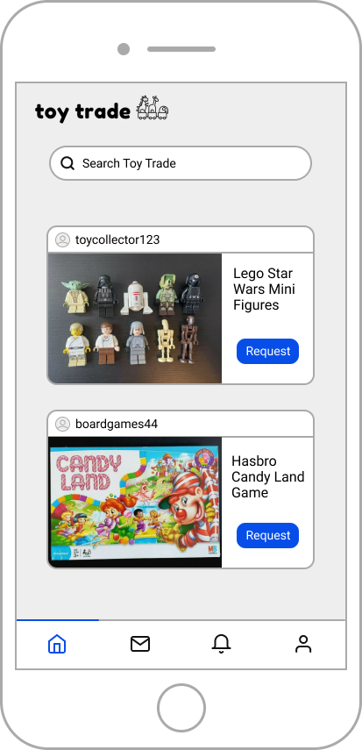
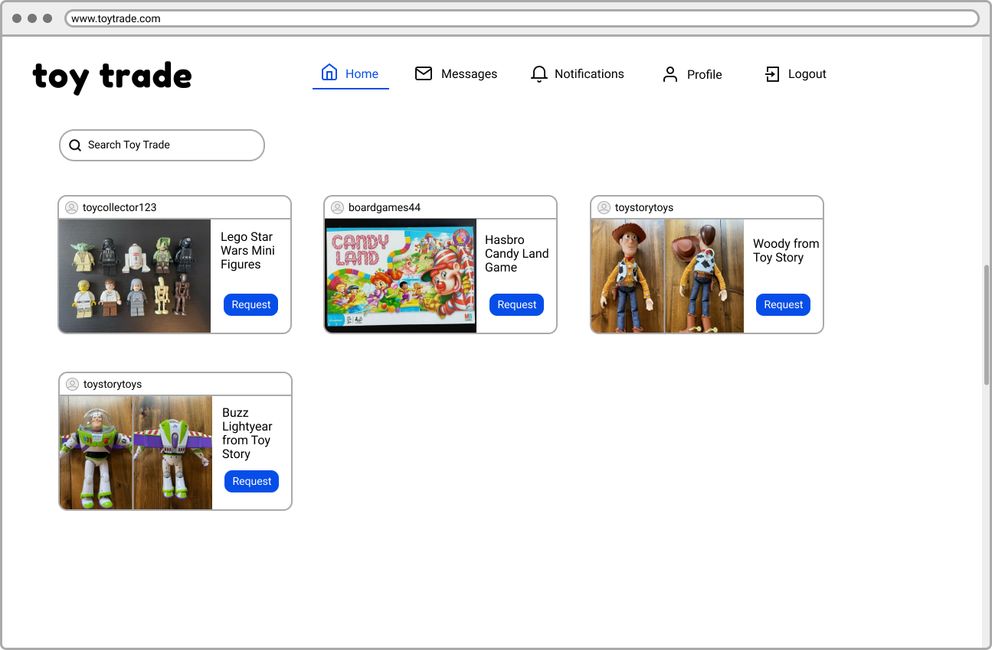
USER INTERFACE

Slide 9
THANKS!
Any questions?

