Slide 1
Welcome to Programming Languages
CSCI 3136: Principles of Programming Languages

Slide 2
Agenda
Announcements
Get a Top Hat account
Check your Dal email
Check your Brightspace account
Lecture Contents
Administrivia
Introduction to Programming Languages

Slide 3
Course Description
Overview
Lexical Analysis
Parsing
Semantic Analysis
Naming and Binding
Flow Control
Computation Abstraction
Type Systems and Memory Management
Functional Languages

Slide 4
Administrivia
Who/Where/When
Instructor: Alex Brodsky (person at front of room)
Location: MACME (right here)
Meet Time: WF 10:05 – 11:25 (now)
Pre-reqs: CSCI 2110, CSCI 2112, CSCI 2132
Contacts:
Email: csci3136@dal.ca
LMS (website): http://dal.brightspace.com
Office hours: Initially:
WF 14:30 – 15:30
Optional Text: Scott M., “Programming Languages Pragmatics, 4th ed.”, Morgan Kaufmann, 2015, ISBN: 0124104096.
Earlier editions are fine.

Slide 5
Class Rules
Cell phones and beepers should be SILENT.
I will start class at 10:05 and finish by 11:25.
Coming late is fine as long as you do not disturb the class.
I am hard of hearing, so I may ask you to repeat yourself.
If my writing becomes too messy let me know.

Slide 6
Course Assessment
Assessment Components:
Participation and Quizzes (5%) via TopHat
Best 8 of 10 assignments: 20% (2.5% each)
Optional midterm: (25% or 0%)
Final exam: (50% or 75%)
I will choose the marking scheme that benefits each student.
Midterm: Wednesday, June 19, 10:05 – 11:25, in CHEB 170.
Final Exam: Scheduled during week of July 31 - August 6.

Slide 7
Top Hat Is Required
We will be using the Top Hat Student Response System in class and in tutorial
You will need to:
Register for Top Hat at http://www.tophat.com
If you are not already registered
Join the course. Join code: 925103
Why do we use Top Hat?
Facilitates ongoing small-stakes assessment and feedback
Fairly assesses attendance and participation

Slide 8
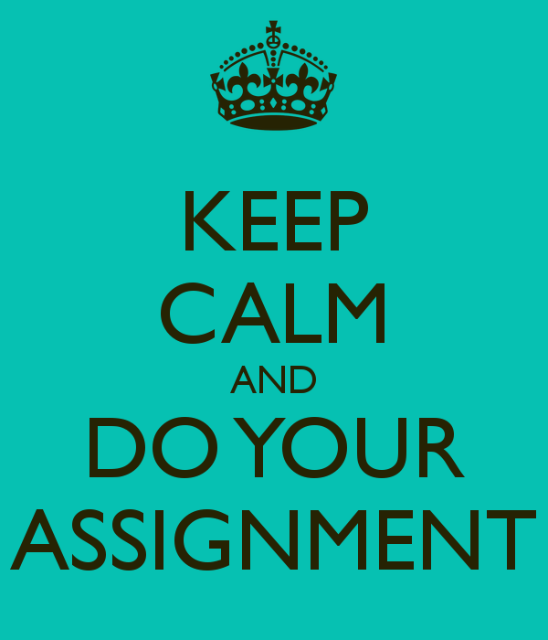
Assignments
Best 8 out of 10 assignments
Due at 9am on
May 24 and 31
June 7, 14, and 28
July 5, 12, 19, 26
No late submissions accepted.
All assignments must be submitted via Brightspace
Written assignments should be scanned and a PDF submitted.
Assignments may be done in groups of up to three students.

Slide 9
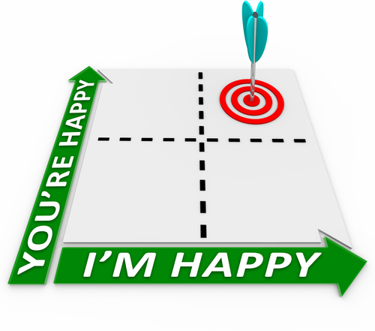
What is Expected of Me?
I don’t know/remember how to do proofs!
You are responsible for knowing/relearning/learning what was covered in CSCI 2112.
I started the assignment yesterday!
You need to start working on the assignments early.
I spent 20 hours on this assignment and could not figure out what to do or where to start!
If you are spinning your wheels, please come and talk to me.
I spent the last 10 hours debugging this assignment!
See above.
I will use the posted power point slides and not take notes
These slides are incomplete. Please take notes during lectures

Slide 10

What Should I Know?
Programming
Mathematical proofs
Testing and Debugging

Slide 11

Self-Assessment Quiz
There is a self-assessment quiz on Brightspace.
Used to gauge the expectations in this course.
Do this on your own and compare to the posted solution.

Slide 12

What Do I Need to Do Now?
Self-Assessment quiz [Recommended]
Get a Top Hat account. [Required]
We will start using Top Hat on Friday.
Check Brightspace regularly. [Required]
Check my Dal Email. [Required]

Slide 13
Course Representative
Our Course Rep is ???: ???@dal.ca
The Course Representative is a point of contact to facilitate and provide more timely feedback mechanisms to instructors and to the Faculty of Computer Science.
Additionally, Course Representatives can assist peers in navigating to the most appropriate support mechanism on campus. You can think of a CR as ‘the middle person’; a neutral point of contact for students to use when they don’t feel comfortable addressing an issue with the professor directly.

Slide 14
I really hate this slide.
30%
10%
15%
13%

Slide 15
Academic Integrity
Academic integrity means being honest in the fulfillment of your academic responsibilities thus establishing mutual trust.
Violations of intellectual honesty are offensive to the entire academic community, not just to the individual faculty member and students in whose class an offense occurs.
E.g., cheating on tests, plagiarism, falsification of experimental data, etc.
All cases of academic misconduct are automatically referred to the Faculty Academic Integrity Officer.
Suggested Guidelines:
Put pencils and pens away when discussing problem with other people
Acknowledge any help you received in your assignments: state name of person.
Write your own code! You may look at code all you want, but don’t cut and paste!

Slide 16
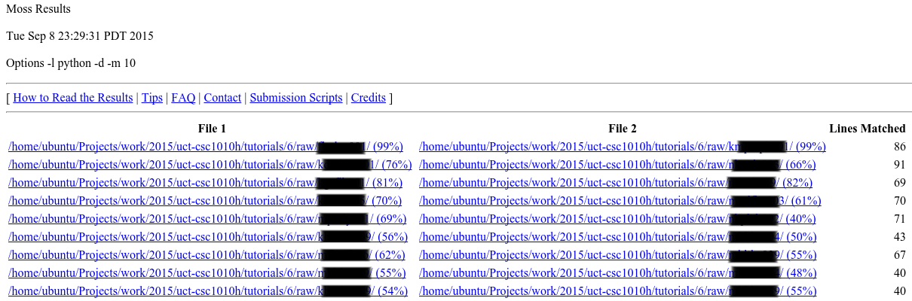
Moss: Software Similarity Detection Software https://theory.stanford.edu/~aiken/moss/
All submitted code will be passed through Moss which performs a pair-wise comparison of similarities

Slide 17
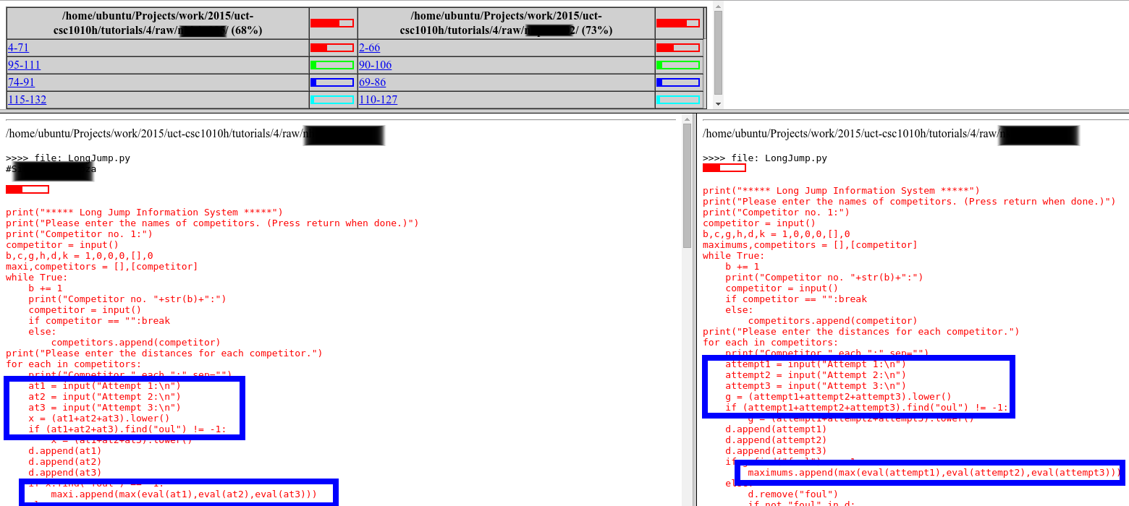
Moss: Software Similarity Detection Software https://theory.stanford.edu/~aiken/moss/
Moss even identifies which parts are similar.
If a student does not wish their assignments to be submitted to Moss,
they should contact the instructor.

Slide 18
Never …
Never email/send/copy your work to another student before the due date
Never use homework sites such as Chegg or Course Hero
If you are using the site, chances are another student is also …
Never copy and paste someone else’s code into your own assignment
Never type code from another source into your own assignment
Never write code while discussing the problem with other students

Slide 19
It’s OK to …
Discuss an assignment with another student or TA
Ask for help to debug your code (but don’t expect someone else to do the work)
Explain to someone else how to solve a problem
Use a whiteboard/blackboard/scrap paper to work out the problem, as long as you erase/destroy the board/paper after the discussion
Look at other people’s code, BUT take a brief break before writing your own

Slide 20
Typical Penalties for First-Time Offences ...
It is always better to take a 0 then to be caught.
Chances of being caught?
High!
Plagiarism:
0 on the assignment
6-month notation on transcript
Minor grade decrement, e.g. B→B-, C→C-, D→F
Contributing to the Commission of Plagiarism
6-month notation on transcript
Minor grade decrement, e.g. B→B-, C→C-, D→F
Cheating on a test / practicum
0 on the test
12-month notation on transcript
Minor grade decrement, e.g. B→B-, C→C-, D→F

Slide 21
Culture of Respect
Every person has a right to respect and safety.
Inclusiveness is fundamental to education and learning.
Misogyny and other disrespectful behaviour in our classrooms, on our campus, on social media, and in our community is unacceptable.
What to do:
Be Ready to Act
Identify the Behaviour
Appeal to Principles
Set Limits
Find or be an Ally
Be Vigilant

Slide 22
Why are we here?

Slide 23
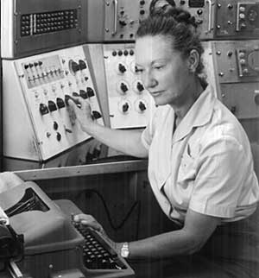
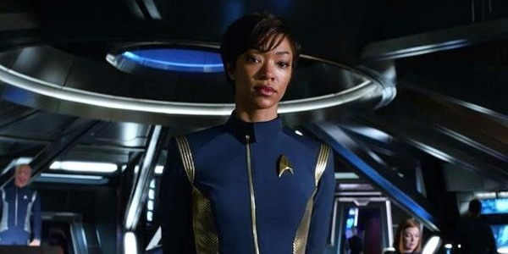
Motivation
Programmer’s Dream
Computer Reality
Natural language instructions:
“Computer schedule my courses for next year.”
Expressive
Easy
Ambiguous
Computers take very primitive instructions:
add $42, %ebp
movl %eax, %ecx
Simple and specific
Hard and Tedious
Unambiguous

Slide 24

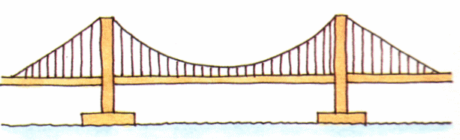
Programmer Reality
Programming Languages bridge the divide
for i in range(1, 10)
print i
Unambiguous
Expressive
Less Tedious

Slide 25
What’s this Course About?
Program Translation:
Computers only understand the low level
Need to translate all programs into the computer’s language
Language Features:
What features should a useful language have?
What tasks is a language suited for?
How do we implement these features?

Slide 26
Why Do We Care?
Idea: Languages are like tools in a toolbox.
Different languages for different tasks.
Sometimes we need to build our own for the task at hand.
Also …
Easier to learn new languages
Make better choices when deciding which language to use
Simulate useful features in other languages
Use languages more effectively

Slide 27
A Brief History of Languages
Stone Age Machine language → assembly language
Scientific FORTRAN (1957) → versions IV, . . . 1995
Structured ALGOL (1958) → Pascal (1971) Ada (1983)
Functional LISP (1959) → Scheme (1975), Common Lisp (1984)
Business COBOL (1959), APL (1960), SNOBOL (1962)
Home/Hobbiest BASIC (1964) → Visual Basic (1990)
Object Oriented Simula (1967) → Smalltalk (1980) → C++ (1985)
Imperative C (1972) → C++ (1985), Java (1995)
Scripting Perl (1987), Python (1990s), JavaScript (1995), PHP (1995), C# (2002)
Declarative Age Prolog (1973)

Slide 28
A Brief History of Languages
Stone Age | Machine language → assembly language
Scientific | FORTRAN (1957) → versions IV, . . . 1995
Structural | ALGOL (1958) → Pascal (1971) Ada (1983)
Functional | Lisp (1959) → Scheme (1975), Common Lisp (1984)
Business | COBOL (1959), APL (1960), SNOBOL (1962)
Home/Hobbiest | BASIC (1964) → Visual Basic (1990)
Object Oriented | Simula (1967) → Smalltalk (1980) → C++ (1985)
Imperative | C (1972) → C++ (1985), Java (1995)
Scripting | Perl (1987), Python (1990s), JavaScript (1995), PHP (1995), C# (2002)
Declarative | Prolog (1973)

Slide 29
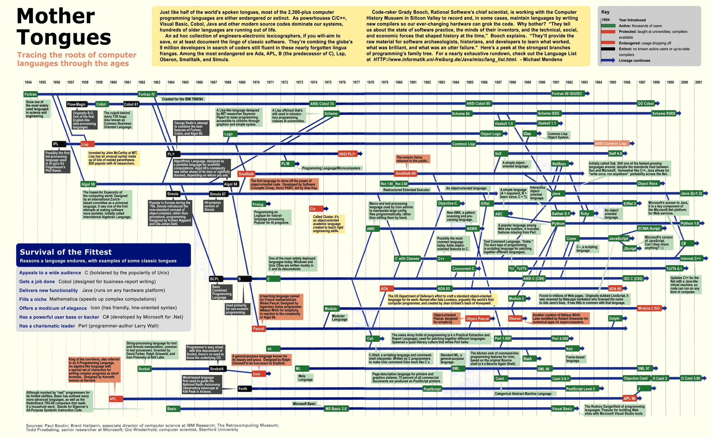
If you can read this you don’t need glasses

Slide 30
Why so many languages?
Evolution
Specific purposes
Programmer preference

Slide 31
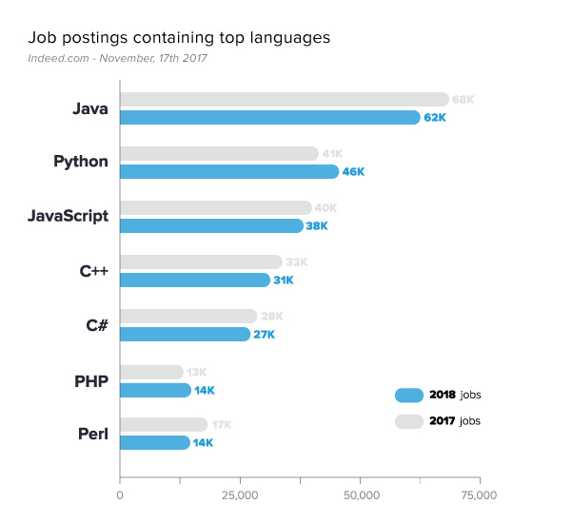
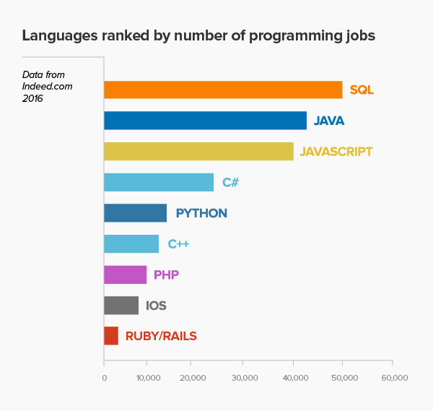
What make languages popular?
Availability
Learnability
Expressiveness
Ease of use
Install base
SQL
Retrieved April 30, http://www.codingdojo.com/blog/9-most-in-demand-programming-languages-of-2016/
https://www.codingdojo.com/blog/7-most-in-demand-programming-languages-of-2018/

Slide 32
How do we categorize languages?
Answer: Programming Paradigms
Imperative : (von Neunmann model)
FORTRAN
COBOL
BASIC
OO languages
Functional :
Lisp,
Scheme,
ML
Declarative :
Prolog
Visicalc
Spreadsheets

