Slide 1
Program Translation
CSCI 3136: Principles of Programming Languages

Slide 2
Agenda
Announcements
Lecture Contents
Trial Top Hat Quiz
Program Translation
Introduction to Formal Languages
Regular Languages

Slide 3
What makes languages useful?
Human Readable / Writable Code
translation
Machine Readable Code

Slide 4
Program Translation
Motivation
All programs (unless written in machine code) are meaningless (to a computer)
These programs must be translated into machine code
Without this step all languages would be academic
Forms of Program Translation:
Compilation:
Translates program to machine code
User can then run the machine code on the computer
Interpretation:
Executes program as it is translating it

Slide 5
Interpretation
Program + Input
Interpreter
Execution
Output

Slide 6
Features of Interpretation
Faster development (maybe)
More expressiveness (dynamic program generation)
Late binding and dynamic features
Interpreters translate programs as they run them
Perform program analysis (syntax and semantic) during execution
e.g., Perl, Python, Basic,
You can get a syntax error during execution

Slide 7
Compilation
Translate once
Run Many
Program
Compiler
Executable
Executable + Input
Execution
Output

Slide 8
Features of Compilation
Stand-alone code
Efficient code and execution
Compilers translate programs into machine, intermediate or byte-code representations
Perform all syntax and semantic analysis up front.
e.g., Java, C, Fortran, etc.
You will never get a syntax error during execution
For the first part of the course we focus on compilation

Slide 9
Aside: The Best of Both Worlds?
Just-in-time compiling (Perl, Java, etc)
Include interpreter in executable
Late binding and dynamic features

Slide 10
Phases of Compilation
Source Code
Scanner (Lexical Analysis)
Token Stream
Parser (Syntax Analysis)
Front End
Parse Tree
Target Independent Code Generator (Semantic Analysis)
Abstract Syntax Tree or Target Independent Code Rep.
Target Dependent Code Generator
Object (machine) Code
Back End
Linker
Executable

Slide 11
Example: Source Code
# This function takes 2 positive integers
# and prints their GCD
def gcd(m,n):
while m != n:
if m > n:
m = m - n
else:
n = n - m
print m

Slide 12
Lexical Analysis
Group characters into tokens
E.g., keywords, literals, identifiers, punctuation
Strip out items ignored by the compiler
E.g., white space and comments
Flag any unknown tokens as errors

Slide 13
Example: Token Stream
# This function takes 2 positive integers
# and prints their GCD
def gcd(m,n):
while m != n:
if m > n:
m = m - n
else:
n = n - m
print m
def
gcd
(
m
,
n
)
:
while
m
!=
n
:
if
m
>
n
:
m
=
m
-
n
else
:
n
=
m
-
n
print
m

Slide 14
Syntax Analysis
Organize tokens into a parse tree according to language grammar
E.g. an assignment statement is of the form:
lvalue = expression
Ensure token sequence conforms to the grammar
E.g., generate syntax errors if not.

Slide 15
Example: Parse Tree
function
def
name
(
arglist
)
block
gcd
arg
,
arglist
statement
block
m
arg
arglist
while_stmt
statement
block
n
𝛜
while
bool_exp
:
block
𝛜
expr
rel_op
expr
statement
block
print
m
!=
n
if_stmt
𝛜
m
if
bool_exp
:
block

Slide 16
Semantic Analysis / Code Generation
Generate symbol table of all identifiers
Ascribe meaning to all identifiers
Condense abstract syntax tree to only important nodes
Generate intermediate code for each node
Ensure the abstract syntax tree is meaningful
E.g., foo() makes no sense if foo is a variable instead of a function name

Slide 17
Example: Symbol Table and Abstract Syntax Tree
# This function takes 2 positive integers
# and prints their GCD
def gcd(m,n):
while m != n:
if m > n:
m = m - n
else:
n = n - m
print m
gcd(m,n)
while
print
!=
if
m
m
n
>
=
else
Symbol Table
Index | Symbol | type
0 | gcd | function name
1 | print | built-in function
2 | m | parameter
3 | n | parameter
m
n
m
-
=
m
n
n
-
m
n

Slide 18
Example: Code Generation
Generate code for each statement using the abstract syntax tree.
E.g., m = m - n
For nodes: m − n
move idx2 → r1
move idx3 → r2
sub r1, r2 → r3
move r3 → idx4
For node: m =
move idx4 → r1
move r1 → idx2
=
m
-
m
n
Index | Symbol | type
0 | gcd | function name
1 | print | built-in function
2 | m | parameter
3 | n | parameter
4 | tmp1 | temporary var

Slide 19
Where do we start?
At the beginning: Lexical Analysis
We need a scanner:
Source Code
Scanner (Lexical Analysis)
Token Stream

Slide 20
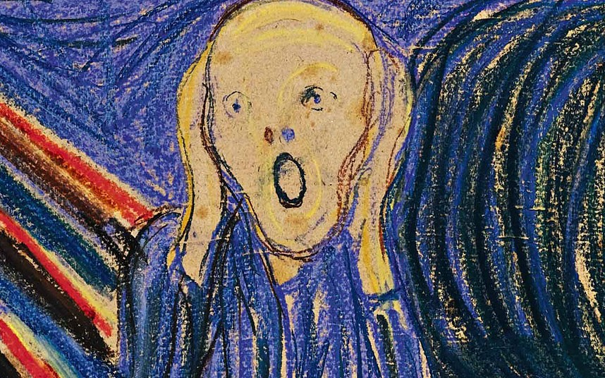
How Do We Build a Scanner?
Need to be able to
Specify unambiguously the tokens of a language
Build a scanner from the specification
Generate the token stream in one pass (no going back)
How do we do this?
Specify the tokens of a language?
Generate a scanner from the specification?
We now need some formal language theory

Slide 21
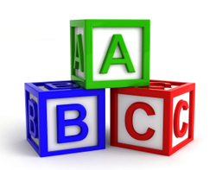

Definitions
A language L is set of strings over an alphabet Σ
Alphabet Σ: is a finite set of characters (symbols)
Examples
0, 1
a, b, ... z
x, y, z
A string σ is a finite sequence of characters from Σ
Examples
1001001
alex
yyz
ε (epsilon) denotes the empty string (no characters)

Slide 22
More Definitions
|σ| denotes the length of σ (# of chars)
Examples
|ε| = 0
|1001001| = 7
|alex| = 4
|yyz| = 3
Σ^{i} denotes languages (sets of strings) of length i over Σ
Example: If Σ = {a, b}
Σ⁰ = {ε}
Σ¹ = Σ = {a,b}
Σ² = ΣΣ = {aa,ab,ba,bb}
Σ³ = ΣΣΣ = {aaa,aab,aba,abb,baa,bab,bba,bbb}
Σ∗ = Σ⁰ ∪Σ¹ ∪Σ²...= ∪_{i} Σ^{i} = set of all words composed of characters in Σ.
This is called the Kleene-* notation.
Note: If language L is over alphabet Σ, then L ⊆ Σ∗
ST = {st|s ∈ S,t ∈ T}

Slide 23
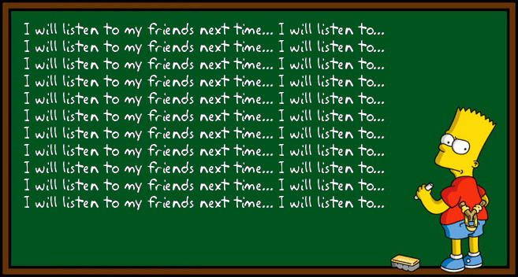
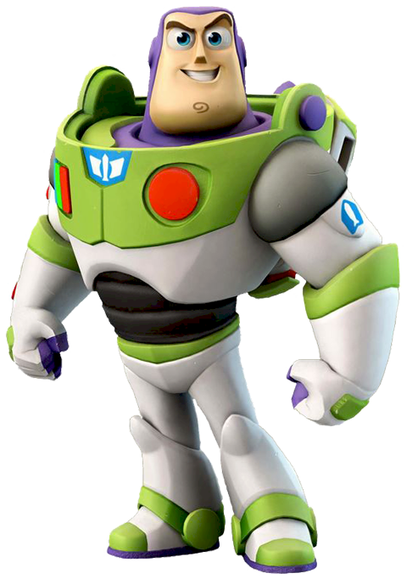
Examples of Languages
Finite Languages
Σ^{i} for any fixed i
English words over the Latin alphabet
Java keywords
Infinite Languages
Σ∗
Set of all English sentences
Set of all Java programs
{0^{n}|n ≥ 0}
{0^{n}1^{n}|n ≥ 0}
{a^{p}|p ∈ PRIMES}
{Σ⁺@Σ⁺(. Σ⁺)^{n}| Σ = {a,b,c,...z},n ≥ 0}

Slide 24
Types of Languages
Type | Name | Recognizer | Compiler Phase
3 | Regular | DFA | Scanner/Tokenizer
2 | Context Free | NPDA | Parser
1 | Context Sensitive | Linearly bound NTMs | Semantic Analyzer / Code Generator
0 | Recursive Enumerable | Turing Machines
Note: Tokens of a programming language almost always form a regular language.
Errrrr… What’s a regular language?

Slide 25
Definition of Regular Languages
Recursive Definition:
Base Cases:
∅ (Empty language)
{ε} (Language consisting of the empty string)
{a}, a ∈ Σ (Language consisting of one symbol)
are all regular languages
Inductive Step: If L₁ and L₂ are regular then so are
L₁L₂ = {στ|σ ∈ L₁,τ ∈ L₂}
L₁ ∪ L₂ = {σ|σ ∈ L₁ ∨ σ ∈ L₂}
L₁∗ = {σ₁σ₂σ₃ … σ_{i-1}σ_{i} |σ_{j}∈L₁, i ≥ 0}

Slide 26
Examples
Regular Languages
{a,ab,abc}
Any finite language
{a}∗
{a,b,c}∗
{1^{n}0|n > 0}
Set of all positive integers (base 10)
{ΣΣ*@ ΣΣ*(. ΣΣ*)^{n}| Σ = {a,b,c,...z},n ≥ 0}
Non-regular languages
{a^{i}b^{j}c^{k}|i > 0,j > i,k > j}
{0^{n}1^{n}|n ≥ 0}
{a^{p}|p ∈ PRIMES}
Set of all correct Java programs.
Does this notation look somewhat familiar?

