Slide 1
Equivalence of Regular Languages, Expressions, and Automata
CSCI 3136: Principles of Programming Languages

Slide 2
Agenda
Announcements
Assignment 1 is out and due May 24
Readings:
Today: 2.2.1
Next: 2.2.1
Note: I recommend using alternative texts for this part of the course:
E..g, Hopcorft et al, “Introduction to Automata Theory”
Lecture Contents
Regular Languages Equivalence Theorem
Equivalence between RLs and Res
Equivalence between RE’s and NFAs
Equivalence between NFAs and DFAs
Minimization of DFAs (time permitting)

Slide 3
Are these all the same?
We have discussed a variety of specifications: RLs, RE, DFAs, NFAs
RLs: a class of languages
RE a way to specify RLs
DFAs: a way to implement scanners for RLs
NFAs: a simpler way to implement scanners for RLs
Questions:
Are these all of equal power?
Are NFAs same as DFAs?
Do REs specify only regular languages?

Slide 4
Regular Languages Equivalence Theorem
Thm: The following statements are equivalent:
L is a regular language.
L is the language described by a regular expression.
L is recognized by an NFA.
L is recognized by a DFA.
We will prove: (i) ≡ (ii) ≡ (iii) ≡ (iv)

Slide 5
Regular Languages are equivalent to Regular Expressions
Every regular language can be specified by a regular expression.
Every regular expression specifies a regular language.
Idea: There is a one-to-one correspondence between the 2 definitions.
Apart from notation, the recursive definitions are identical.
Operation | Regular Language | Regular Expression
Empty Language | ∅ | ∅
Empty String | {ε} | ε
Single character | {a}, a ∈ Σ | a
Disjunction | L₁ ∪ L₂ | R₁|R₂
Concatenation | L₁L₂ | R₁R₂
Kleene-* | L∗ | R*

Slide 6
Regular Expressions are Equivalent to NFAs
Proof: We will show that
For each RE R there is an NFA M that recognizes L(R)
For each NFA M there is an RE that specifies L(M)
We do part 1 first.
Idea: For each RE base case and inductive step we can construct a corresponding NFA, hence for any RE, we can construct an NFA.
Recall the base cases:
Empty Language: ∅
Empty String: ε
Single character: a
And inductive steps:
Disjunction: R₁|R₂
Concatenation: R₁R₂
Kleene-*: R∗

Slide 7
NFA for each RE Base Case.
Recall: An NFA M = (Q,Σ,δ,q_{S},F)
Empty Language: ∅ : Q = {q₁}, F = ∅, δ = ∅
Empty String: ε : Q = {q₁}, F = {q₁}, δ = ∅
Single character: a : Q = {q₁,q₂}, F = {q₂}, δ(q₁,a) = q₂
q₁
q₁
q₁
a
q₂

Slide 8
NFAs for each RE Inductive Step
M(R₁|R₂)
Notation:
M(R₁) = (Q₁,Σ,δ₁,q₁,F₁)
M(R₂) = (Q₂,Σ,δ₂,q₂,F₂)
Disjunction: R₁|R₂ :
M(R₁|R₂) = (Q,Σ,δ,q₀,F)
Q = Q₁ ∪ Q₂ ∪ {q₀},
F = F₁ ∪F₂,
δ = δ₁ ∪ δ₂ ∪ {δ(q₀,ε) = {q₁,q₂}}
Concatenation: R₁R₂:
M(R₁R₂) = (Q,Σ,δ,q₁,F₂)
Q = Q₁ ∪Q₂
δ = δ₁ ∪ δ₂ ∪ {δ(q,ε) = {q₂} | q ∈ F₁}
Kleene-*: R₁∗ :
M(R₁*) = (Q₁,Σ,δ,q₁,F₁)
δ = δ₁ ∪ {δ(q₁,ε) = {q ∈F} ∪ {δ(q,ε) = {q₁} | q ∈ F₁}
M(R₁)
ε
q₀
M(R₂)
ε
M(R₁R₂)
M(R₁)
ε
M(R₂)
F₁
ε
M(R₁*)
M(R₁)
q₁
F₁
ε

Slide 9
Back to Regular Expressions are Equivalent to NFAs
Proof: We will show that
For each RE R there is an NFA M that recognizes L(R) ✅
For each NFA M there is an RE the specifies L(M)
Part 2 is a bit trickier.
Proof Idea:
Treat NFA as a GNFA (Generalized NFA)
Edges are labeled by REs, not just characters
If δ(q₁,α) = q₂, the (q₁,αβ) → (q₂,β)
Start with the NFA (which is a GNFA)
Collapse the GNFA, one state at a time into an RE
NFA
GNFA₁
GNFA₂
GNFA_{k}
RE

Slide 10
NFA to RE To Do List
NFA M
F
q_{F}
Normalize NFA by ensuring only one final state.
Add ε transitions and a new final state if needed
Collapse GNFA to a two state start/finish GNFA
one state at a time
Transform the two state GNFA to an RE
RE = R₁∗ R₂ ((R₃R₁∗R₂) | R₄)∗
NFA
GNFA₁
GNFA₂
…
R₂
RE
q₀
q_{F}
GNFA_{k}
R₃
R₁
R₄

Slide 11
Collapsing the GNFA
GNFA_{i} q
Select state q to remove
Identify adjacent states
Identify all paths through q
Remove q from each path
Remove state q
r
GNFA_{i+1}
r→q→r
r→q→s
r→q→t
s→q→r
s→q→s
s→q→t
t→q→r
t→q→s
t→q→t
q
r
s
t
s
t

Slide 12
Removing a State from a Path
R₄
r
R₁
q
R₃
s
R₂
r
R₄|R₁R₂*R₃
s

Slide 13
Example for NFA to RE Process
0
q₁
q₂
0
0
ε
q₀
1
q_{F}
0
11
1
ε
1
q₃
q₄
1

Slide 14
Regular Languages Equivalence Theorem
Thm: The following statements are equivalent:
L is a regular language.
L is the language described by a regular expression.
L is recognized by an NFA.
L is recognized by a DFA.
We will prove: (i) ≡ (ii) ≡ (iii) ≡ (iv)
✅
✅

Slide 15
NFAs are Equivalent to DFAs
Proof: We will show that
For each DFA M that accepts L there is an NFA N that recognizes L
For each NFA N that accepts L there is an DFA M that recognizes L
We do part 1 first.
This is easy. Every DFA is by definition also an NFA.
The second part is a bit trickier. ☺

Slide 16
For each NFA N(L) there is a DFA M(L)
Q
q₄
q₀
q₃
q₁
q₂
Define
NFA N = (Q,Σ,δ,q₀,F)
DFA M = (Q′,Σ,δ′,q₀′,F′)
Where
q₀′ = ε−close(q₀)
ε−close(q) = {p ∈ Q | δ(q, ε) = p}
Set of states form q₀ reachable by ε transitions
Note: ε−close(P) = ∪_{p∈P} ε−close(p)
Each state in Q’ is represented by a subset of Q
I.e., Q’ ⊆2^{Q}
We will build Q’ iteratively:
Start with the start state q₀’∈Q’
For each q’∈Q′ and a∈Σ compute p’ = δ’(q’,a)
Add p’ to Q’ if p’ ∉ Q’
Repeat steps until no more states are added.
q₁
ε
q₂
ε
0
q₀
{q₀,q₁,q₂} = ε-close(q₀)
q₃
q₄
0
0
Q’
{q_{0 ,}q_{1 ,}q₂}
{q_{3 ,}q₄}
{q₄ }
{q_{5,}q_{6,}q₇}

Slide 17
The δ’ Function for DFA M(L)
The transition function δ’(q’,a) = p’ where
p‘ = ε−close(P)
P = {δ(q,a) | q ∈ q’′}
Example: δ’({q₀,q₁,q₂},0) = {q₃,q₄,q₅}
Lastly, F′ ={q′∈Q′|F∩q′ ≠ ∅}
Every state in F ′ contains a state of an NFA that was in its final set.
Example: {q₂,q₃,q₅}∈F’
In the worst case,the DFA is exponentially bigger than the NFA.
q₁
ε
q₂
ε
0
q₀
q₃
q₄
0
0
ε
q₅

Slide 18
Example L=(0|1)*1(0|1)(0|1)
q₀
1
q₁
0,1
q₂
0,1
q₃
q₀’ = {q₀}
Q’ = (see table)
δ’ = (see table)
F’ = (bolded states)
0,1
State | 0 | 1
{q₀} | {q₀} | {q₀,q₁}
{q₀,q₁} | {q₀,q₂} | {q₀,q₁,q₂}
{q₀,q₂} | {q₀,q₃} | {q₀,q₁,q₃}
{q₀.q₁,q₂} | {q₀,q₂,q₃} | {q₀,q₁,q₂,q₃}
{q₀,q₃} | {q₀} | {q₀,q₁}
{q₀,q₁,q₃} | {q₀,q₂} | {q₀,q₁,q₂}
{q₀,q₂,q₃} | {q₀,q₃} | {q₀,q₁,q₃}
{q₀,q₁,q₂,q₃} | {q₀,q₂,q₃} | {q₀,q₁,q₂,q₃}

Slide 19
Example L=(0|1)*1(0|1)(0|1)
State | Q’ | 0 | 1
{q₀} | q₀’ | {q₀} | {q₀,q₁}
{q₀,q₁} | q₁’ | {q₀,q₂} | {q₀,q₁,q₂}
{q₀,q₂} | q₂’ | {q₀,q₃} | {q₀,q₁,q₃}
{q₀.q₁,q₂} | q₃’ | {q₀,q₂,q₃} | {q₀,q₁,q₂,q₃}
{q₀,q₃} | q₄’ | {q₀} | {q₀,q₁}
{q₀,q₁,q₃} | q₅’ | {q₀,q₂} | {q₀,q₁,q₂}
{q₀,q₂,q₃} | q₆’ | {q₀,q₃} | {q₀,q₁,q₃}
{q₀,q₁,q₂,q₃} | q₇’ | {q₀,q₂,q₃} | {q₀,q₁,q₂,q₃}
q₄
0
0
1
q₂
0
0
1
0
q₀
1
q₁
q₅
q₆
1
0
1
0
0
1
q₃
q₇
1
1

Slide 20
Example L=(aa|bb)* | (ab|ba)*(a|b)
q₀’ = {q₀,q₁,q₄,q₇}
Q’ = (see table)
δ’ = (see table)
F’ = (see bolded entries)
State | a | b
{q₀,q₁, q₄,q₇} | {q₂,q₅,q₇} | {q₃,q₆,q₇}
{q₂,q₅,q₇} | {q₁,q₇} | {q₄}
{q₃,q₆,q₇} | {q₄} | {q₁,q₇}
{q₁,q₇} | {q₂} | {q₃}
{q₄} | {q₅,q₇} | {q₆,q₇}
{q₂} | {q₁,q₇} | ∅
{q₃} | ∅ | {q₁,q₇}
{q₅,q₇} | ∅ | {q₄}
{q₆,q₇} | {q₄} | ∅
1
q₂
a
b
q₃
a
q₁
b
q₀
ε
ε
q₇
ε
a,b
b
q₄
b
q₅
a
a
q₆

Slide 21
Minimization of Automata
Motivation: To build a scanner, we need to build a DFA
The simpler a DFA is, the more efficient it is.
So, we want to build the smallest DFA possible
Process:
Build a DFA to recognize L ✅
Minimize it.
A DFA is minimal if it has the minimum number of states necessary to recognize L

Slide 22
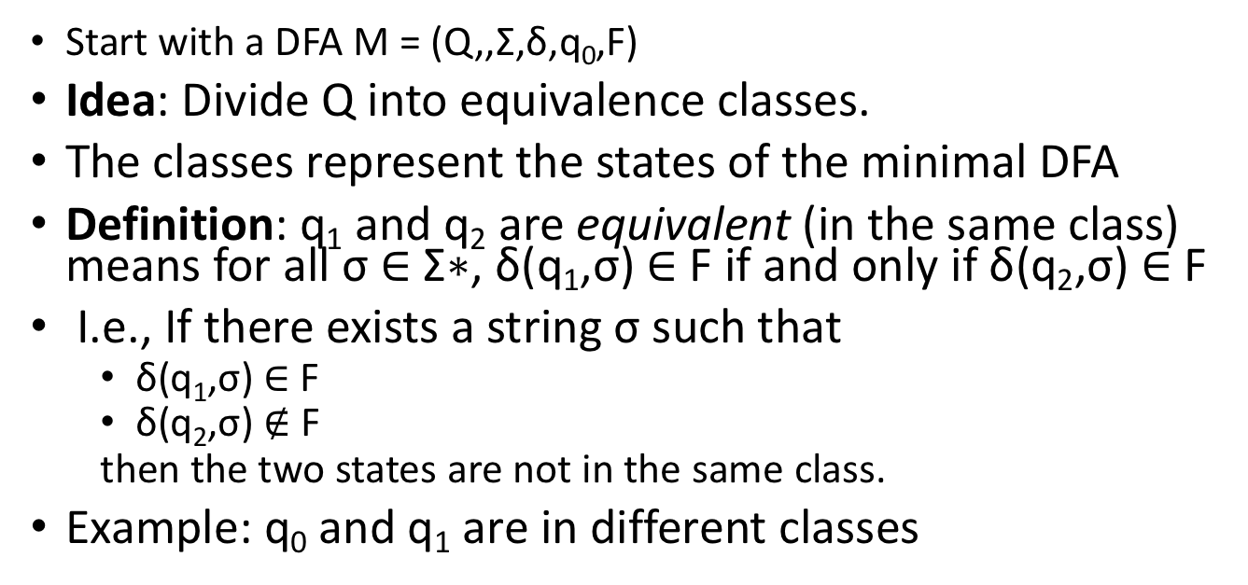
Equivalence Classes
Q
q₀
q₃
q₂
q₁
Start with a DFA M = (Q,,Σ,δ,q₀,F)
Idea: Divide Q into equivalence classes.
The classes represent the states of the minimal DFA
Definition: q₁ and q₂ are equivalent (in the same class) means for all σ ∈ Σ∗, δ(q₁,σ) ∈ F if and only if δ(q₂,σ) ∈ F
I.e., If there exists a string σ such that
δ(q₁,σ) ∈ F
δ(q₂,σ) $∉$ F
then the two states are not in the same class.
Example: q₀ and q₁ are in different classes
q₀
1
q₁
1
q₂
0,1
0
0

Slide 23
Minimization Procedure
Initially all states are either accepting or not
If there is a class C and character a ∈ Σ such that
{δ(q_{i},a)|q_{i} ∈ C} are in k > 1 equivalence classes
Then Split C into k classes C_{j} such that
δ(q_{i}, a), where q_{i} ∈ C_{k}, are in the same equivalence class.
Repeat until no more splits are needed.

Slide 24
Example 1
Q
C₀
C₁
0
q₀
q₃
1
q₂
q₁
q₂
q₀
1
q₁
0
0
0
1
q₃
1
 | Q | 0 | 1
C₀ | q₀ | C₀ | C₁
 | q₂ | C₀ | C₁
C₁ | q₁ | C₁ | C₀
 | q₃ | C₁ | C₀

Slide 25
Example 2
Q
C₀
C₁
q₀
q₃
0
q₂
q₂
q₁
0
q₀
q₁
1
1
1
0
0
q₃
1
 | Q | 0 | 1 | 0 | 1 | 0 | 1
C₀ | q₀ | C₀ | C₀ | C₀ | C₀
 | q₂ | C₀ | C₀ | C₀ | C₂
 | q₁ | C₀ | C₁
C₁ | q₃
C₃
C₂

