Slide 1
Building a Scanner and Properties of RLs
CSCI 3136: Principles of Programming Languages

Slide 2
Agenda
Announcements
Assignment 1 is out and due May 24
Assignment 2 is out and due May 31
Professor Zeh will give the May 30 lecture
Readings:
Today: 2.2.1
Next: 2.2.1
Note: I recommend using alternative texts for this part of the course:
E..g, Hopcorft et al, “Introduction to Automata Theory”
Lecture Contents
Minimization
Scanner Implementations
Properties of Regular Languages

Slide 3
Learning Centre Office Hours
Lauchlan and Kaari are the TAs for CSCI 3136
Holds office hours in the Learning Centre on
Kaari: Thursday 1 – 3pm
Lauchlan: Monday 12 – 2pm
Lauchlan: Friday 11 - 12
Email Lauchlan to meet outside of above hours: lauchlan@dal.ca
The Learning Center is in the Goldberg CS Building (CS 233)

Slide 4
Minimization of Automata
Motivation: To build a scanner, we need to build a DFA
The simpler a DFA is, the more efficient it is.
So, we want to build the smallest DFA possible
Process:
Build a DFA to recognize L ✅
Specify L with a regular expression
Create an NFA that recognizes L
Convert NFA to DFA
Minimize it.
A DFA is minimal if it has the minimum number of states necessary to recognize L

Slide 5
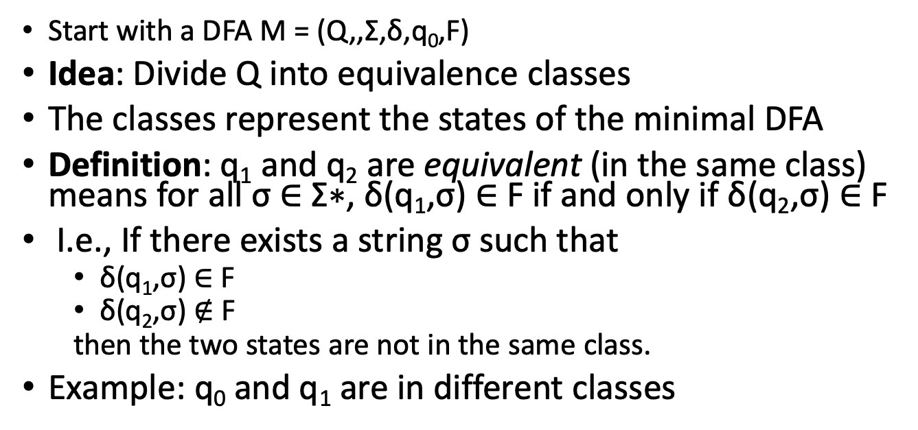
Equivalence Classes
Q
q₀
q₃
q₂
q₁
Start with a DFA M = (Q,,Σ,δ,q₀,F)
Idea: Divide Q into equivalence classes
The classes represent the states of the minimal DFA
Definition: q₁ and q₂ are equivalent (in the same class) means for all σ ∈ Σ∗, δ(q₁,σ) ∈ F if and only if δ(q₂,σ) ∈ F
I.e., If there exists a string σ such that
δ(q₁,σ) ∈ F
δ(q₂,σ) $∉$ F
then the two states are not in the same class.
Example: q₀ and q₁ are in different classes
q₀
1
q₁
1
q₂
0,1
0
0

Slide 6
Minimization Procedure
Initially all states are either accepting or not
If there is a class C and character a ∈ Σ such that
{δ(q_{i},a)|q_{i} ∈ C} are in k > 1 equivalence classes
If there exists q, r ∈ C where q’ = δ(q,a) and r’ = δ(r,a)
Such that q’ and r’ are not in the same equivalence class
Then Split C into k classes C_{j} such that
δ(q_{i}, a), where q_{i} ∈ C_{k}, are in the same equivalence class.
Repeat until no more splits are needed.
Q
a
q₃
q₀
q₂
a
q₁

Slide 7
Example 1
Q
C₀
C₁
0
q₀
q₃
1
q₂
q₁
q₂
q₀
1
q₁
0
0
0
1
q₃
1
0
 | Q | 0 | 1
C₀ | q₀ | C₀ | C₁
 | q₂ | C₀ | C₁
C₁ | q₁ | C_{O} | C₁
 | q₃ | C₀ | C₁
C₀
1
C₁
1
0

Slide 8
Example 2
Q
C₀
C₁
q₀
q₃
0
q₂
q₂
q₁
0
q₀
q₁
1
1
1
0
0
q₃
1
 | Q | 0 | 1 | 0 | 1 | 0 | 1
C₀ | q₀ | C₀ | C₀ | C₀ | C₀
 | q₁ | C₀ | C₀ | C₀ | C₂
 | q₂ | C₀ | C₁
C₁ | q₃
C₃
C₂

Slide 9
Implementing a Scanner
Scanners produce a token stream from a character stream
Token = (token type, value)
Scanners operate in one of two modes:
Complete pass mode: produces the entire token stream at once
Iterative mode: produces the next token when requested by parser
Note: Scanners typically produce the longest possible valid tokens
Example: abc42 can either be tokenized as
(identifier, “abc”) (int, 42)
(identifier, “abc42”)
The latter is what will be produced.

Slide 10
Implementation Options
Case-based (ad-hoc)
Implemented by hand
Transitions are implemented using switch or if statements
Table-based (ad-hoc)
Implemented by hand
Transitions are implemented using table lookup
Table-based (generated)
Generated from a series of REs (e.g., lex, flex)
Transitions are implemented using table lookup

Slide 11
Case-based Scanners
Use a state variable to keep track of what you have seen so far.
Use a nested switch statement to decide on transition
Outer switch switches on state
Inner switches switch on character
Each inner case represents a transition
If no transition is possible
Current token is done
Reset state to NEW_TOKEN
Return completed token
Reset current token to empty
Repeat until all input is read
Note: The code is long and tedious but simple
while input available:
c = next_char()
switch(state):
case NEW_TOKEN:
switch(c) # switch on character
case ‘C’:
state = STATE_2
token.add(c)
break
…
case STATE_1:
switch(c) # switch on character
…
case STATE_2:
switch(c) # switch on character
…
…

Slide 12
Case-based Scanners Example
Use a state variable to keep track of what you have seen so far.
Use a nested switch statement to decide on transition
Outer switch switches on state
Inner switches switch on character
If the next character is part of the next token,
Return current token if using iterative mode
Save current token and reset state if using complete pass mode
Keep doing this as long you have input
state = NEW_TOKEN
while input available:
c = next_char()
switch(state):
case NEW_TOKEN:
switch(c):
case [ \n\t\r]: # white space
break
case [0-9]:
state = NUMBER
token.add(c)
break
case [a-z]:
state = WORD
token.add(c)
break
…

Slide 13
Table-based Scanners
State | Typ | 0 | 1 | … | a | b | c | … | z | = | …
0 | New | 1 | 1 | 1 | 3 | 3 | 3 | 3 | 3
1 | Int | 1 | 1 | 1 | X | X | X | X | X |  | 2
2 | Dbl |  |  |  | X | X | X | X | X
3 | ID | X | X | X
4 | KW | X | X | X
… | …
next_token():
state = 0
init(token)
while input available:
c = next_char()
ns = Tab[state][c]
if ns == X:
undo(c)
break
state = ns
token.add( c )
typ = Table[state][TYP]
return (token, typ)

Slide 14
Table based (auto generated)
%{
#include <string.h>
#include "y.tab.h"
%}
D [0-9]
NUM {D}+
INT "-"?{NUM}
ID [A-Za-z_][A-Za-z0-9_]*
WS [\t\ \r\n]
%%
<<EOF>> { return(END_OF_FILE);}
while { return(KW_WHILE);}
if { return(KW_IF);}
...
A script such as the one on the left is fed into a scanner generator
E.g., flex, lex, etc
The script contains regular expressions and actions.
The generator generates code that performs the specific actions when the corresponding token is encountered.
foo.l script
flex
foo.c

Slide 15
Generating a Scanner
Develop RE
Minimize DFA
Generate Table
Transform REs to NFA
Transform NFA to DFA
Scanner generation can be completely automated except for the first step.

Slide 16
Note: These are extended DFAs
Token type, value and location are returned, not (accept/reject)
A different accepting state is used for each token type
Keyword and identifiers are treated separately (both look the same)
Keywords are encoded in REs or stored in a hash-table.
Backtracking to last accepted state is done to find longest token
Question: How do we ensure that our tokens are representable by REs?

Slide 17
Are All Tokens Regular?
Our theory/scanners only work for regular languages
Tokens are typically regular (How do we know?)
What happens when we combine tokens?
Do the languages remain regular?
It depends...

Slide 18
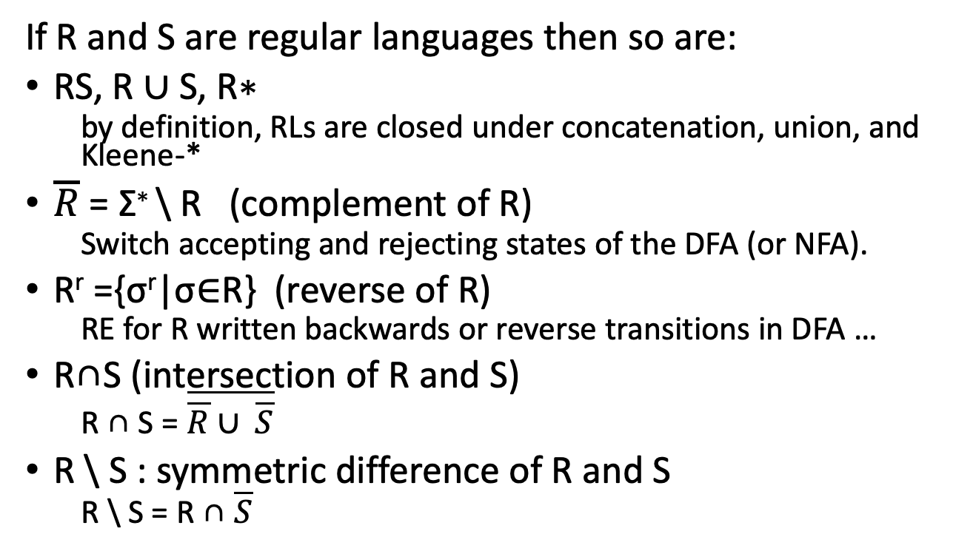
Properties of Regular Languages
If R and S are regular languages then so are:
RS, R ∪ S, R∗
by definition, RLs are closed under concatenation, union, and Kleene-*
$\overline{R}$ = Σ∗ \ R (complement of R)
Switch accepting and rejecting states of the DFA (or NFA).
R^{r} ={σ^{r}|σ∈R} (reverse of R)
RE for R written backwards or reverse transitions in DFA …
R∩S (intersection of R and S)
R ∩ S = $\overline{\overline{R}∪ \overline{S}}$
R \ S : symmetric difference of R and S
R \ S = R ∩ $\overline{S}$

Slide 19
Examples:
Show that L = {a^{p} | p is not prime} is not regular.
Recall that {a^{p} | p is prime} is not regular
Show that L = {a^{p}b^{q} | p or q is prime} is not regular.
Show that L = {a^{p}a*a^{p} | p is prime} is regular.

Slide 20

Nonregular Languages
Problem: Not all languages are regular!
E.g. L = {0^{n}1^{n}|n >= 0} is not regular.
Intuition: We need to keep track of how many 0’s we encounter.
A DFA has a finite number of states, so beyond that number we cannot keep track.
How do we prove this formally?
The Pumping Lemma!

Slide 21
Intuition
DFA M
10 states
y
z
y
xyzyz
x
z
q₀
xyzyyxxzx
q₀
x
y
xyzyyxxzxyzyz
z
x
x(yzyyxxzx)^{i}yzyz
x
Any string of this form is accepted!
Observation: If a DFA with n states reads a string of length n or greater, one or more states will be visited multiple times (there will be a cycle).

Slide 22
The Pumping Lemma
For every regular language L, there exists a constant n such that every σ ∈ L, where |σ| ≥ n, can be divided into three substrings σ = αβγ with the following properties:
|αβ|≤n
|β| > 0,and
αβ^{k}γ∈L,∀k≥0
We can use this Lemma to show that a given language is non-regular.

Slide 23


Using the Pumping Lemma is like an Argument with the Devil
I think L is regular.
αβγ
n
I don’t.
I choose n.
I choose 𝞼∈L
I get to divide σ into αβγ
I choose j such that
αβ^{j}γ ∉ L
Hence, L is not regular!
I win

Slide 24
Applying the Pumping Lemma
Procedure: To show that L is not regular
Convince yourself L is not regular (intuition)
Assume that L is regular and that there is a constant n as stated by the Pumping Lemma
Select σ ∈ L such that
|σ| > n
σ = αβγ such that for all α and β
|αβ| ≤ n
|β| > 0
Show that there exists a j ≥ 0 such that αβ^{j}γ ∉ L
But according to Pumping Lemma, σ ∈ L.
Contradiction!
Therefore L is not regular.
σ will (typically) be a function of n
HARD
PART

Slide 25
Example: Use the Pumping Lemma
Show that L = {0^{m}10^{m}|m ≥ 0} is not regular.
Proof by contradiction: Assume L is regular.
If L is regular, then there exists an n, by the PL
Select σ = 0^{n}10^{n}
Therefore, for all α and β
αβ = 0^{p}, because p ≤ n
β = 0^{j}, 0 < j ≤ p
By the PL, αβ²γ∈L
But αβ²γ = 0^{n+j}10^{n} ∉ L
Contradiction!
n
n
00…0
1
00…0
σ
p
00…0
αβ
j
00…0
00…0
n+j
n
α
β
00…0
00…0
00…0
1
00…0
α
β
β

Slide 26
Examples
L = {a^{i}b^{j}|i < j}
L = {a^{p}|p is prime}
L = {a^{i}b^{j} | i = j mod 3}
This one is actually regular
Note: We cannot use the Pumping Lemma to prove a language is regular.
Question: How do you show a language is regular?
Construct a regular expression for the language
Construct an NFA that recognizes the language
Construct the language from known Regular Languages using closure properties of regular languages.

