Slide 1
Recursive Descent and Pushdown Automata
CSCI 3136: Principles of Programming Languages

Slide 2
Agenda
Announcements
Assignment 4 is out and due June 19.
Midterm next week: June 19, 10 – 11:30 in CHEB 170.
Readings:
Today: 2.3.0, 2.3.1
Note: I recommend using alternative texts for this part of the course:
E.g., Hopcorft et al, “Introduction to Automata Theory”
Lecture Contents
Recursive Descent
Pushdown Automata (PDA)
Deterministic Pushdown Automata

Slide 3
LL(1) Parser Implementation
Two efficient approaches:
Recursive Descent
Deterministic Pushdown Automata (DPDA)
Recursive Descent is easier to understand and implement.

Slide 4
LL(1) Parser Implementation
Two efficient approaches:
Recursive Descent
Deterministic Pushdown Automata (DPDA)
Recursive Descent is easier to understand and implement.

Slide 5
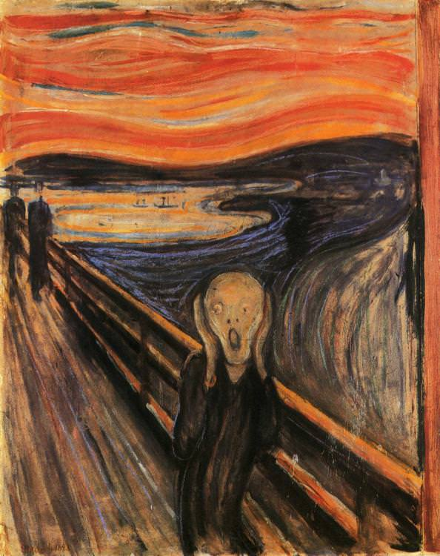
Recursive Descent
X
parse_X:
n = TreeNode(‘X’)
t = peek_next_token()
select X → α based on t
for each α_{i} ∈ α :
if α_{i} == Y₁ ∈ V:
n.addChild(parse_Y₁())
elseif α_{i} == Y₂ ∈ V:
n.addChild(parse_Y₂())
…
elseif α_{i} == Y_{k} ∈ V:
n.addChild(parse_Y_{k}())
elseif α_{i} == t:
n.addChild(remove_token())
t = peek_next_token()
else:
syntax error
return n
⍺₁
⍺₂
Use PREDICT table
Idea: For each variable X, write a procedure: parse_X()

Slide 6
Example
parse_S:
t = peek_at_token()
select S → α based on t
for each α_{i} ∈ α :
if α_{i} == Add ∈ V:
parse_Add()
elseif α_{i} == Sub ∈ V:
parse_Sub()
elseif α_{i} == Mul ∈ V:
parse_Mul()
…
elseif α_{i} == Val ∈ V:
parse_Val()
else:
syntax error
Grammar
S → Add
S → Sub
S → Mul
S → Div
S → Val
Add → + S S
Sub → − S S
Mul → ∗ S S
Div → / S S
Val → integer

Slide 7
Example More Concrete
parse_S:
t = peek_at_token()
if t == ’+’ :
n = parse_Add()
elseif t == ‘-’:
n = parse_Sub()
elseif t == ‘*’:
n = parse_Mul()
elseif t == ‘/’:
n = parse_Div()
elseif t == ‘neg’:
n = parse_Neg()
elseif t is integer:
n = parse_Val()
else:
syntax error
return TreeNode(“S”, n)
Grammar
S → Add
S → Sub
S → Mul
S → Div
S → Val
Add → + S S
Sub → − S S
Mul → ∗ S S
Div → / S S
Val → integer
S
Add

Slide 8
Example More Concrete
Grammar
S → Add
S → Sub
S → Mul
S → Div
S → Val
Add → + S S
Sub → − S S
Mul → ∗ S S
Div → / S S
Val → integer
parse_Add:
t = peek_at_token()
if t != ’+’:
# never happens
syntax error
remove_token()
s1 = parse_S()
s2 = parse_S()
return TreeNode(“Add”,t,s1,s2)
Add
+
S₁
S₂

Slide 9
Push Down Automata
We proved that
L can be parsed by a DFA if and only if it is regular
Some context free languages, including most programming languages, are not regular.
DFAs are not powerful enough to parse context free languages.
We need a more powerful automata!
A push-down automaton (PDA) is an NFA with a stack.
We can use this model to reason and derive properties of context free languages.

Slide 10
Example: PDA for L = {σ1σ^{r}|σ∈{0,1}∗}
Transition: a,x/y means
Read input symbol a
Pop x of the stack
Push y on the stack
Transition to next state
ε means empty (nothing)
States: Q ={q₀,q₁}
Input alphabet: Σ ={0,1}
Stack alphabet: Γ ={a,b}
Start state: q₀∈Q
Initial stack: S = ε∈Γ
Final states: F ={q₁}⊆Q
Transition function: δ
0,ε/a
0,a/ε
q₀
1,ε/ε
q₁
Stack
State | Input | Pop | New State | Push
q₀ | 0 | ε | q₀ | a
q₀ | 1 | ε | q₀ | b
q₀ | 1 | ε | q₁ | ε
q₁ | 0 | a | q₁ | ε
q₁ | 1 | b | q₁ | ε
1,ε/b
1,b/ε
Problem: In this language we do not know when to transition to q₁.

Slide 11
Formal Definition of a PDA
A pushdown automata (PDA) M is a 7-Tuple
M = (Q,Σ,Γ,δ,q₀,S,F)
Q is the set of states
Σ is the input alphabet
Γ is the stack alphabet
δ is the transition function:δ:Q×Σ×Γ→2^{Q}×Γ
q₀ is the start state
S the initial symbol on the stack
F is the set of final states
There are two different modes of acceptance we can adopt.

Slide 12
Modes of Acceptance for PDAs
Empty Stack : Accept if and only if it is possible to reach a configuration where
The input has been consumed completely
The stack is empty
State does not matter
Final state : Accept if and only if it is possible to reach a configuration where
The input has been consumed completely
The current state is an accepting state
Stack contents do not matter
The two modes are equivalent!
We can convert one kind of PDA to the other!

Slide 13
Facts about PDAs
A language is a CFL if and only if it can be recognized by a PDA.
A deterministic PDA (DPDA) is a PDA that has only one possible transition in any configuration
L can be recognized by a DPDA if and only if it is LL(k) or LR(k)
Not all L are LL(k) or LR(k),
e.g. Languages of palindromes.

Slide 14
Deterministic Pushdown Automata
Definition: A deterministic pushdown automata (DPDA) M is a 7-Tuple:
M = (Q,Σ,Γ,δ,q0,S,F
Q is the set of states
Σ is the input alphabet
Γ is the stack alphabet
δ is the transition function: δ:Q×Σ×Γ → Q×Γ
q₀ is the start state
S the initial symbol on the stack
F is the set of final states
DPDAs also accept by empty stack or by final state
This is the only difference between PDAs and DPDAs

Slide 15
Example: DPDA for L = {0^{n}1^{n}|n>0}
States: Q ={q₀,q₁}
Input alphabet: Σ ={0,1}
Stack alphabet: Γ ={a}
Start state: q₀∈Q
Initial stack: S = ε∈Γ
Final states: F = ? (Accept by empty stack)
Transition function: δ
0,ε/a
1,a/ε
q₀
1,a/ε
q₁
State | Input | Pop | New State | Push
q₀ | 0 | ε | q₀ | a
q₀ | 1 | a | q₁ | ε
q₁ | 1 | a | q₁ | ε

Slide 16
Examples
Build a DPDA that recognizes
L = {0^{n}10^{n} | n ≥ 0}
L = {0^{n}1^{n}0^{m}1^{m} | n, m ≥ 0}
Build a PDA that recognizes
L = {w ∈ {0,1}* | w is a palindrome}

Slide 17
Parsing with a DPDA
How do we build a DPDA to implement LL(1) grammar?
Idea:
Input: token stream
Σ is the alphabet of tokens.
Transitions are based on:
Tokens read, matching predictor sets for given productions
Symbols on the stack
The stack contains partial sentential forms
Rewriting involves popping off a nonterminal and pushing on the RHS of the corresponding production

Slide 18
Example: Our Favourite Grammar
Grammar
S → + S S
S → − S S
S → ∗ S S
S → / S S
S → neg S
S → integer
Q = {q₀}
Σ = {+,−,∗,/,neg,int}
Γ = {S}
q₀: q₀∈Q
Stack = S∈Γ
F ={q₀}⊆Q
δ:
-,S/SS
State | Input | Pop | Next | Push
q₀ | + | S | q₀ | SS
q₀ | - | S | q₀ | SS
q₀ | * | S | q₀ | SS
q₀ | / | S | q₀ | SS
q₀ | neg | S | q₀ | S
q₀ | int | S | q₀ | ε
+,S/SS
*,S/SS
q₀
-,S/SS
int,S/ε
neg,S/S

Slide 19
Implementing DPDAs
Implementation Options
Using nested case statements
Level 1: Branch on current state
Level 2: Branch on current input symbol
Level 3: Branch on current stack symbol
Similar to recursive-descent parsing
Instead of recursion, maintain the stack explicitly.
Table-driven
3-D table mapping (state, input symbol, stack symbol) triples to strings to be pushed onto the stack.
Options for generating the parser
Hand-coded
Automatic generation from grammar
E.g.using yacc, bison, etc

