Slide 1
Computation Abstractions and Exception Handling
CSCI 3136: Principles of Programming Languages

Slide 2
Agenda
Announcements
Assignment 9 is out, due July 30
Final exam, 1:00pm, Friday, August 2 in CHEB 170
In-class SRIs on Wednesday
Readings: Read Chapter 6.6, 9
Lecture Contents
Finish previous lecture
Motivation
Parameters and Arguments
Applicative and Normal Order Evaluation
Introduction to Exceptions
Languages Support
Exception Propagation
Exception Implementation
Examples

Slide 3
How are the Student Ratings of Instruction (SRI) used?
Course and program (re) design.
Evaluation of teaching effectiveness.
Promotion and tenure applications for instructors, and other personnel decisions.
Preparation of supporting evidence for teaching awards and grants.
Quality assurance processes in the review and restructure of institutional, faculty, department and program goals.

Slide 4
How to complete the SRI
Find the email in your Dal email account
Subject heading (depending on the system) is:
Student Ratings of Instruction; or
Course Name and Number
Open the email and click on the link
Your course list should be visible
Select the course for which you want to complete the evaluation
Be sure to hit the SUBMIT button when you FINISH completing the form
You may also SAVE and return to your work later

Slide 5
Motivation
We take functions, procedures, methods, and subroutines for granted
We learn them in 1st year and then use them
How we use them is dictated by
Scope (Static or Dynamic) ✅
Binding (Deep or Shallow) ✅
Parameters (what the functions expect)
Arguments (what is passed in)
Evaluation (what takes place inside)
Return (L-values, R-Value, Composite, etc)

Slide 6
A Function Is …
Also known as a subroutine, procedure, method, etc.
A piece of code that
Specifies what parameters it is expecting to be called with (0+)
Is called from somewhere in the program by the caller who provides arguments to be bound to parameters
When called, the callee performs a computation using the arguments provided by the caller
Optionally returns a value
Optionally generates side-effects
Example:
def fact( n = 1 ):
if n < 2:
return 1
else:
return n * fact( n – 1 )
fact( 42 )
What does this do? It returns a big number. ☺

Slide 7
Recall: Before the Call
…
…
Stack
…
…
…
…
…
Caller
Pushes arguments on the stack
Pushes a dummy return value (optional)
Executes call instruction
call foo
Pushes return address on stack
Jumps to subroutine (callee)
Arg n
…
Arg 2
Arg 1
Return Value
Return Addr

Slide 8
Recall: During the Call
…
…
Stack
…
…
…
…
…
Callee
Saves base pointer
Allocates local variables
Allocates temporary variables
Saves registers
Performs body of subroutine
Restores registers
Destroys local and temp variables
Returns
ret
Pops return address off stack
Jumps to return address
Arg n
…
Arg 2
Arg 1
Return Value
Return Addr
Base Pointer
Local var 1
Local var 2
…
Local var m
Temp var 1
Temp var 2
…
Temp var r
Saved reg 1
Saved reg 2
…
Saved reg t

Slide 9
Recall: After the Call
…
…
Stack
…
…
…
…
…
Caller
Pops arguments off the stack
Arg n
…
Arg 2
Arg 1
Return Value

Slide 10
Parameters and Arguments
Parameters are the variables specified by the function declaration, which are visible during the call
E.g. here is a function declaration in Swift
func choose( m:Int, n:Int = 1 ) -> Int { …
Specifies two parameters: m and n of type Int
The second parameter has a default value
Arguments are the values passed by the caller to the callee
E.g. here is a function call in Swift
marbles = choose( 42, 13 )
Passes two arguments to choose(): 42 and 13
During the call, m is bound to 42 and n is bound to 13

Slide 11
Parameter Modes
Parameter modes is how the arguments are actually passed to the function
The standard modes are
Pass-by-value: the r-value of the variable or expression is passed
Used by C
Pass-by-reference: the l-value of the variable or expression is passed
Used in Lisp, Smalltalk, Ruby, available in C++
Other modes are:
Pass-by-value/result: pass by value, but copy the value from the parameter back to the variable that was passed
Used in Algol W, Ada (in out)
Pass-by-sharing: Similar to pass by reference. The object can be modified, but reference cannot
Used in Java for Composite types
Read-only: Are passed by reference but cannot be modified

Slide 12
Pass By Value
The value of the expression is bound to the parameter (copied), and passed to the function
Modifications to the value are not visible outside of the function
int increment( int val ) {
val++;
return val;
}
int i = 42;
int j = increment( i );
printf( “%d %d\n”, i, j );
The output is:
42 43

Slide 13
Pass By Reference
The location (reference) of the value of the expression is bound to the parameter (copied), and passed to the function
Modifications to the value are visible outside of the function
int increment( int& val ) {
val++;
return val;
}
int i = 42;
int j = increment( i );
printf( “%d %d\n”, i, j );
The output is:
43 43

Slide 14
Pass-by-Reference vs Pass-by-Value
Pass-by-value
Easier to understand (fewer side-effects)
Efficient for primitive values (integer, floats, characters)
Changes are not propagated back from the call
Inefficient for large objects
Pass-by-reference
Used to pass large or complex data structures
Changes to parameters are reflected in arguments
Greater care needs to be taken during recursion
Question: When should arguments be evaluated?
At call?
At use?

Slide 15
Applicative and Normal Order of Evaluation
Applicative-order evaluation
Arguments are evaluated before a subroutine call
Default in most programming languages
Normal-order evaluation
Arguments are passed unevaluated to the subroutine
The subroutine evaluates them as needed
Useful for infinite or lazy data structures that are computed as needed
Examples: Macros in C, Haskell
Fine in functional languages
Problematic if there are side effects
What if argument is not always used?
Potential for inefficiency
What happens if argument is passed to other subroutines?

Slide 16
Return Values
In most languages functions typically return r-values
A value that can be assigned to a variable or used in an expression
Some languages, such as C++, allow functions to return l-values (locations of the value)
Seen in a previous lecture
Return of l-values can be simulated in most languages
Using pointers in C
Returning references in Java
Etc.
But … Sometimes it’s hard to know what to return!

Slide 17
Exception Handling
Things go wrong (bleep happens), we need to handle it gracefully
Exception are unexpected or abnormal conditions during execution
Generated automatically in response to runtime errors
Raised explicitly by the program
Exception handling is needed to
Perform operations necessary to recover from the exception
Terminate the program gracefully
Clean up resources allocated in the protected block
Exception handling allows the programmer to
Specify what to do when an error occurs during program run-time
Separate the common path code from the error handling code

Slide 18
Exception Handling Syntax
Syntax for catching and handling exceptions tends to be similar
A protected block comprises 3 parts:
try : the common path code to be executed
catch : exception handlers for each exception to be caught
finally : an optional ”clean-up” handler that always runs after the ”try” regardless of whether an exception occurs
Exception are raised (or thrown) by a raise (or throw) statement
raise Exception_1(…)
try {
// common path
} catch ( Exception_1 e ) {
// Exception 1 handler
} catch ( Exception_2 e ) {
// Exception 2 handler
} ...
} else { // optional
// default handler
} finally { // optional
// clean up code
}

Slide 19
Exception Handling Semantics
An exception handler is lexically bound to a block of code
When an exception is raised in the block, search for a handler in present scope
If there is no matching handler in present scope,
The scope is exited (may include block or subroutine)
A handler is searched for in the next scope
def main():
try:
parse()
except MemoryError as p:
print “Program too big!”
def parse():
try:
l = parseS()
if lookahead() != None:
raise ParseError( 'S' )
eval_result( top_ref, l )
except ParseError as p:
print "Syntax Error”
except EvalError as p:
print "Evaluation Error”
Out of Memory

Slide 20
Language Support
How are exceptions represented?
Built-in exception type (Python)
Object derived from an exception class (Java)
Any kind of data can be passed as part of an exception
When are exceptions raised?
Automatically by the run-time system as a result of an abnormal condition
e.g., division by zero, null dereference, out-of-bounds, etc
throw or raise statement to raise exceptions manually
Where can exceptions be handled?
Most languages allow exceptions to be handled locally
Propagate unhandled exceptions up the dynamic chain.
Clu does not allow exceptions to be handled locally
Some languages require exceptions that are thrown but not handled inside a subroutine be declared (Java)

Slide 21
Language Non-support
Some languages do not support exceptions
e.g., C
Solution 1:
Reserve a return value to indicate an exception
Solution 2:
Caller passes a closure (exception handler) to call
Solution 3:
In C, signals and setjmp / longjmp can be used to simulate exceptions
#include <setjmp.h>
int func(…) {
static jmp_buf env;
int i = setjmp(env);
if( i == 0 ) {
/* common path */
...
/* exception 42 */
longjmp(env, 42);
...
} else if( i == 42 ) {
/* handle exception 42 */
} else if( i == ? ) {
...

Slide 22
Exception Implementations
Options:
Simple (Pay as you go)
Location to Exception map (Pay on Exception)
Hybrid

Slide 23
Simple, Pay-as-You-Go Exception Handling
…
…
H Stack
…
…
…
…
…
Idea:
The program uses a second stack, called a Handler Stack (HS)
When a protected block is entered, a handler is pushed on the (HS)
Pointer to the handler code
Current stack frame (Program Stack)
I.e., referencing environment
Sound familiar?
An optional exit (finally) handler may also be pushed
If there are multiple exception handlers, these are implemented using an if/elseif/… construct in a single handler
When a protect block is exited, the handler is popped of the stack
Simple implementation is costly because handler stack is manipulated on entry/exit of each protected block

Slide 24
Simple, Pay-as-You-Go Exception Handling
…
…
…
…
H Stack
…
Stack
…
…
…
…
…
…
…
…
…
def foo():
try:
bar()
except E1 as e:
# E1 handler
except E2 as e:
# E2 handler
def bar():
try:
...
except E3 as e:
# E3 handler
except E4 as e:
# E4 handler:
Handler
Stk Frame
Finally (opt)
…
…
…
if isinstance(E1, e):
# E1 handler
elsif isinstance(E2, e):
# E2 handler
else:
raise e
…
Handler
Stk Frame
Finally (opt)
…
…
…
…
…
…
E1
…
…
…
if isinstance(E3, e):
# E3 handler
elsif isinstance(E4, e):
# E4 handler
else:
raise e
…

Slide 25
Location to Exception Mapping
A faster implementation (Pay on exception)
Store a global map of code blocks (memory addresses) to handlers
Generated by compiler/linker
On exception, index map with program counter to get handler
Still need to keep track of stack frames
Each stack frame stores a pointer to most recent protected block

Slide 26
Pay on Exception Exception Handling
…
…
Stack
…
…
…
Handler
Finally (opt)
…
…
def foo():
try:
bar()
except E1 as e:
# E1 handler
except E2 as e:
# E2 handler
def bar():
try:
...
except E3 as e:
# E3 handler
except E4 as e:
# E4 handler:
…
Handler
Finally (opt)
…
…
if isinstance(E1, e):
# E1 handler
elsif isinstance(E2, e):
# E2 handler
else:
raise e
…
…
…
…
…
…
…
E1
…
…
…
if isinstance(E3, e):
# E3 handler
elsif isinstance(E4, e):
# E4 handler
else:
raise e
…

Slide 27
Comparison of the 2 Approaches
Location-based Exception handling
Handling an exception is more costly (search), but exceptions rare
No cost if no exceptions
Cannot be used if the program consists of separately compiled units and the linker is not aware of this exception handling mechanism
Hybrid Approach:
Use a local map for each subroutine
Store a pointer to a local map in subroutines stack frame

Slide 28
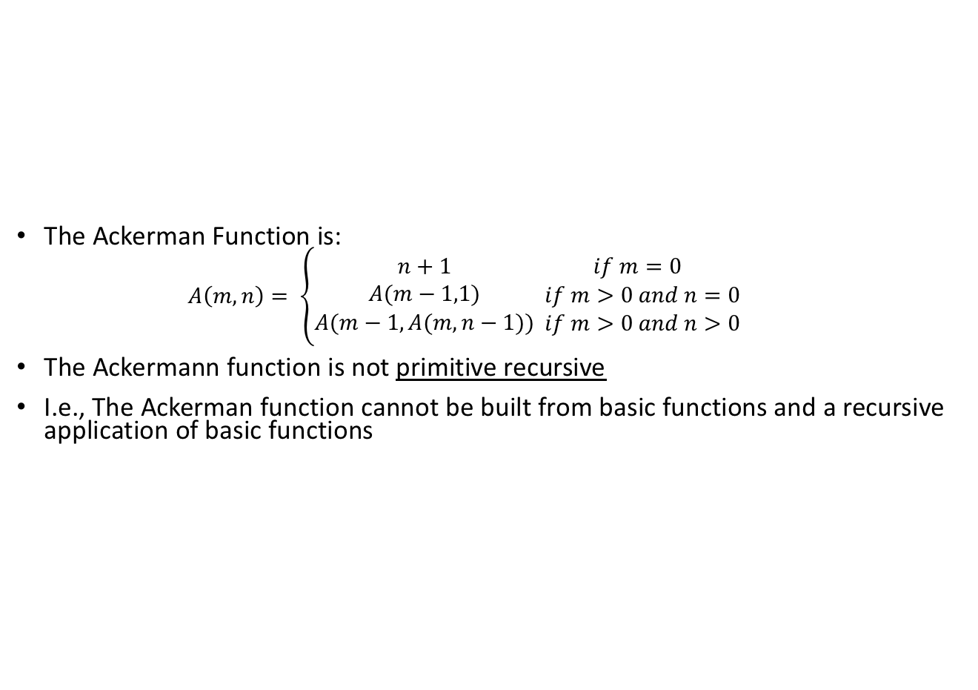
Ack, Ack, Ackerman Function
The Ackerman Function is:
$$A\left(m,n\right)= \left\{\begin{aligned}n+1 \\ A(m−1,1) \\ A(m−1,A(m,n−1))\end{aligned}\begin{matrix}if m=0 \\ if m>0 and n=0 \\ if m>0 and n>0\end{matrix}\right.$$
The Ackermann function is not primitive recursive
I.e., The Ackerman function cannot be built from basic functions and a recursive application of basic functions
The function can be implemented using recursion
It can be executed on a computer
Hence, it can be computed iteratively
def ackermann(m,n):
if m == 0:
return n + 1
elsif n == 0:
return ackermann(m-1,1)
else:
a = ackermann(m,n-1)
return ackermann(m-1,a)

Slide 29

Lazy Evaluation
By default, Scheme uses strict evaluation
This code runs forever
( define naturals
( letrec ( ( next
( lambda ( n )
( cons n ( next ( + n 1 ) ) )
) ) )
(next 1)
)
)
What does this do?
This can be avoided by delaying evaluation (lazy)

Slide 30
The Lazy Evaluation Variant
Instead, we only need to evaluate when we need the next value in naturals
( define naturals
( letrec ( ( next
( lambda (n)
( cons n ( delay ( next ( + n 1 ) ) ) )
) ) )
( next 1 )
)
)
( define head car )
( define tail ( lambda ( stream )
( force ( cdr stream ) ) )
)
What do these do?
> ( head naturals )
1
> ( head ( tail naturals ) )
2
> ( head ( tail ( tail naturals ) ) )
3

Slide 31
Implementation of delay and force
delay can be a special form or macro that wraps the expression in a function
i.e., closure or generator
( define-syntax delay
( syntax-rules ()
( ( delay exp ) ( lambda () exp ) )
)
)
force simply evaluates the given function:
( define force ( lambda ( delayed-exp ) ( delayed-exp ) ) )
Note: This is inefficient
Evaluation is performed when passed (applicative order) instead of when needed (normal order)

