Slide 1
PLAN FOR TODAY
Six parts, about 30 mins, the rest for Q & A
TAKE-HOME REVIEW · INTERFACE.AI
# | Part | Time
1 | The problem, my approach, what I built, and how I built it with AI | 4 min
2 | Why I built it this way: designed per requirement | 4 min
3 | Live demo and a walk through the capability file | 10 min
4 | What is weak, and the fix for each | 4 min
5 | How I would scale it | 4 min
6 | How I would measure it in production | 4 min
Rote
Learn a task once.
Save the recipe.
Repeat it with checks.
Toyin Bakare
Notes:
Open with one line: many bank systems have no API, so an agent has to use the screen. Rote learns the task once with AI, then repeats it without AI. Then: the problem, why I built it this way, a live demo, what is weak, how I would scale it, how I would measure it.

Slide 2
PART 1 · PROBLEM AND APPROACH
Many bank systems have no API. The screen is the only way in.
From the brief: “the only way in is to drive the UI the way a human operator would.”
Stable screens, real runtime errors
Old screens
UI is rarely redesigned
The hard part is what happens while a task runs
  Validation errors, record not found, permission denied
  Surprise dialogs, session timeouts, slow or failed loads
Server-rendered pages, framesets and iframes
Deeply nested tables, markup with no meaning
No test IDs; sometimes a desktop app
No clean DOM, no stable selectors, no API
Many tenants
Regulated data
Hundreds of institutions, about 20 apps each
Thousands of app instances
Same vendor product, set up and versioned differently
One recipe, tuned per tenant, not rebuilt
An allowlist of what the agent may do
Risky or irreversible actions handled with care
No secrets or raw sensitive data in artifacts or logs
Rote · take-home review
Part 1 · Problem and approach
Notes:
Every box on this slide comes from section 1 of the brief. Headline quote: "the long tail of legacy applications that have no API at all … the only way in is to drive the UI the way a human operator would." The brief says the hard part is NOT constant change; it is the errors that happen at run time. "Regulated data" comes from section 3.4: allowlist, risky actions handled conservatively, never persist secrets or raw sensitive data.

Slide 3
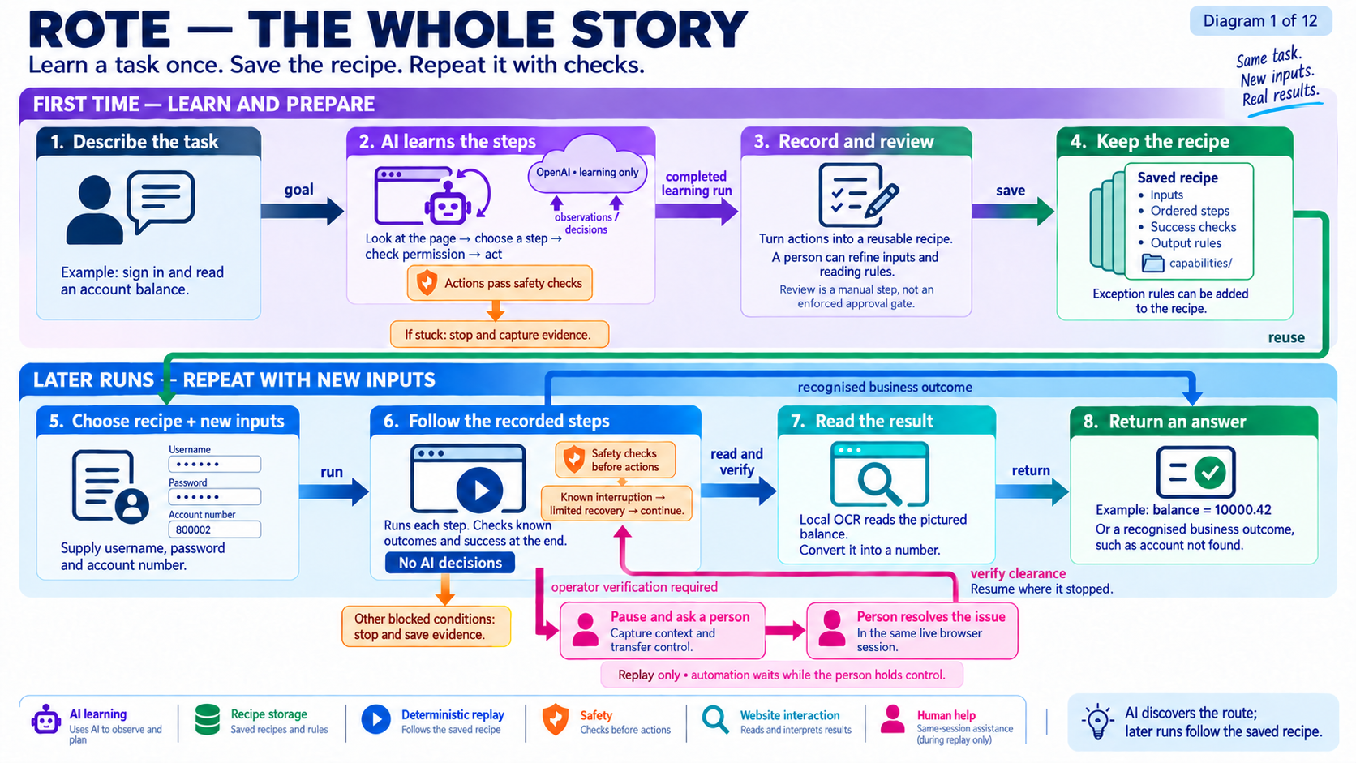
Notes:
Walk the top band left to right, then the bottom band. Say once: the recipe is what the brief calls the capability artifact. Point at the pink loop: replay only, same live session.

Slide 4
PART 1 · PROBLEM AND APPROACH
What I built, what I simulated, what I only designed
Built and working
Simulated on purpose
Designed, not built
AI discovery loop
Capability file with checks
Replay with no AI
Local OCR for the canvas balance
Safety gate and policy file
Human handoff in the same session
Failure evidence on every blocked run
The operator console is one button
Error states come from test records, so they repeat offline
Desktop adapter
Per-tenant overrides
Drift reports
Capability catalogue
Queues and scaling
Rote · take-home review
Part 1 · Problem and approach
Notes:
Say this early so nobody has to ask. The brief says mock the operator console and the desktop surface if needed, and not to build scaling infrastructure. The file and function for every bullet is in the prep doc.

Slide 5
PART 1 · PROBLEM AND APPROACH
How I built it with AI
# | Step | Who
1 | I read the brief myself, before any model. | Me
2 | OpenAI and Gemini each read it separately and wrote a requirements list: 29 and 32 items. They mostly agreed. | OpenAI, Gemini
3 | Claude read the brief and checked both lists against it. It found 3 that both had missed. | Claude
4 | I added 1 that all three models missed. | Me
5 | We designed the framework of the solution first: the parts and the lines between them. | Claude and me
6 | We wrote the code against the requirements checklist. | Claude and me
7 | We built the test gate: 43 tests that must pass, including 7 that fail the build if the architecture rules are broken. | Claude and me
8 | OpenAI runs discovery inside the product. Claude, outside the product, reviewed the work before I submitted. | OpenAI, Claude
Rote · take-home review
Part 1 · Problem and approach
Notes:
One line: two models wrote the requirements, a third reviewed them, and I read the brief first and found one that all three missed. Then framework first, code against the checklist, and a test gate to prove it. Claude sits OUTSIDE the product; say so. If the 29/32/3/1 numbers cannot be confirmed, drop them and say it without numbers. Tests: 36 behaviour + 7 structural = 43.

Slide 6
PART 2 · DESIGNED PER REQUIREMENT
Language and browser tool: designed per requirement
What the brief requires
1. The tool: Playwright. Frames are built in, it waits until a control is ready, and it finds a control by role, name or label.
Really click, type, navigate and read a live screen (3.1)
Lean toward an approach that still works with no clean DOM (3.1)
Legacy screens: framesets, nested tables, no test IDs (1)
Stable targeting on replay, with no AI deciding (3.3)
Language and tool are my call, and I must defend them (4)
Tool | Frames and waiting | For this job
Playwright | Built in; waits for the control | Best fit
Selenium | Switch frames and write waits by hand | Works, with more code
Puppeteer | Partly built in | Close cousin, Chrome first
Cypress | Weak on iframes | Made for testing your own app
2. The language: TypeScript. Playwright is a Node library with first-class TypeScript types. I describe a step once, and that one description checks my code, checks every saved file, and tells the AI what format to answer in. The compiler catches mistakes before anything touches a bank screen.
Language | Verdict
Python | Close second. Official binding, same API. Type checks need mypy or pyright in CI; not part of the build.
Java | Works. The class, the rules and the AI format are written apart.
Go | Weak fit. No official Playwright.
Rote · take-home review
Part 2 · Designed per requirement
Notes:
The chain: the requirement picks the browser tool, and the browser tool picks the language. Do not say "the best tool"; say "the best fit for this requirement". Python was a close second. Java works but needs the same definition written in three places. Details and likely questions are in the prep doc.

Slide 7
PART 2 · DESIGNED PER REQUIREMENT
Architecture: designed per requirement
The brief asks for | What I designed | Where in the code
“Pause, cede control, and resume on the same session”, and know who is in control (3.6). “Simpler is fine if justified” (4). | One process. Every part shares one live browser session. The gate checks who holds control and then acts, back to back in the same program, so nothing can slip in between. To scale, run many copies. | cli.ts wires the parts. core/contracts.ts holds the four interfaces.
“Replay without invoking the LLM” (3.3). “Clear boundaries” (7). | One folder, one job. The replay folder has no AI code in it. Only surfaces/ knows Playwright. Only safety/ acts on the browser. | tests/replay-boundary.test.ts fails the build if replay ever imports an AI client.
An LLM-driven observe, decide, act loop with stopping rules: max steps, timeout, dead end (3.1). | OpenAI sits behind one function. Its answer is already a valid step, not free text. It sees the visible text, the control list, and a screenshot. It stops on max steps, a time limit, or a repeating screen. | discovery/openai-model.ts decide(), discovery/discovery-runner.ts run()
“The only reliable surface is what a human operator sees” (1). Never persist raw sensitive data (3.4). | Local OCR reads the balance that is drawn as a picture. Reads by OCR; clicks by role and name, not yet by pixels. Replay needs no outside service, and account data stays on the machine. | surfaces/playwright-adapter.ts extract(), recognizeVisualText()
Rote · take-home review
Part 2 · Designed per requirement
Notes:
Each row starts from a line in the brief. Row 1: the check "who holds control" and the click happen back to back inside one program, so nothing can get in between them. To scale you run many copies. Row 2: the test is tests/replay-boundary.test.ts. Row 3: stopping rules are max steps, a time limit, and the same screen plus same action repeating. Row 4: the cost of local OCR is accuracy; see the weak-spots slide.

Slide 8
PART 2 · DESIGNED PER REQUIREMENT
The capability file, results, safety and handoff
Capability file (brief 3.2)
Three kinds of result (brief 3.3)
Typed inputs and outputs, ordered steps, a success check
How each control is found, with the reason it should hold
JSON, one file per version, reviewed like code
Secrets saved as {{password}}, never the real value
Business outcome: “account not found” is an answer
Recoverable: close a known notice, at most twice
Blocked: stop, name the step, save evidence
Written in the file: a new condition is a data change
One safety gate (brief 3.4)
Human handoff (brief 3.6)
Every action passes actuator.execute() first
It checks who holds control, then policy.json, then acts
policy.json: allowed hosts, routes, action types, risky button names
Risky actions are blocked, not flagged
Replay pauses and sends a request: step, reason, evidence
The person works in the same live browser session
Rote checks for itself that the block is gone, then resumes
One owner at a time, with a timeline (session-lease.ts)
Rote · take-home review
Part 2 · Designed per requirement
Notes:
The brief says these are where they will focus: the artifact schema, the error taxonomy, and the control-transfer model. Open capabilities/altoroj-challenge-account-balance/v2.json here (it has the eight known outcomes; the discovered v1 has none), or use the viewer's Recipes tab. Known limits are on the weak-spots slide; the rest is in the prep doc.

Slide 9
PART 4 · WHAT IS WEAK
What is weak, and the fix for each
Gap | Fix
Nearby text is saved but never used to find a control. Three of six steps are found by a CSS pattern alone. | Use nearby text inside locate(). One function changes.
No saved file has a per-step checkpoint. Known outcomes are checked only at the end. | Add a checkpoint per step. Check known outcomes after every step.
The report says no fixed waits. There is a 350 ms wait after each click. | Wait for the frame to finish loading instead.
Resume runs the blocked step again. Fine for a read. A double action for a write. | Give each write a unique key. Check the state before and after.
OCR on money has no confidence check. A wrong digit still says success. | Set a confidence floor, read twice, block if the reads differ.
Discovery sends the password to the AI inside the goal text. | The AI writes {{password}}. The gate fills in the real value.
Only navigate actions are checked against the host list. | Check the page address after every click too.
The handoff timeline writes one fixed sentence, not the person’s real clicks. | Record page click and input events while the person holds control.
Discovery runs with no session lease, so handoff is replay-only. The brief names “stuck during discovery” as a trigger. | Give the discovery runner the same lease and coordinator that replay uses.
Rote · take-home review
Part 4 · What is weak
Notes:
None of these is a bug: everything runs and all 43 tests pass. These are places where the code does less than my report or the brief says. Naming them first sets the tone. File and line for each one is in the prep doc and the code map. The last row is the one the brief names directly.

Slide 10
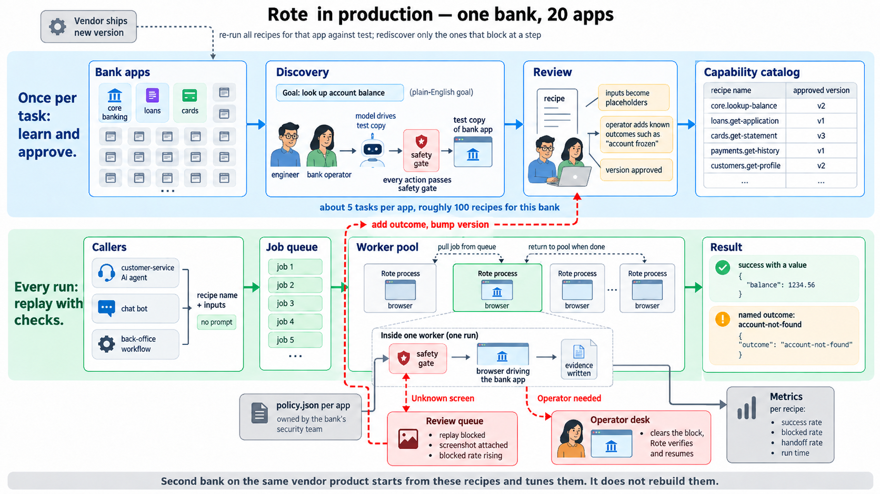
PART 5 · SCALE
One bank, 20 apps: how it runs

Slide 11
PART 5 · SCALE
How I would scale it: four stages, in this order
1. Safe for one tenant
2. Many runs
3. Many tenants
4. Many kinds of screen
Draft, then approved
Secrets from a vault
Safe writes: unique key, before and after check
Replay keeps no state, so add workers
A queue in front, a browser pool behind
A cap per tenant
One base file per product version
Small reviewed overrides per tenant
A test replay before a version takes real work
A desktop adapter
It reads the same capability files
Roles and names, not browser terms
What I would not build yet: many regions, a custom scheduler, or AI inside replay. At most one limited, approved AI retry for one failed control, never an open loop. Each adds moving parts before a number says we need it.
Rote · take-home review
Part 5 · Scale
Notes:
The order matters: scaling something unsafe just makes more unsafe runs. Stage 2: my workers are not the limit; the core banking system’s session and rate limits are. These map to the brief’s stretch goals; say so. Details in the prep doc.

Slide 12
PART 6 · MEASURE
How I would measure it in production
Is it working?
Is it correct?
Is it safe?
Is it worth it?
Success rate per capability, version, tenant
The mix of success, business outcome, blocked
Time per step
Test accounts with known answers, on a schedule
OCR confidence; do two reads agree
A person checks a small sample
Actions blocked by policy
Attempts to leave allowed hosts
How often a person is needed, and for how long
Cost per task vs AI on every run
Review edits per discovered file: 2 today (1 placeholder, 1 OCR scope)
Tasks finished with no person
From a number to an action: an alert on one version → that version stops taking work → the saved evidence shows what changed → a reviewed fix ships as the next version. No AI guessing in the loop.
Rote · take-home review
Part 6 · Measure
Notes:
Correct is the one a bank cares about most: a run that succeeds with the wrong number is worse than a run that stops. The outcome mix is the cheapest early warning. Replay time from the dry run: about 10 seconds lease to result; the handoff run was 11 seconds including the operator click. Discovery cost: check the OpenAI usage page before quoting a number.

