Slide 1

FORMAL VERIFICATION OF OMNET++ DSR PROTOCOL SIMULATION USING SPIN
Presented By : Emir Kuanyshev
Nazarbayev University | 2024

Slide 2
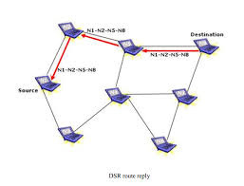
INTRODUCTION
OMNeT++ can be used to simulate network protocol, however:
No guarantee of dead-lock freedom
No guarantee of message arrival at the destination
Verification using formal languages
Verification of the DSR protocol using SPIN

Slide 3
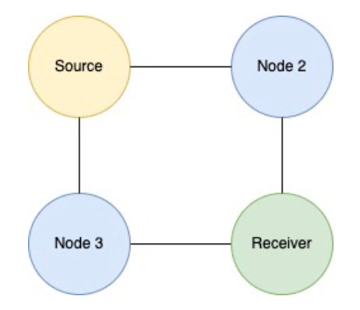
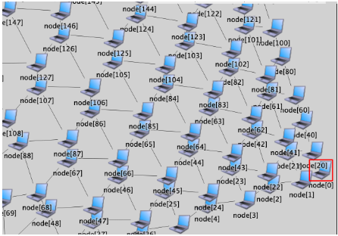
NETWORK TOPOLOGY
The grid of nodes network was used to simulate DSR in OMNeT++
400 nodes used
Each node randomly selects the available neighbor to send RREQ message until the destination is reached
Destination sends RREP back to the source caching with cache TTL time limit

Slide 4
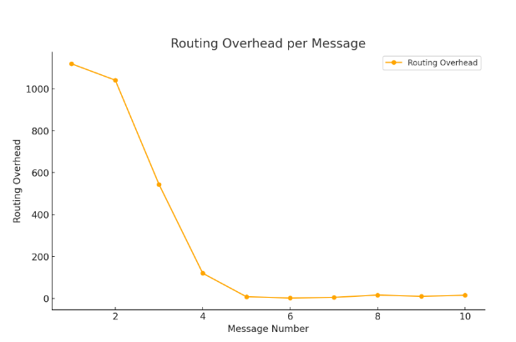
OMNET++ SIMULATION RESULTS
Routing overhead
Number of message travelled from source to destination

Slide 5
TRANSLATE OMNET++ CODE TO SPIN
Translate OMNeT++ simulation into Promela:
Represent messages using chan: chan network[NODES] = [NODES] of { mtype, int, int, int };
Represent each node using proctype
Verify that RREQ message gets to the destination using LTL & RREP gets to the source
Verify that there is no duplication in messages
Verify message get’s deleted if it is not used

Slide 6
SUMMARY
Translating the OMNeT++ simulation code to the Promela with exact logic is hard
Important properties can by successfully verified using formal methods tools such as SPIN

Slide 7
Nazarbayev University | 2024
THANK YOU
Presented By : Emir Kuanyshev

