Slide 1
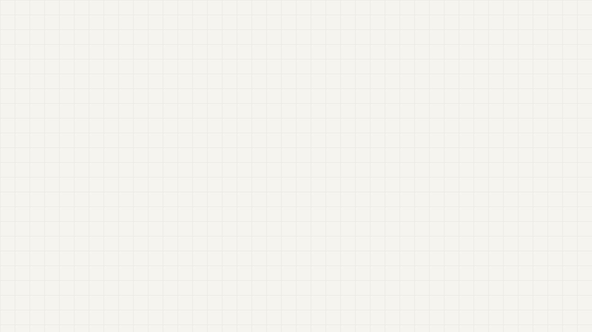
CS5610- Web Development
Trupal Jageshkumar Patel's
Personal Homepage
computer vision · deep learning · edge AI
least-squares.playground
Trupal Jageshkumar Patel — tpatel2103.github.io/Trupal-homepage

Slide 2
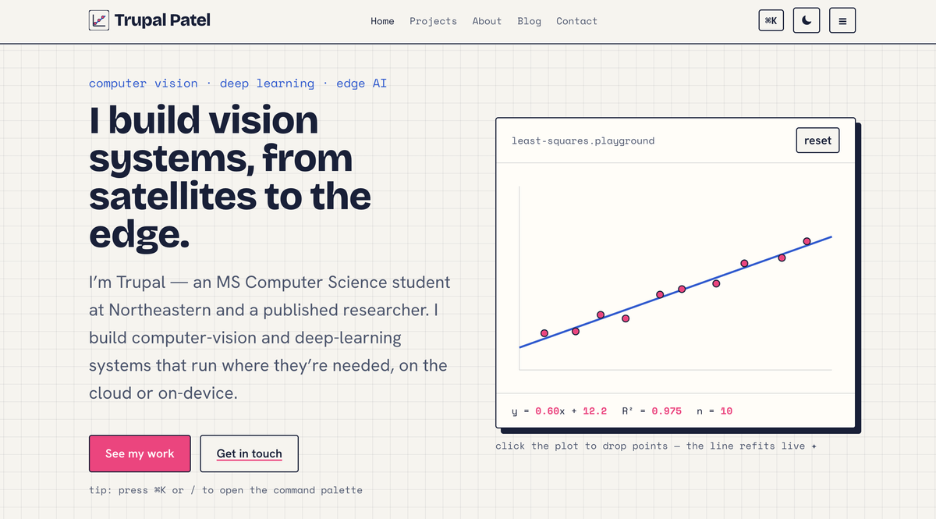
objective()
the site, in one line
I fit models to the messy real world.
Objective
Build a static, front-end-only homepage that introduces me and my work — accessible, standards-compliant, and deployed publicly — using only the core web platform.
Vanilla HTML5, CSS3, and ES6 modules — no frameworks
Four pages with clean URLs (three authored, one AI-generated)
An original interactive JavaScript feature, hand-written
Accessible and W3C-valid; responsive down to mobile
Deployed on GitHub Pages as a public site

Slide 3
technologies()
Technologies used
HTML5
CSS3
JavaScript (ES6 modules)
Semantic structure, accessible markup, valid W3C output
Custom properties, Grid & Flexbox, dark/light theming
import/export, loaded with type="module"
Canvas API
Google Fonts
Git & GitHub Pages
Hand-drawn interactive visuals, retina-aware
Bricolage Grotesque · Hanken Grotesk · Space Mono
Version control and public static deployment
ESLint + Prettier keep the code linted and consistently formatted.

Slide 4
features()
Key features
Three original interactive components, written from scratch in vanilla JavaScript.
Regression playground
Orbital sandbox
Command palette
1
2
3
Click the plot to drop data points and a least-squares line refits in real time, with a live equation and R².
A two-body gravity simulator — drag to launch a satellite and watch it orbit, crash, or escape. My nod to space.
Press ⌘K / Ctrl-K to navigate the site and run actions from the keyboard, on every page.

Slide 5
hardest()
The hardest part
the challenge
how I solved it
Making the canvas components feel good to use while staying correct — with no framework to lean on.
Split each feature into its own small ES6 module
Read colours from CSS variables; redraw on theme change
Tested on real devices and against the W3C validator
Used custom events so the palette can drive the plot & orbit
Stable inverse-square gravity for the orbit sim
Canvas redraws that follow the theme, crisp on retina
Accessible: keyboard, reduced-motion, W3C-valid

Slide 6
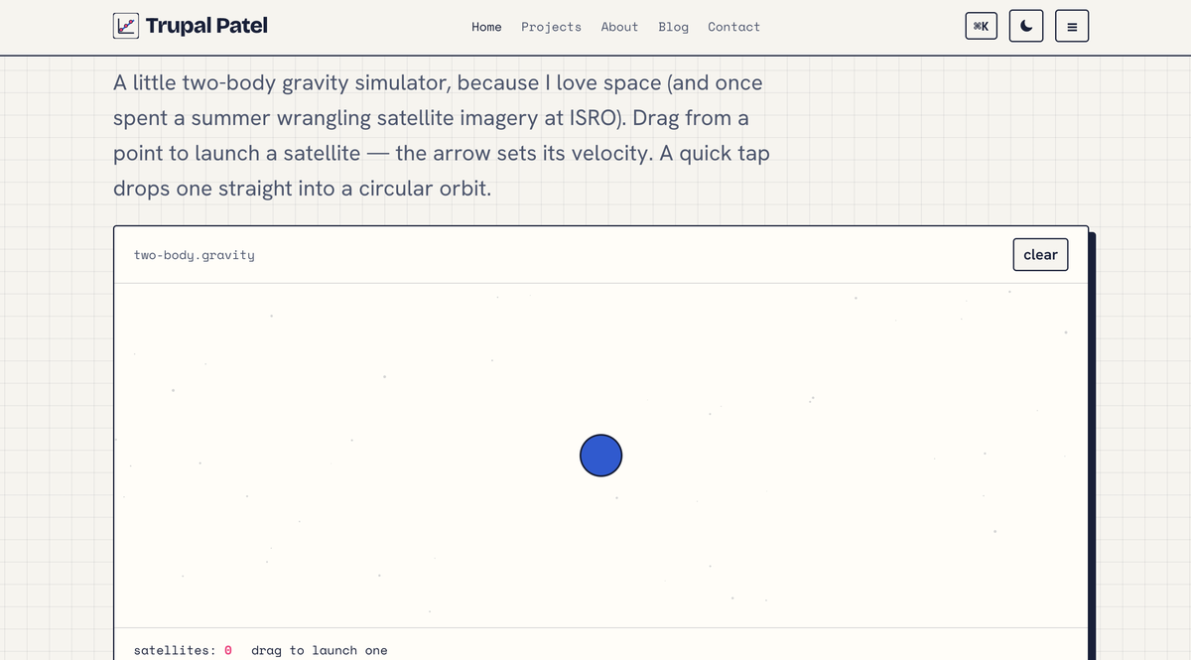
demo()
Live demo
tpatel2103.github.io/Trupal-homepage
pages
Home · Projects · About · Blog · Contact
try it
Press ⌘K / Ctrl-K to open the command palette
Click the plot to add points and watch the line refit
Drag inside the orbital sandbox to launch a satellite
Toggle dark / light mode from the top-right

Slide 7
least-squares.playground
Thank you
Trupal Jageshkumar Patel
NUID: 002546083
Patel.trupa@northeastern.edu
linkedin.com/in/trupal-patel-08a959268
tpatel2103.github.io/Trupal-homepage

