Slide 1









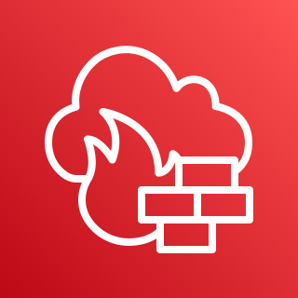
AWS Cloud
Region
Region
VPC
VPC
VPC
VPC
Segment
network
AWS Cloud WAN
EC2 instances
VPC endpoints
EC2 instances
VPC endpoints
EC2 instances
VPC endpoints
VPC endpoints
EC2 instances
Core network edge
Non-Prod
Prod
Shared Services
Inspection VPC
Inspection VPC
Internet
AWS Network Firewall
AWS Network Firewall
Internet

