Slide 1


Iowa Liquor Sales 2015-2016 Analysis and Projections
By Thomas Plapinger

Slide 2
Goals of Analysis
Determine if Liquor Sales of 2016 will improve based 2015 and Jan-March 2016 Sales
Determine areas with Highest Sales

Slide 3
Methodology and Process
Reorganization of data based on Yearly Quarters
2015 Q1 and 2016 Q1 used for Sales increase Prediction and Linear relationship
Ordinary Least Squares of Linear Regression
Error reduced using Rigid Regression
Linear relationship investigated with Cross-Validation

Slide 4
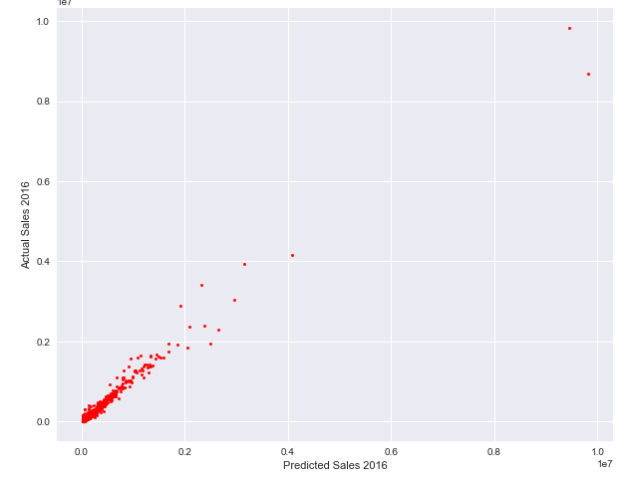
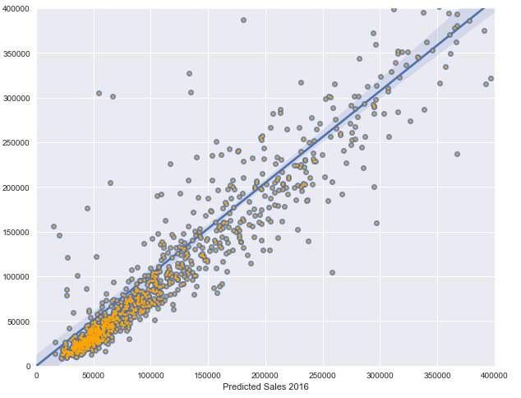
Findings
Expected Increase of near $11.40 million in 2016 over 2015
Majority of Profits Come from Counties and Zip Codes around ISU and Des Moines
Clear Linear Relationship between 2015 Sales and 2016 Sales

Slide 5
Recommendation
It is very likely Liquor Sales will continue to increase
Increase Current Liquor Tax
Helps reduce $130 Million Iowa State Debt
Raises Money for
Iowa General Fund (≈80% recipient, ≈40% Funder)
Department of Public Health (≈16% recipient)

Slide 6
Further Study
Areas to Include for further study of 2015-2016 Liquor Sales:
Snowstorms
Data on Previous Years
Socio-Economic Status of Iowans
Tracking of Influx and Departure of Non-Iowans
2016 Iowa Caucasus
Wine and Beer Sales

Slide 7
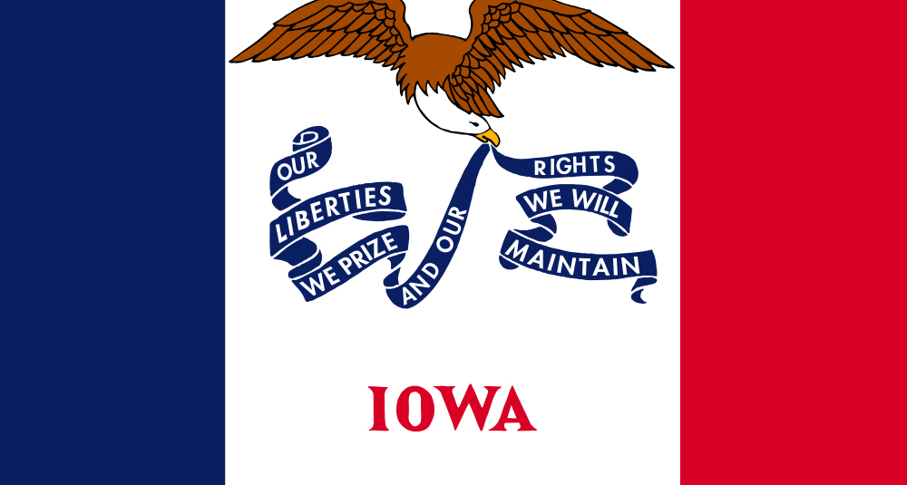
Questions?

