Slide 1



THE NATIONAL INSTITUTE OF ENGINEERING, MYSURU
(AN AUTONOMOUS INSTITUTE UNDER VTU, BELAGAVI)
Operating System
Submitted by
YELLALA MANEESH REDDY -- 4NI19CS124
T PRASANNA -- 4NI19CS111

Slide 2

CPU SCHEDULING ALGORITHM
CPU Scheduling is a process of determining which process will own CPU for execution while another process is on hold. The main task of CPU scheduling is to make sure that whenever the CPU remains idle, the OS at least select one of the processes available in the ready queue for execution. The selection process will be carried out by the CPU scheduler. It selects one of the processes in memory that are ready for execution. These algorithms are either non-preemptive or preemptive. Non-preemptive algorithms are designed so that once a process enters the running state, it cannot be preempted until it completes its allotted time, whereas the preemptive scheduling is based on priority where a scheduler may preempt a low priority running process anytime when a high priority process enters into a ready state.

Slide 3
NON-PREEMPTIVE PRIORITY SCHEDULING ALGORITHM
In Priority Scheduling, processes are assigned Priorities and the process with the highest is executed first. Each process is assigned a priority and processes are given CPU time according to their priority
If 2 processes have equal priorities the those process are scheduled in First Come First Serve order.
Priority can be defined internally or externally.
It can be either preemptive or non preemptive algorithm.

Slide 4
Implementation
First input the processes with their arrival time, burst time and priority.​
First process will schedule, which have the lowest arrival time, if two or more processes will have lowest arrival time, then whoever has higher priority will schedule first.​
Now further processes will be schedule according to the arrival time and priority of the process. (Here we are assuming that lower the priority number having higher priority). If two process priority are same then sort according to process number.​
Once all the processes have been arrived, we can schedule them based on their priority.​

Slide 5
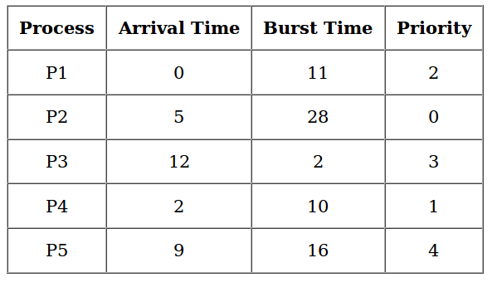
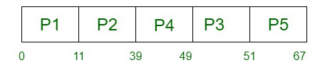
Example
⦁ At time t = 0, there is only process that has arrived i.e., P1 so it will execute first for next 11 ms.
⦁ At time t = 11, P1 is completed and there are three more processes that have arrived, P2 ,P4,P5
P2 has priority 0 and P4 has 1 and P5 has 4
Thus, P2 will execute for next 28 ms, i.e. till t = 39 ms.
At time t = 39ms, P2 has just completed and P3 has arrived
⦁ At time t = 39ms all the processes have arrived.
⦁ Thus, P4 with priority 1 will be next
⦁ Similarly, P3 ->P5
⦁ P1->P2->P4->P3->P5

Slide 6
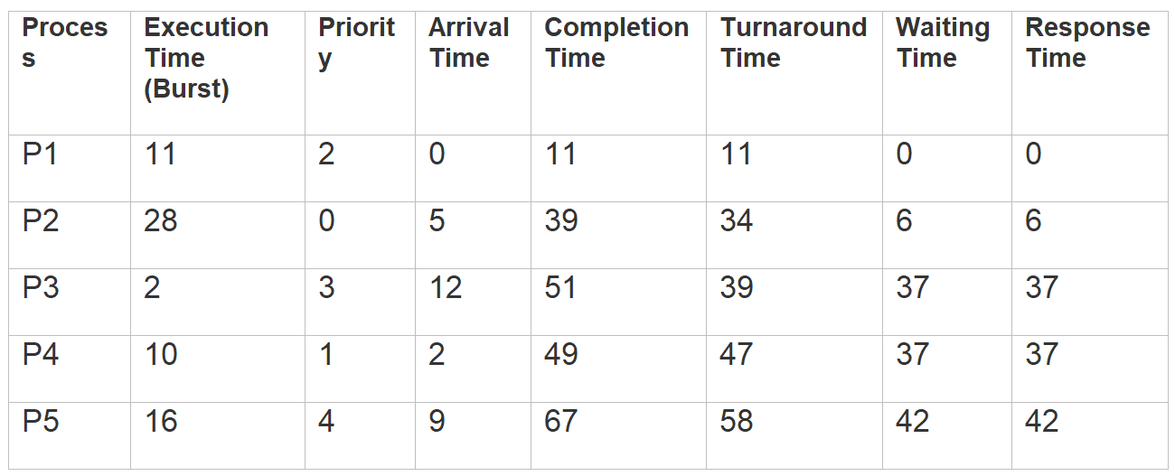
Average Wait Time=(0+6+37+37+42)/5​ =24.4​
Average Turn Around Time=(11+34+39+47+59)/5​ =38​
Average Response Time=(0+6+37+37+42)/5 =24.4​

Slide 7
Advantages
Priority Scheduling algorithm provides a good mechanism where the relative importance of each process maybe precisely defined.

Slide 8
Disadvantages
If high priority processes use up a lot of CPU time, lower priority processes may starve and be postponed indefinitely.
The situation where a process never gets scheduled to run is called starvation.
To prevent this, we do aging where the priority of the process is increased as it waits in the queue. So, a process which has been in a queue for a long time will reach high priority, hence it won’t be starved

Slide 9
#include <iostream>
using namespace std;
int main()
{
int a[10], b[10], x[10], pr[10], rt[10] = {0};
int waiting[10], turnaround[10], completion[10];
int i, j, smallest, count = 0, time, n;
double avg = 0, tt = 0, end;
cout << "\nEnter the number of Processes: ";
cin >> n;
for (i = 0; i < n; i++)
{
cout << "\nEnter arrival time of process: ";
cin >> a[i];
}
for (i = 0; i < n; i++)
{
cout << "\nEnter burst time of process: ";
cin >> b[i];
}
for (i = 0; i < n; i++)
{
cout << "\nEnter priority of process: ";
cin >> pr[i];
}
for (i = 0; i < n; i++)
x[i] = b[i];
pr[9] = 100;
CODE

Slide 10
for (time = 0; count != n; time++)
{
smallest = 9;
for (i = 0; i < n; i++)
{
if (a[i] <= time && pr[i] < pr[smallest] && b[i] > 0)
smallest = i;
}
time += b[smallest];
b[smallest] = -1;
count++;
end = time;
completion[smallest] = end;
waiting[smallest] = end - a[smallest] - x[smallest];
turnaround[smallest] = end - a[smallest];
time = time - 1;
}
cout << "Process"<< "\t"<< "burst-time"<< "\t"<< "arrival-time"<< "\t"<< "waiting-time"<< "\t"
<< "turnaround-time" << "\t" << "completion-time" << "\t"<< "Priority" << endl;
for (i = 0; i < n; i++)
{
cout << "p" << i + 1 << "\t\t" << x[i] << "\t\t" << a[i] << "\t\t" << waiting[i] << "\t\t" << turnaround[i] << "\t\t" << completion[i] << "\t\t" << pr[i] << endl;
avg = avg + waiting[i];
tt = tt + turnaround[i];
}
cout << "\n\nAverage waiting time =" << avg / n;
cout << " Average Turnaround time =" << tt / n << endl; }
}
CODE

Slide 11
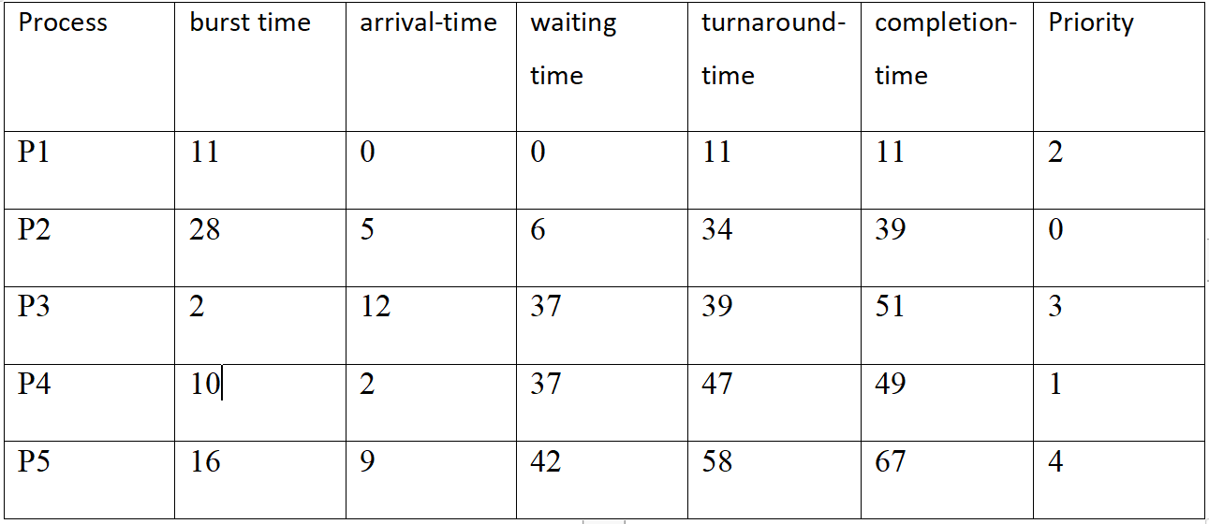
OUTPUT
Average Wait Time=24.4
Average Turn Around Time = 37.8

Slide 12
PAGE REPLACEMENT ALGORITHM
The operating system uses the method of paging for memory management. This method involves page replacement algorithms to decide about which pages should be replaced when new pages are demanded. The demand occurs when the operating system needs a page for processing, and it is not present in the main memory. The situation is known as a page fault. In this situation, the operating system replaces an existing page from the main memory by bringing a new page from the secondary memory. In case of page fault, Operating System might have to replace one of the existing pages with the newly needed page. Different page replacement algorithms suggest different ways to decide which page to replace. The target for all algorithms is to reduce the number of page faults.

Slide 13
FIFO Page Replacement Algorithm:
This is the simplest page replacement algorithm. In this algorithm, the operating system keeps track of all pages in the memory in a queue, the oldest page is in the front of the queue. When a page needs to be replaced page in the front of the queue is selected for removal.

Slide 14
Implementation
Let capacity be the number of pages that memory can hold. Let set be the current set of pages in memory.
⦁ Step 1. Start to traverse the pages.
⦁ Step 2. If the memory holds fewer pages, then the capacity else goes to step 5.
⦁ Step 3. Push pages in the queue one at a time until the queue reaches its maximum capacity, or all page requests are fulfilled.
⦁ Step 4. If the current page is present in the memory, do nothing.
⦁ Step 5. Else, pop the topmost page from the queue as it was inserted first.
⦁ Step 6. Replace the topmost page with the current page from the string.
⦁ Step 7. Increment the page faults.
⦁ Step 8. Stop

Slide 15
Advantages
It is simple and easy to understand & implement.

Slide 16
Disadvantages
The process effectiveness is low.
When we increase the number of frames while using FIFO, we are giving more memory to processes. So, page fault should decrease, but here the page faults are increasing. This problem is called as Belady’s Anomaly
Every frame needs to be taken account off.

Slide 17
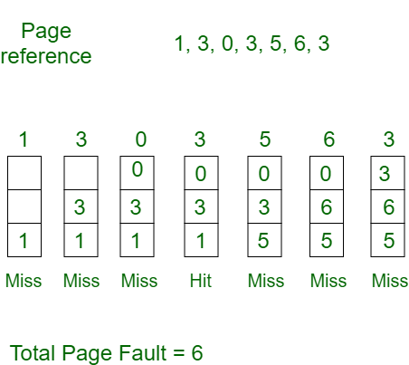
Consider page reference string 1, 3, 0, 3, 5, 6,3 with 3 page frames . Find number of page faults.
Initially all slots are empty, so when 1, 3, 0 came they are allocated to the empty slots —> 3 Page Faults. ​
when 3 comes, it is already in memory so —> 0 Page Faults. ​
Then 5 comes, it is not available in memory so it replaces the oldest page slot i.e 1. —>1 Page Fault. ​
6 comes, it is also not available in memory so it replaces the oldest page slot i.e 3 —>1 Page Fault. ​
Finally when 3 come it is not available so it replaces 0 1 page fault

Slide 18
CODE
#include<bits/stdc++.h>
using namespace std;
int main()
{
int referenceString[10], pageFaults = 0, m, n, s, pages, frames;
printf("\nEnter the number of Pages: ");
scanf("%d", &pages);
printf("\nEnter reference string values:\n");
for(m = 0; m < pages; m++)
{
printf("Value No. [%d]:\t", m + 1);
scanf("%d", &referenceString[m]);
}
printf("\nWhat are the total number of frames: ");
{
scanf("%d", &frames);
}
int temp[frames];
for(m = 0; m < frames; m++)
{
temp[m] = -1;
}
for(m = 0; m < pages; m++)
{
s = 0;

Slide 19
for(n = 0; n < frames; n++)
{
if(referenceString[m] == temp[n])
{
s++;
pageFaults--;
}
}
pageFaults++;
if((pageFaults <= frames) && (s == 0))
{
temp[m] = referenceString[m];
}
else if(s == 0)
{
temp[(pageFaults - 1) % frames] = referenceString[m];
}
printf("\n");
for(n = 0; n < frames; n++)
{
printf("%d\t", temp[n]);
}
}
printf("\nTotal Page Faults: %d\n", pageFaults);
return 0;
}
CODE

Slide 20
OUTPUT
Enter the number of Pages: 5
Enter reference string values:
Value No. [1]: 4
Value No. [2]: 1
Value No. [3]: 2
Value No. [4]: 4
Value No. [5]: 5
What are the total number of frames: 3
4 -1 -1
4 1 -1
4 1 2
4 1 2
5 1 2
Total Page Faults: 4

