Slide 1
NFT and IPFS

Slide 2
What is an NFT?
NFT stands for Non-fungible token
Non-fungible:
Unique
contain a small amount of arbitrary data
The value of an NFT is thus highly dependent on the data it contains and represents
Value is completely different from person to person based on aesthetic taste
By existing on the same networks that enable digital currency, NFTs leverage the payment and account infrastructure for transactions and benefits from security guarantees of the blockchain

Slide 3
Content Addressing
organizing and locating data in an information system in which the key used to locate content is derived from the content itself
Works just like key-value store interface, however, with one significant difference:
You no longer get to choose the keys, instead, the keys are derived from the values that are stored using a deterministic function that will always generate the same key for the same content
When there is one global key, and everyone try to change it, things become complicated
Either all follows the same rules, or the space needs to be splitted into domains
With multiple domains, we have problems when trying to get the value of the keys, and no easy way to tell all of them refer to the same value

Slide 4
Problem with web link HTTP
Http link is dynamic
Links can rot
Anyone can fetch the contents of the NFTs
Contents can be changed and there is no way to know if it has been changed or not
Data storage is much more expensive on blockchain networks
May 2021 the cost to store one megabyte of data directly on Ethereum was approximately 21.5 Ether (ETH) or about $56,000
NFT data needs to be stored “Off Chain” where storage is manageable
Limiting “on-chain” storage to a minimum.
Store only the link to the “off chain” data inside the NFT itself

Slide 5
How can we leverage content addressing to make NFTs with durable links?

Slide 6
IPFS (the InterPlanetary File System)
When data is stored on IPFS, users can fetch it from any IPFS node that has a copy.
Makes data transfers more efficient and reduce load on any single server.
As each user fetches a piece of data, they keep a local copy around to help other users who might request it later.
IPFS provides a content identifier (CID) that's directly derived from the data itself and links to the data in the IPFS network.
CID can only link to one content at a time, so we’re sure that no one can replace or alter the content
ipfs://<CID>
Link is immutable
Nft.storage.net
Free storage and bandwidth for public NFT data
Makes it easy to get our data onto IPFS
Long term persistence
Backed by the decentralized Filecoin storage network
Developers register for an account, generate an API access key, and can use a simple client library to generate meta data and permanently store their NFTs

Slide 7
Content Persistence
How do we ensure that our data continues to be available throughout time? (AKA persists)
Decentralized vs Centralized content persistence
Centralized - go to a service that will promise to always store our content on their servers (does not achieve true persistence, as its subject to single centralized point of failure
Decentralized - Only way to ensure true persistence.
Uses completely separate, interoperable nodes to store strong cryptographic guarantees protection from becoming unavailable due to any action (or inaction) of any centralized server.
Filecoin
Decentralized Storage Unit
Builds the foundation for content persistence
Creates a set of tools and services
Proving Algorithms (verification) :
Proof-of-Replication
Proof-of-Spacetime

Slide 8
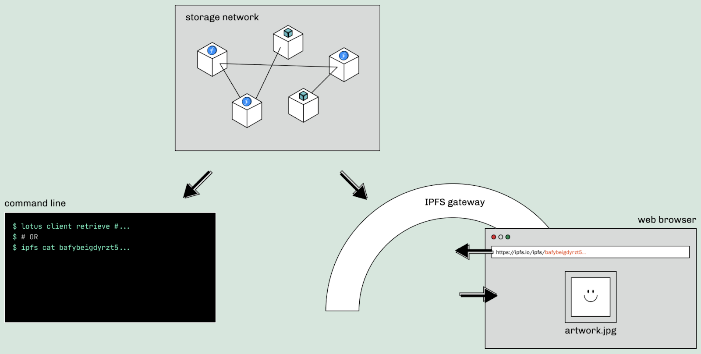

Slide 9
Techstack Plan
We decided to build a web app for our MVP
The backend will utilize NFTs & Smart Contracts:
Language(s): Solidity (for smart Contract) + Javascript (Web3.js)
Environment: Hardhat (for Javascript)
Frontend - similar to Web2:
Language(s): HTML, JavaScript, CSS
Framework: NextJS or React

Slide 10
Next Sprint Plan
Each person completes the tutorials on:
Solidity & Web3: Build a Web3 App with Solidity + Ethereum Smart Contracts | Buildspace
NFT & IPFS: Mint an NFT with IPFS | IPFS Docs
Design the UX/UI for the web application using Figma/Balsamiq
Build the first smart contracts for the projects and run on testnet

