Slide 1
DrinkUp
& WeDeliver
Testes e Qualidade de Software
Orlando Macedo, 94521
Rui Fernandes, 92952
Óscar Fernandez, 101631
Inês Leite, 92928
Pedro Marques, 92926
Notes:
Rui

Slide 2
Project Concept
WeDeliver:
An app for order delivery
Drink Up:
An app for ordering alcoholic beverages
Notes:
Rui

Slide 3
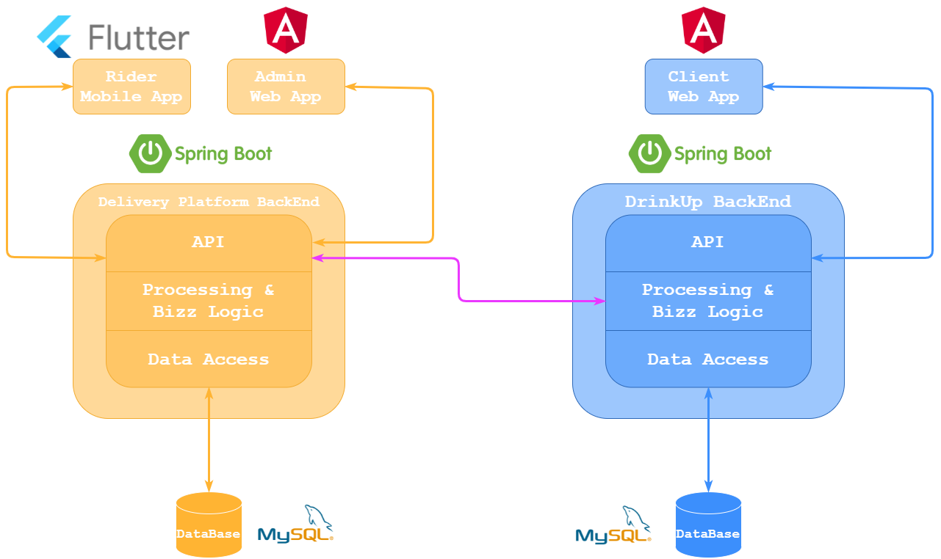
Project Architecture And Technologies
Notes:
Rui

Slide 4




Quality Assurance
Github Workflow
New User
Story
New Branch
Pull Request
To Dev
Pull Request
To Release
Pull
Request
To Main
CI/CD
Notes:
Orlando

Slide 5
Demos
WeDeliver Rider
WeDeliverAdmin
Drink Up

