Slide 1
Project Report: Sales Data Analysis and Dashboard
Introduction
In today’s data-driven business environment, understanding historical sales patterns helps companies make informed decisions, boost profitability, and gain a competitive edge. This project focuses on analyzing the Superstore sales data using Microsoft Excel and Power BI. The primary objective is to create an insightful and interactive dashboard that helps visualize key business metrics like revenue, profit, and order volume across various segments, regions, and time periods.
Objectives
Collect, clean, and preprocess sales data.
Identify key performance indicators (KPIs) to measure business health.
Analyze regional, categorical, and temporal trends in sales and profit.
Create a user-friendly interactive dashboard using Power BI.
Deliver recommendations to improve business decision-making.
Tools and Technologies Used
Microsoft Excel: Initial data analysis using PivotTables and slicers.
Power BI: Advanced visualizations, dashboard creation.
Power Query Editor: Data transformation and cleaning.
Data Source: Superstore Sales Dataset (1000+ records, 20+ fields).

Slide 2
Dataset Overview
The dataset contains transactional information from a retail store, including:
Temporal Data: Order Date
Geography: Region, Segment
Product Hierarchy: Category, Sub-Category
Sales Information: Sales, Quantity, Profit
The cleaned dataset contains 1,000 records.
KPI | Value
Total Sales | ₹493,348.75
Total Profit | ₹124,913.67
Total Quantity Sold | 4,991 Units
Top Sales Month | March
Top Region (Sales) | Central
Top Segment (Sales) | Home Office
Top Category | Technology
Top Sub-Category | Accessories (₹61,264.07)

Slide 3
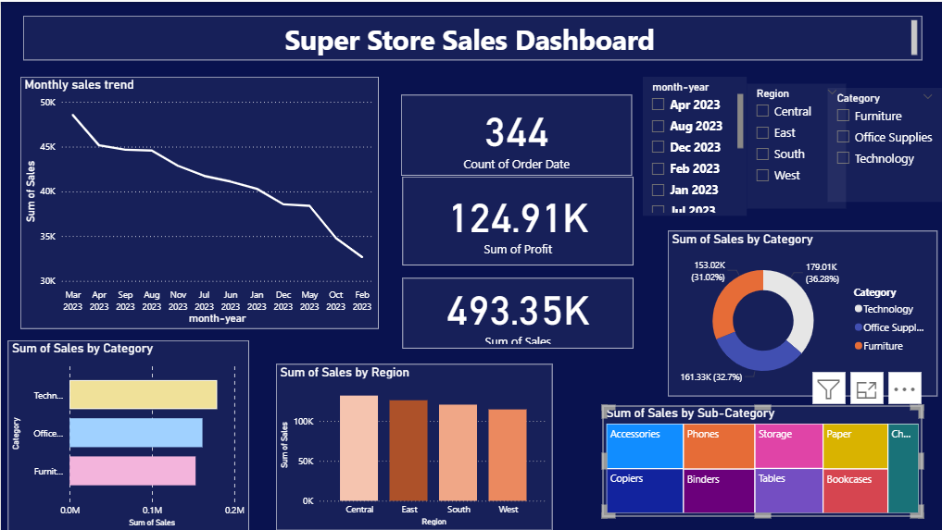
Super Store Sales Dashboard Summary Report
Date Range Covered:
March 2023 to February 2024

Slide 4
Key Performance Metrics:
Total Sales: $493.35K
Total Profit: $124.91K
Total Orders: 344
1. Monthly Sales Trend:
There is a steady decline in sales over the year.
The highest sales occurred in March 2023 (~47K).
Sales gradually fell below 35K by February 2024.
Indicates a need to investigate causes of decreasing sales over time (seasonality, supply issues, etc.).

Slide 5
2. Sales by Category:
Technology: $179.01K (36.28%)
Office Supplies: $161.33K (32.79%)
Furniture: $153.02K (31.02%)
Insight:
Technology leads in sales, but all three categories are relatively close in value. Balanced contribution across product categories suggests diversified revenue streams.
3. Sales by Region:
All four regions (Central, East, South, West) perform closely in total sales.
The East and Central regions have marginally higher sales compared to the South and West.
Insight: No region significantly dominates. Indicates potential to drive growth by tailoring strategies regionally.

Slide 6
4. Sales by Sub-Category:
Top-performing sub-categories appear to be:
.Phones, Accessories, and Storage
Sub-categories like Binders, Copiers, and Bookcases contribute less to overall sales.
Insight: Focus marketing and inventory strategies on high-performing sub-categories, while exploring ways to boost underperformers.

Slide 7
Conclusion:
The Super Store is generating steady revenue across multiple regions and product categories, but the downward sales trend month-over-month is a concern. Technology is the strongest category, and phones/accessories are key sub-category drivers.

Slide 8
THANK YOU

