Slide 1


Slide 2
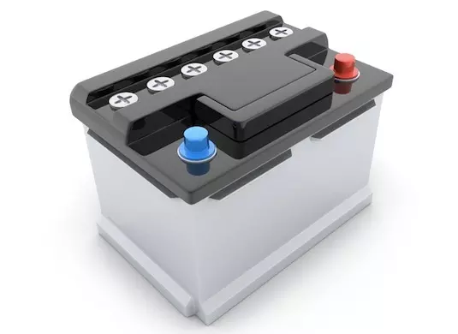
About Us
The WHOs
Invented the Triumvirate Nitro Tessellation Battery
The WHO-verboard

Slide 3
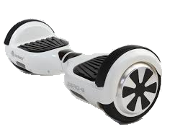
The WHO-verboard
$100 - $200
Why us?

Slide 4
If you buy…
Cant ship through air
Cant ship through sea
Only by land

Slide 5

Valid Countries
United States of America
Canada
Mexico

Slide 6
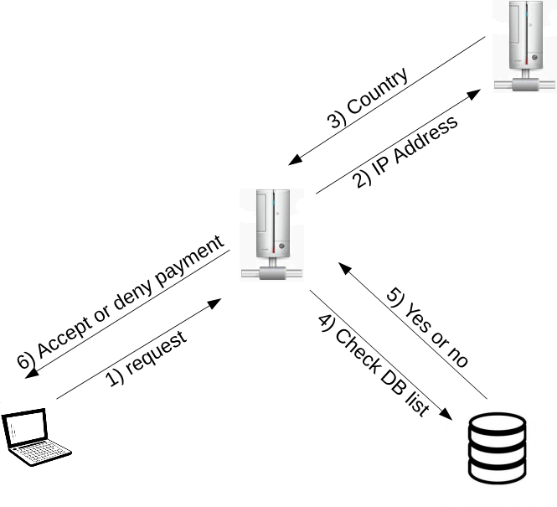
How the website works

Slide 7
Where to buy
WHOverboard Website

