Slide 1
Lab: Data Visualization and Analysis
Topic: Transport of Goods
Addressing Topic: Impact On Environment
By:
Devendra Hupri Doriel Habasllari
Nagesh Taverekere Ramamoorthy Chandan Acharya

Slide 2
Impact of CO2 on environment
Total Goods
Fuel Consumed
CO2 Released

Slide 3
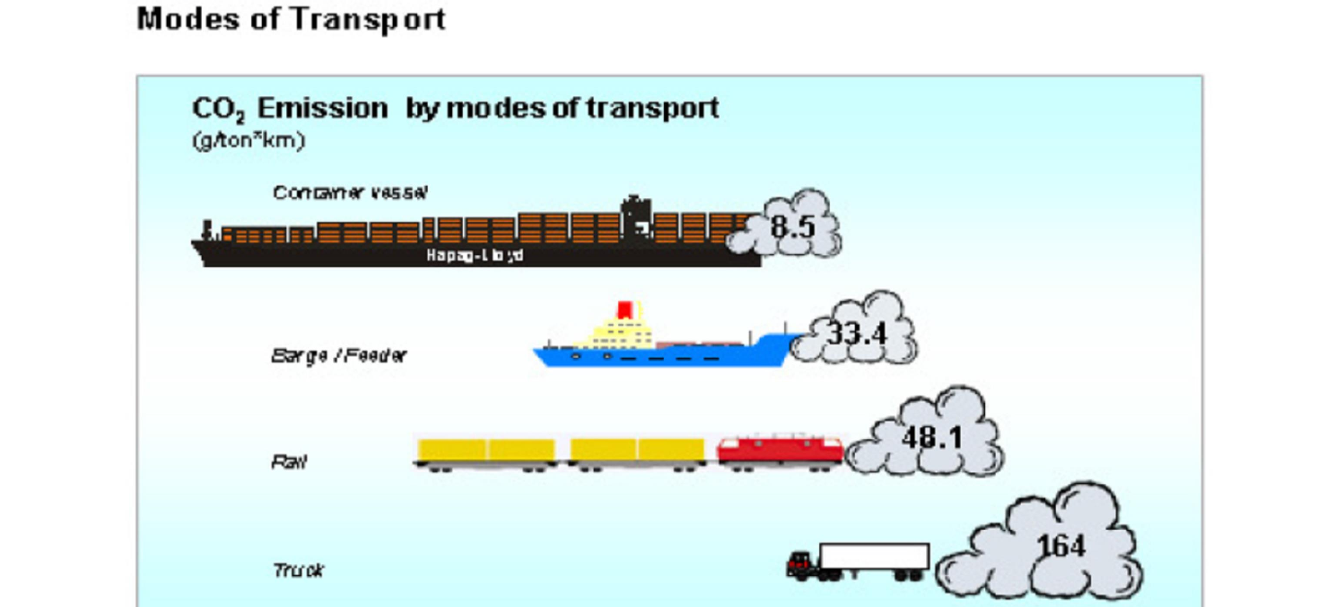
Modes of Transport

Slide 4
Total Transport Report

Slide 5

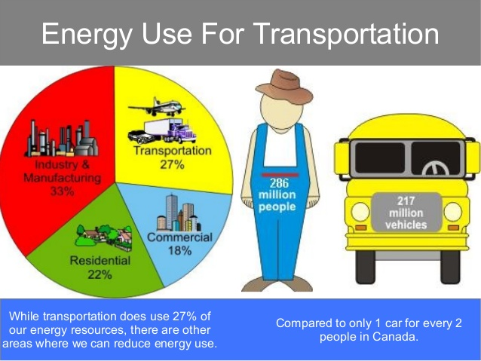

Slide 6
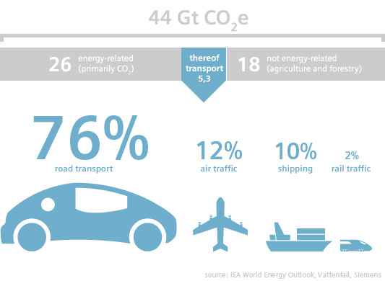
C02 released by different modes of transportation

Slide 7
Map

Slide 8
Comparison

Slide 9
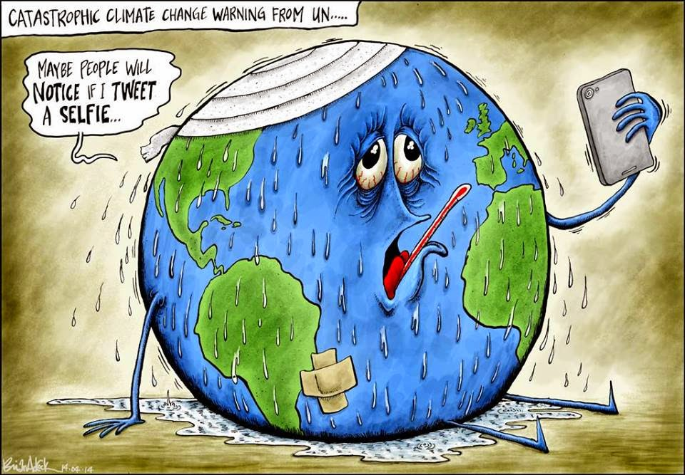
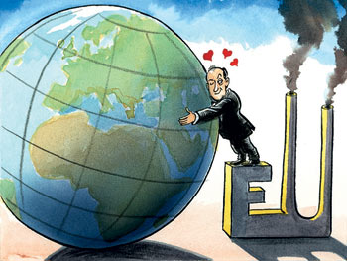

Slide 10


