Slide 1
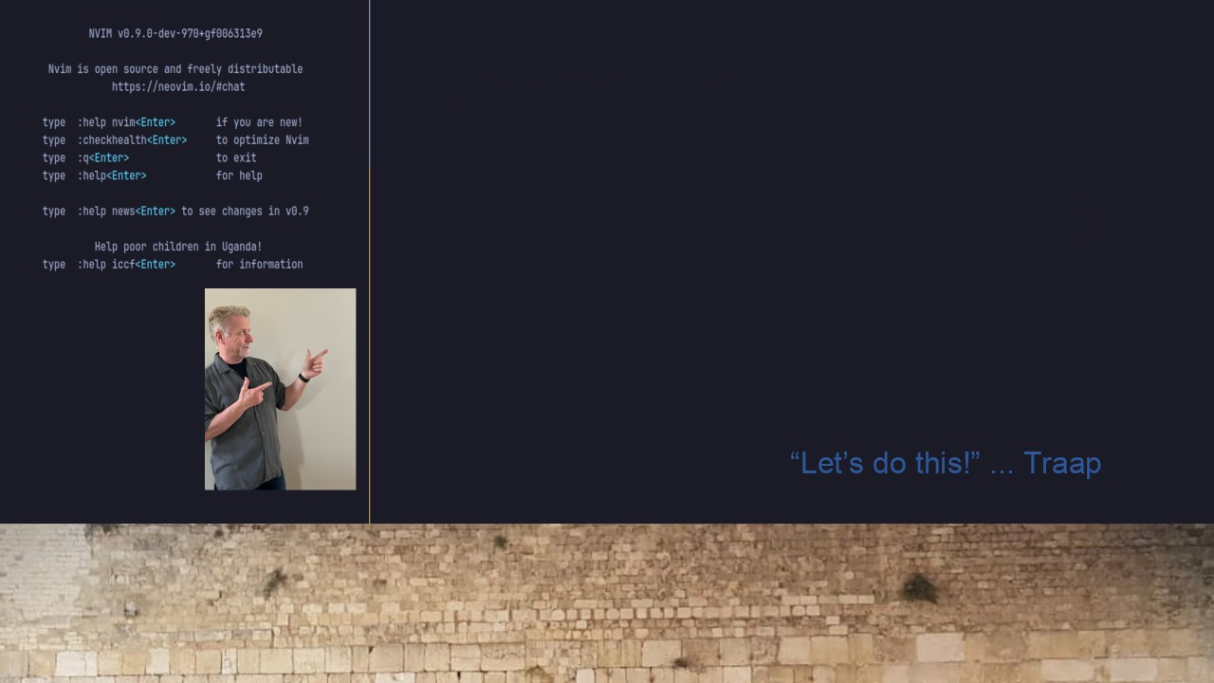
#35 Harpoon2 & Neovim
ThePrimeagen’s Harpoon2
Amazingly simple upgrade
Integration with Telescope

