Slide 1
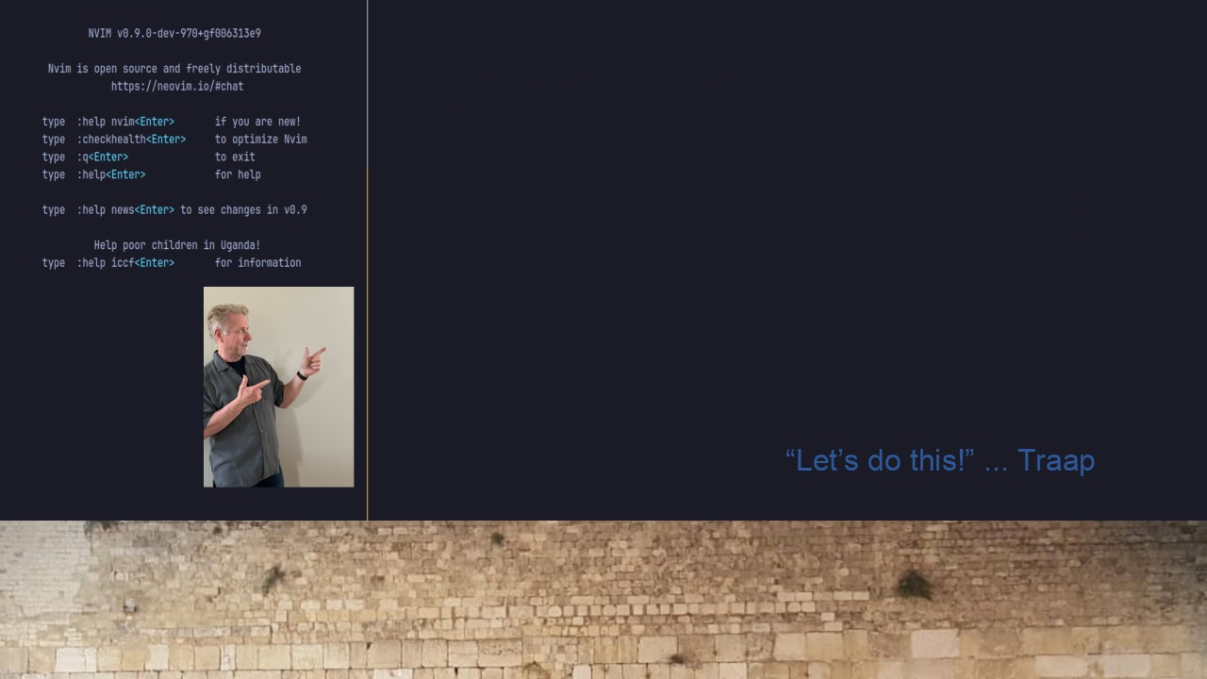
#30 TMXU & Neovim
Navigation
With Ctrl-[H,J,K,L]

