Slide 1
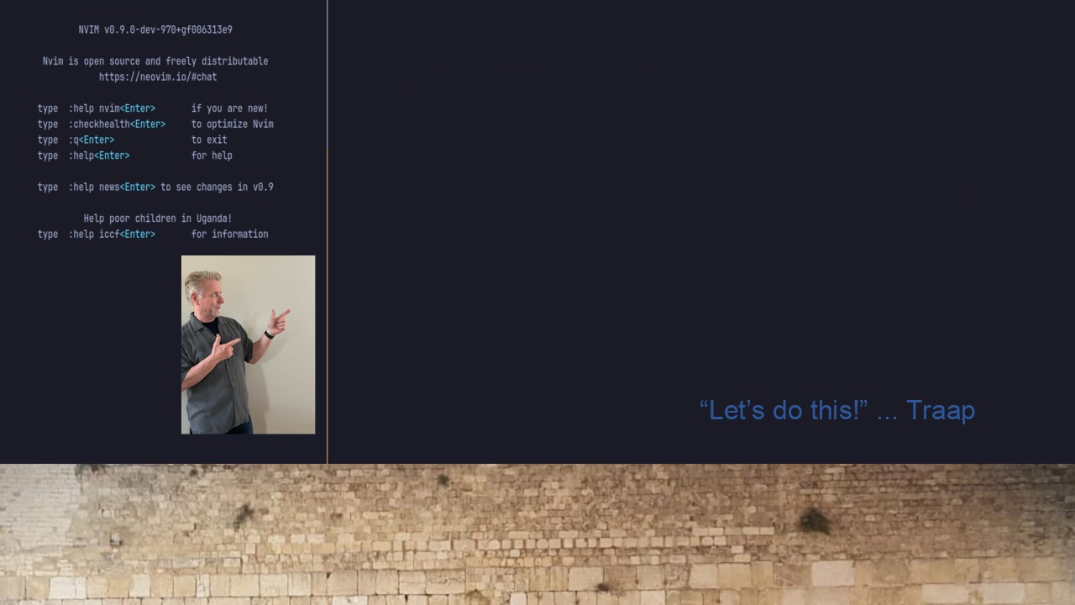
#25 Finding a Pattern
fzf as an interactive Ripgrep launcher
How I quickly find text and launch Neovim

