Slide 1
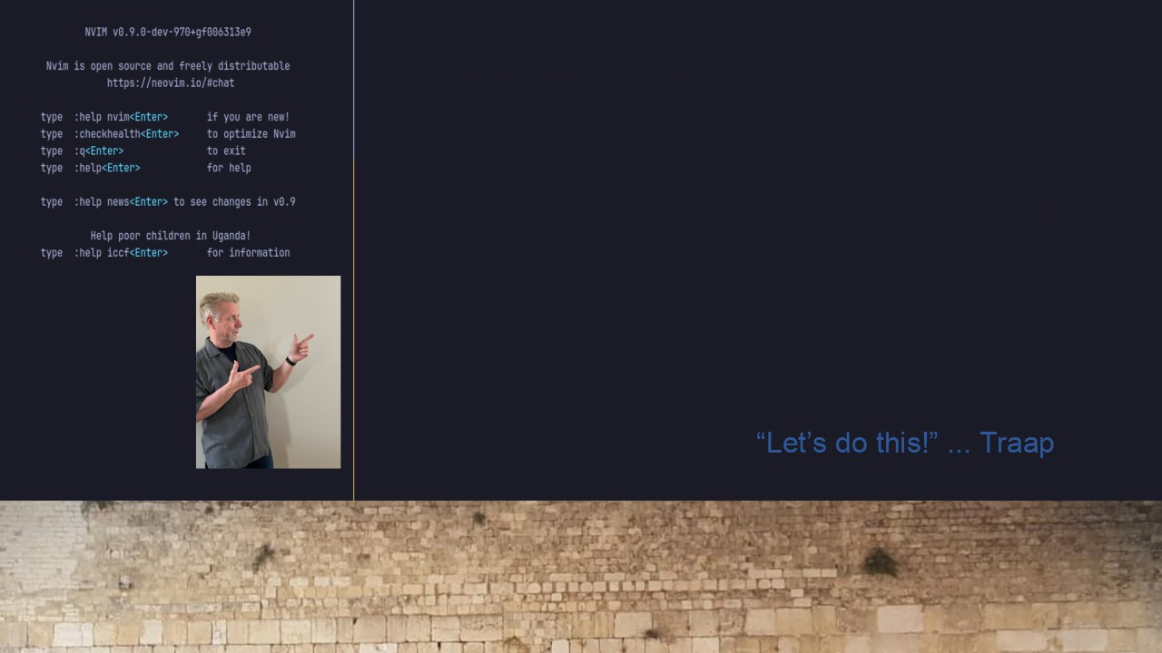
#33 LSP-ZERO.NVIM
Easy to use Neovim and LSP configuration:
https://github.com/Traap/lazy.zero

