Slide 1
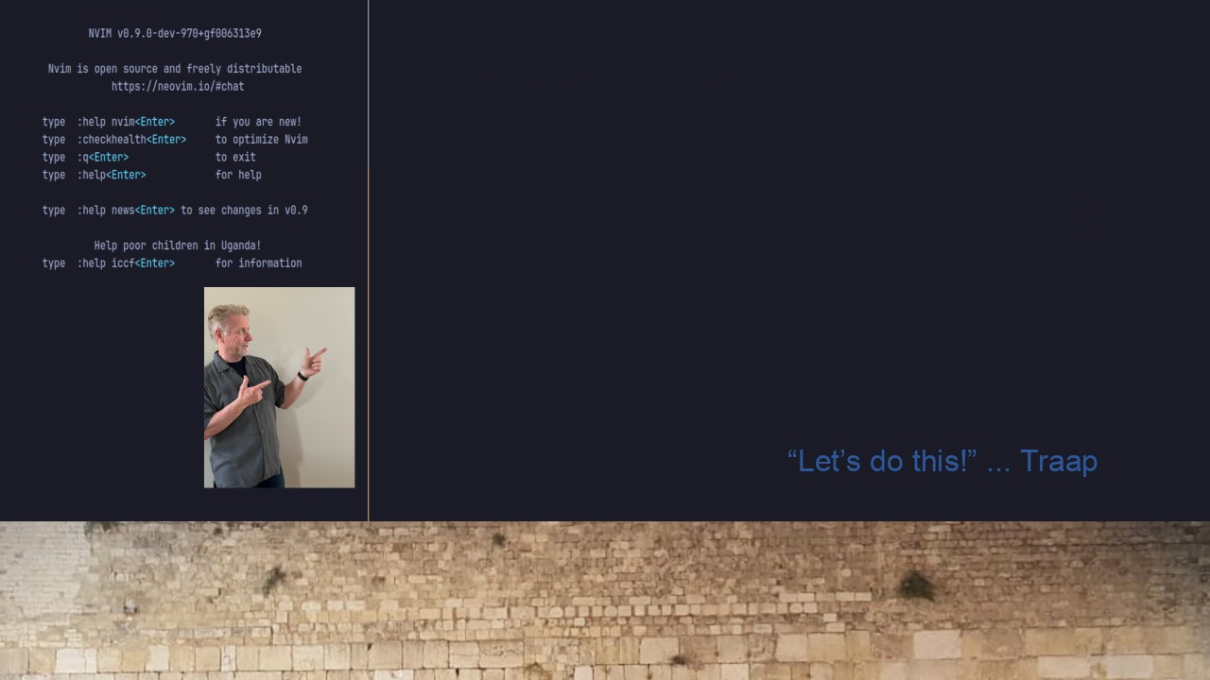
#21 Archlinux & WSL2
TMUX, Neovim, and Vim
Answering a Viewers Question

