Slide 1
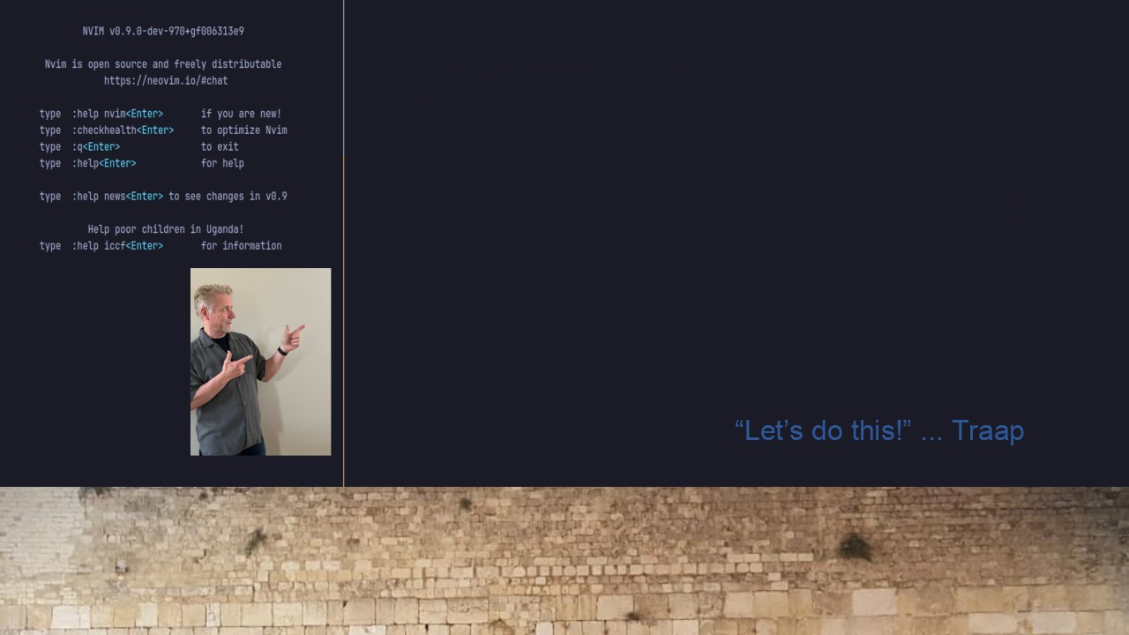
#31 NVIMS Update NeoVim Config Switcher
Move Repository
https://github.com/Traap/nvims

