Slide 1
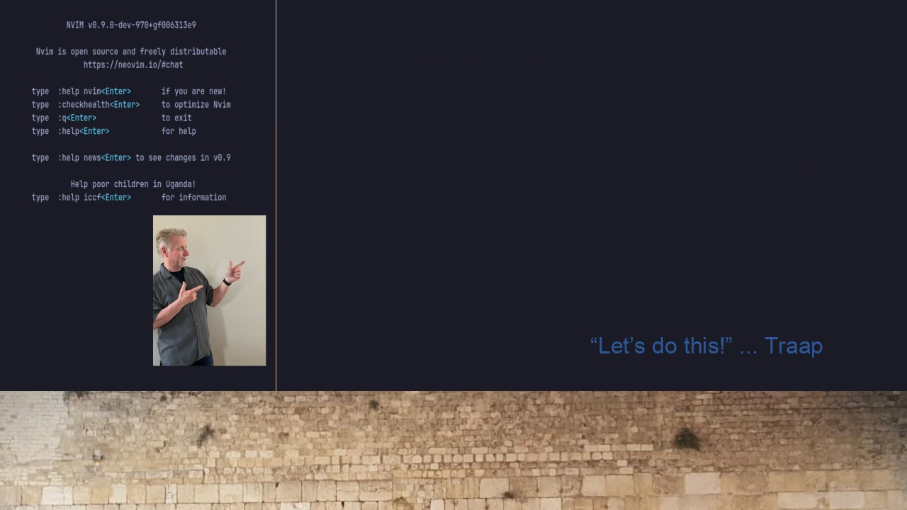
#26 TMUX Productivity
Toggle TMUX sessions.
Alt-N Toggle Neovim
Alt-U Toggle Upgrade
Alt-Y Toggle YouTube

