Slide 1
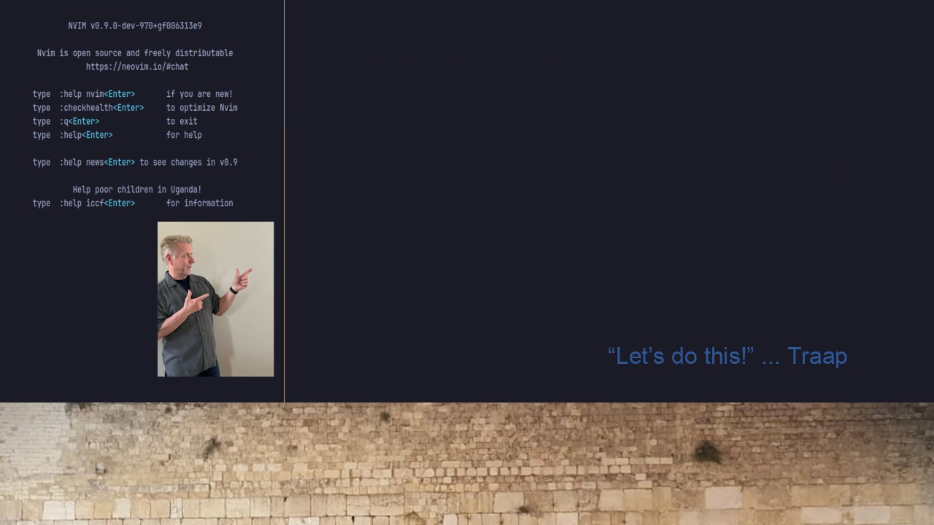
#36 lazy.nvim & nvims
Demonstrate
lazy.nvim
Correct dependencies for
Harpoon
Telescope-fzf-native

