Slide 1
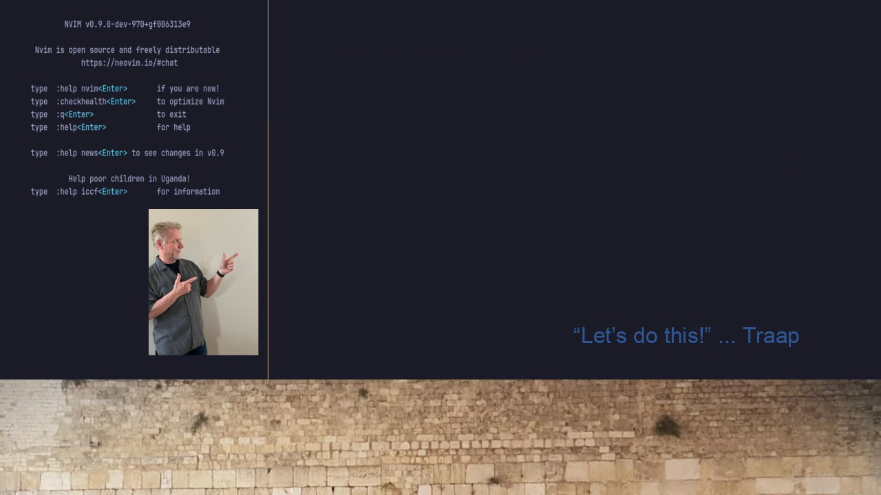
#32 CLIPBOARD IMAGE for Neovim
Single solution:
Arch / Ubuntu
Window 10 / 11
WSL2 +

