Slide 1
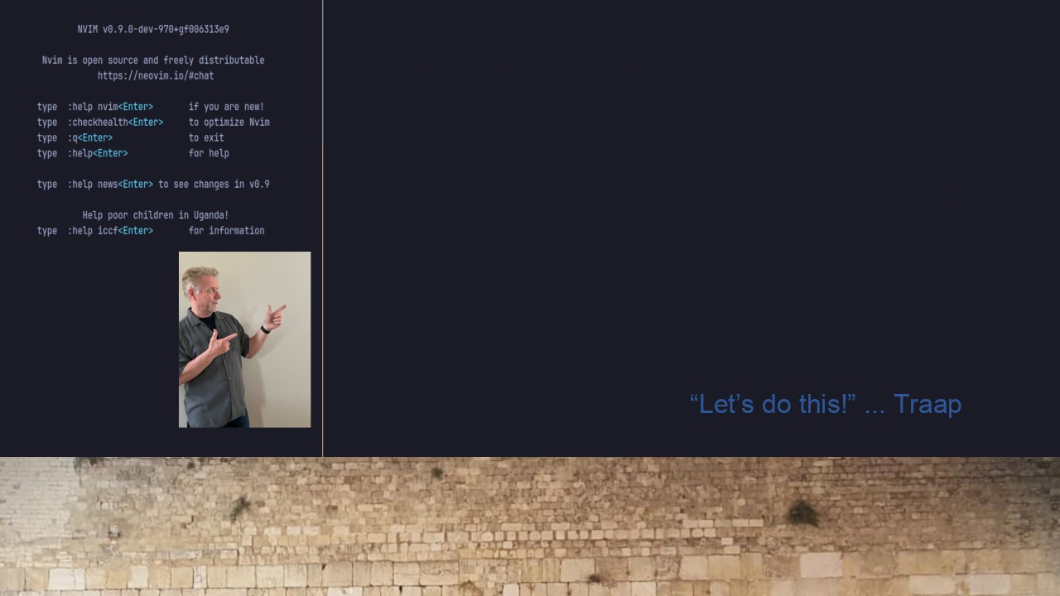
#05 Neovim & Lazy
Blazingly fast startup
~23ms
Part: 1

