Slide 1
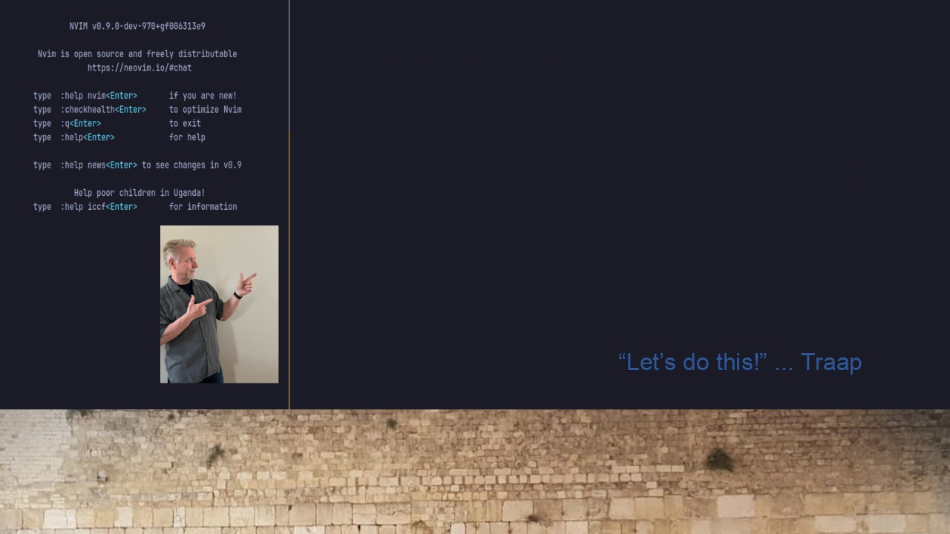
#34 IMG-CLIP.NVIM
Paste or Drag-n-Drop Images
to your Neovim documents.
https://github.com/HakonHarnes/img-clip.nvim

