Slide 1
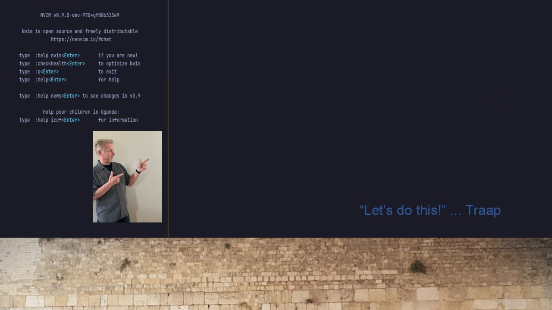
#22 Multiple Neovims?
Config, Use, & Delete them Safely!
Inspired by Elijah Manor’s Neovim Config Switcher
YouTube Video

