Slide 1
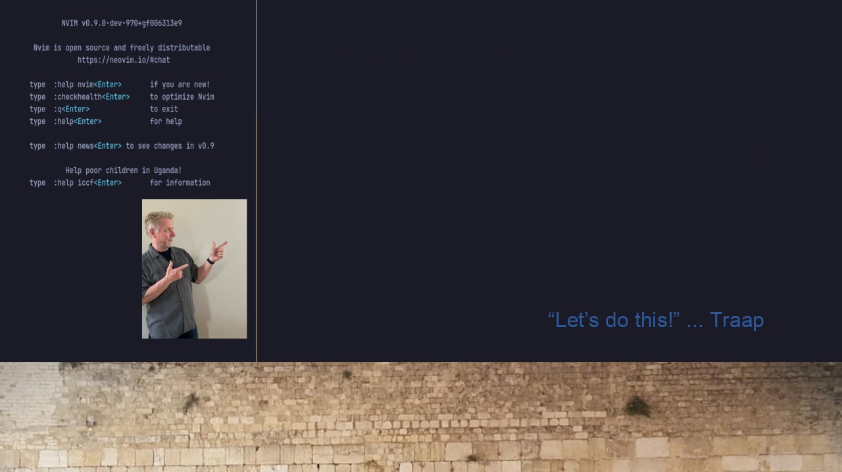
#27 TLC-ARTICLE
A Custom LaTeX Document Class
Use to assemble
Basic document
Customize header & footer
Atomic Elements

