Slide 1
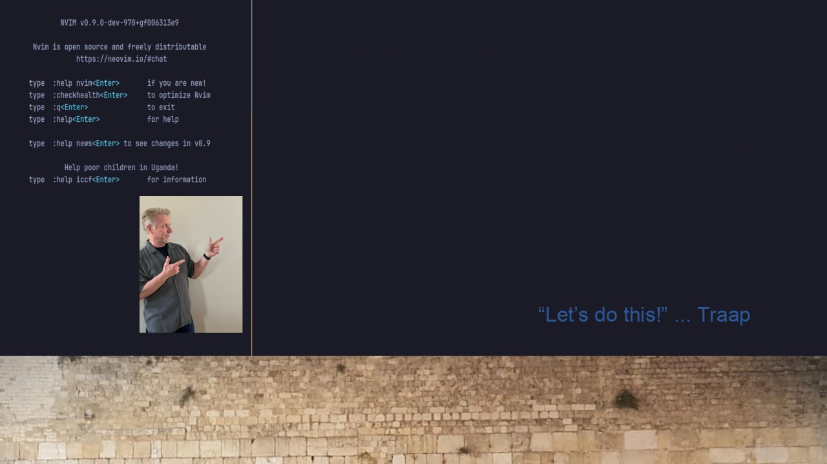
#31 NVIMS Update NEVIM Config Switcher
Move to Repository https://github.com/Traap/nvims

