Slide 1
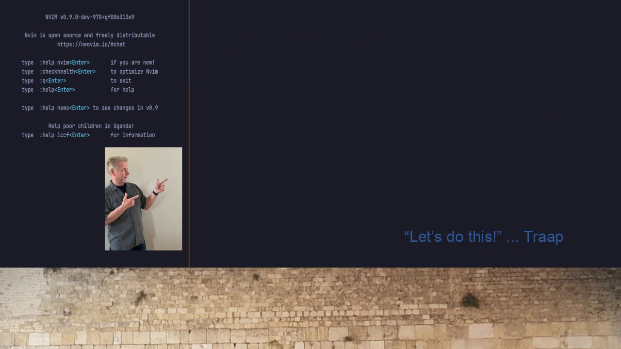
#18 Neovim
Simple: LazyVim Customization
todo-comments.nvim

