Slide 1








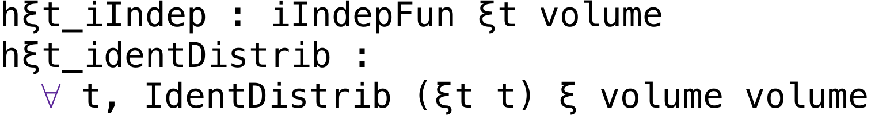




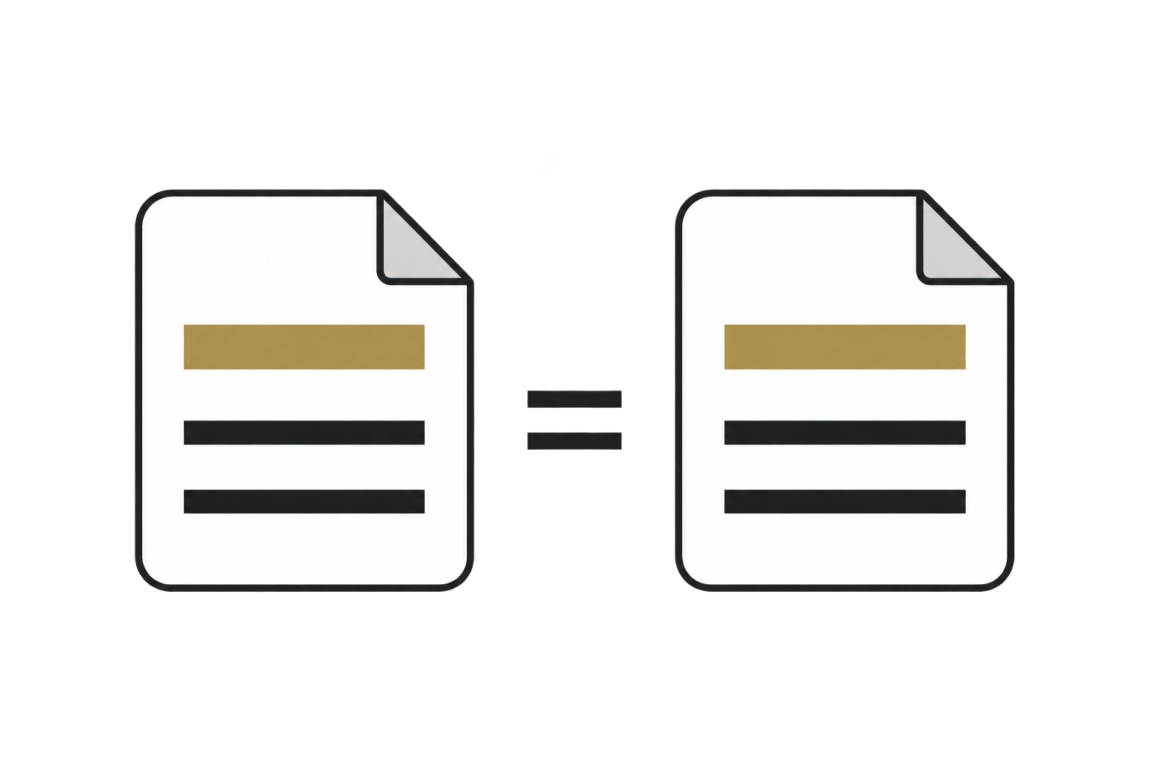




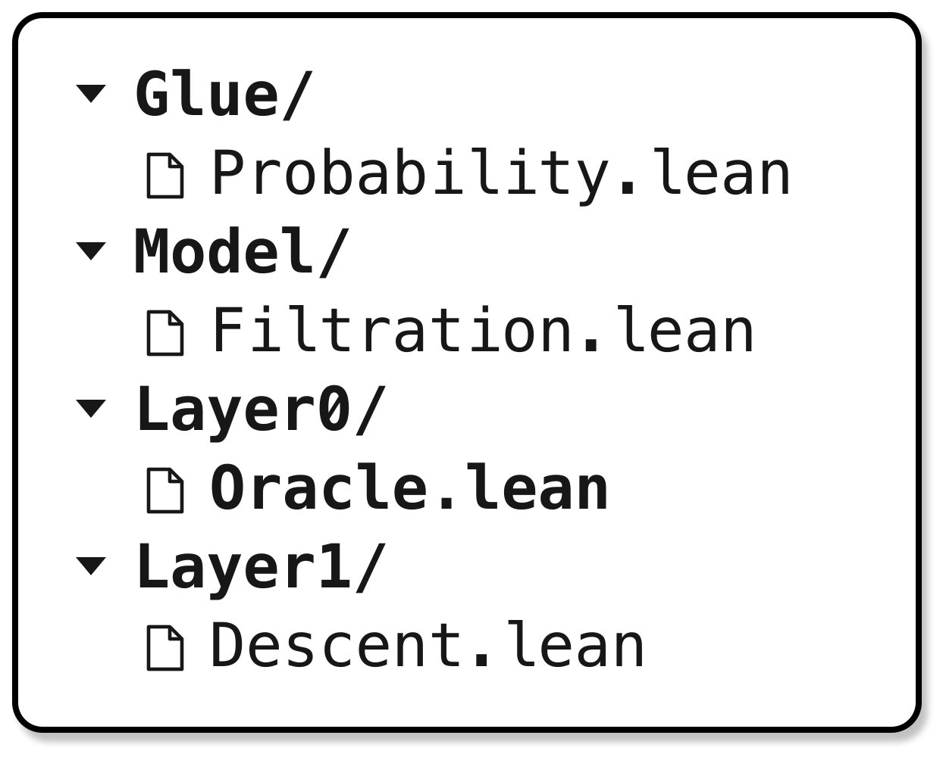
Model
Prove
Lean goal
Reconstruct
A
Algorithm
Target theorem
Expose sampling history
revise
Proof obligations
Signature contract
Blueprint
Descent step
Source:
i.i.d. sampling
T
Main theorem
Conditional expectation
Scope:
stochastic process
Planner
Measurability
Output bound
Prover
Proof trajectory
Role: derived lemma
P
Source proof
Current Lean goal
Lean model
Retrieve a mean-zero lemma
for each fixed x.
Try it at the current iterate x
x depends on F. The conditional goal is still open.
Scope check
Claim check
Second Judge
Inspect how x and ξ depend on history F
1
2
3
Audit
Show x is F-measurable: it uses only the past.
Source-backed
Same algorithm
Agrees with
Judge
process change?
and theorem?
first Judge?
Resume proving
approve
Reuse
Show the current sample ξ is independent of F.
Completed proof
Certify
Extract and Merge
SOptLib
Construction records
Lean
Layer0/Oracle.lean
knowledge/
Modeling
descent
oracle
Sampling & freshness
No goals
model
Proof patterns
source audited
Pitfalls
Search & inspect
Conventions
Notes:
SMD source: ProofLoom commit b8d93f3. Input A: algorithm_spec update and sampled oracle, lines 2888–2900, 2937–2954. Input T: main theorem statement, lines 4293–4310. Input P: key conditional-noise step, lines 3731–3753; the complete proof has additional descent and averaging steps. Input formulas summarize the source under its stated assumptions. formalizations/StochasticMirrorDescent/Algorithms/Unverified/StochasticMirrorDescent.lean:2476–2501, 2882–2886, 3066–3073, 3731–3753. Reusable bridge: formalizations/StochasticMirrorDescent/SOptLib/Layer0/Oracle.lean:413–440. F and δ are display aliases. Review icons are AI-generated illustrations of source evidence, target preservation and independent cross-review. The Lean model card excerpts the actual structure and sample-stream fields; structure parameters, other fields, proof bodies and some library hypotheses are elided with ellipses.

