Slide 1


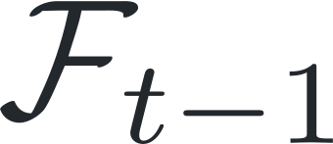


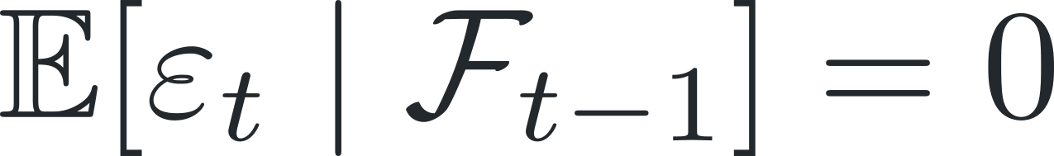
(a) Bottom-up
(b) Proof-obligation-driven (ours)
Main theorem
Main theorem & proof
Next theorem
theorem
smd_convergence
theorem
smd_convergence
import
... := by
... := by
SOptLib
have
h_noise :
Proof obligation
Test interfaces
condExp F (ε x) = 0 := ?_
Stochastic interfaces
Reuse
Theory under construction
prove
def
filtration ...
lemma
noise_centered ...
Sampling history
Stochastic oracle
Bridge lemmas
Lean foundations
def
filtration
def
oracle
lemma
seq t := ...
𝜀(𝑥) = 𝐺(𝑥, 𝜉) − 𝑔(𝑥)
noise_centered :
def
MeasurableSet ...
theorem
integral_add
𝐺(𝑥, 𝜉)
condExp F (ε x)
𝑥
= 0 := by ...
Measure
Integration
Probability
Stochastic
Convex
Extract, Generalize & Integrate
theory
processes
analysis
(Ω, Σ, 𝜇)
∫ 𝑓 d𝜇
𝔼[𝑋]
𝑋₀, 𝑋₁, …
∇𝑓(𝑥)
SOptLib
Definitions
Interfaces
Lemmas
Notes:
Source: Fig1_Methodology_Refined_v6.pptx. This revision removes the refine interface annotation and associated short orange loop at the user’s request. Sampling history, stochastic oracle and bridge lemmas retain the existing common construction heading, mathematical content and connections. Three aligned green collection stems meet a shared horizontal rail. One downward arrow leads to SOptLib after the full target proof closes; the check seal sits separately beside that arrow. All content remains an editable schematic. Required sampling, measurability and integrability conditions are omitted at this overview level.

