Slide 1
A Predator-Prey model For Largemouth Bass and Channel Catfish
Trace Patterson
Tarleton State University
Dr. Christopher Mitchell

Slide 2
Importance
Over 7,000 lakes, and 800,000 private ponds in Texas.
Bass and Catfish are most popular/common sport fish.
Model could be used to estimate fish population, without using test instruments.
If healthy populations are maintained, lakes and pond managers could save thousands of dollars

Slide 3
Assumptions
Similar sizes of each fish.
Constant water level.
½ Acre Pond ~ 15 ft deep.
Ample amount of Insects.
No predators.
Natural Mortality is included.
Quality of Water is adequate.

Slide 4

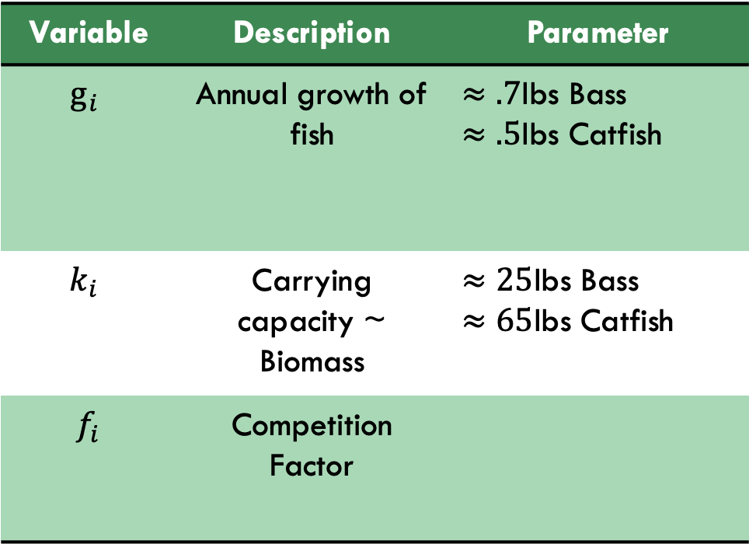
Variables
Lotka-Volterra
Equations
${Catfish}^{′}=Cg_{c}\left(1−\frac{C}{k_{c}}\right) −f_{c}CB$
${ Bass}^{′}=Bg_{b}\left(1−\frac{B}{k_{b}}\right)−f_{b}CB$
Variable | Description | Parameter
$$g_{i}$$ | Annual growth of fish | $≈.7$lbs Bass $≈.5$lbs Catfish
$$k_{i}$$ | Carrying capacity ~ Biomass | $≈25$lbs Bass $≈65$lbs Catfish
$$f_{i}$$ | Competition Factor

Slide 5


Catfish win
Conditions
$$Competiton_{b} >\frac{Growth_{b}}{Carrying_{c}}$$
Equilibrium
$$(C→65 lbs,B→0)$$

Slide 6

Bass win
Conditions
$$Competiton_{c} >\frac{Growth_{c}}{Carrying_{b}}$$
Equilibrium
$$(C→0 lbs,B→25 lbs)$$

Slide 7

Co-Existence
Conditions
$$0<Competition_{b}≤ \frac{{Growth}_{C}}{{Carrying}_{C}}$$
$$\& 0<{Competition}_{c}<\frac{{Growth}_{b}}{{Carrying}_{b}}$$
Equilibrium
$$(C→42.35 lbs,B→17.44lbs)$$

Slide 8
Improvements/Future Works
water level
Harvesting rate
Feeding Benefits
Expanded
to Lakes

Slide 9
References
Anderson, Dr. R. O. A., & Lusk, B. L. (n.d.). Managing Fish Naturally. Retrieved from https://www.bassresource.com/fish_biology/natural-fish-management.html
Lusk, B. L. (n.d.). Big Bass in Small Ponds .Retrieved from https://www.bassresource.com/fish_biology/big_bass_pond.html
D. Michael Leonard, Dennis R. DeVries & Russell A. Wright (2010) Investigating Interactions between Channel Catfish and other Sport Fishes in Small Impoundments, North American Journal of Fisheries Management, 30:3, 732-741, DOI: 10.1577/M09-141.1
Texas Farm Ponds: Stocking, Assessment, and Management Recommendations ;Special Publication Number 1 Texas Chapter of the American Fisheries Society Revised January 2005; http://fisheries.tamu.edu/files/2013/10/Texas-Farm-Ponds-Stocking-Assessment-and-Management-Recommendations-.pdf
Texas Chapter of the American Fisheries Society. (2005, January). Texas Farm Ponds: Stocking, Assessment, and Management Recommendations. Retrieved from http://fisheries.tamu.edu/files/2013/10/Texas-Farm-Ponds-Stocking-Assessment-and-Management-Recommendations-.pdf
https://www.turbosquid.com/3d-models/channel-catfish-3d-obj/997420
https://www.fishmountstore.com/largemouth-bass-19-inch-full-mount-fish-replica/

