Slide 1
CpE 403 Final Project
Trace Stewart, Guillermo Galvez

Slide 2
Goal
Main Goal
The goal will be to interface a sensor (I2C/SPI/ADC) etc to the sensor node and transmit the data using TI-15.4 stack RF to the co-processor. The co-processor CC1350 interfaced to the BBB collects the data and the BBB displays or visualizes the data.
Objectives
The goal(s) were accomplished by interfacing a temperature sensor that was included in the sensor program that collected the data in Celsius then would send the data to the co-processor which would receive that data and send it to the BBB.

Slide 3
Outcome - Accomplishments
That outcome of our project was successful. We were able to interface a temperature sensor to the sensor board that had code written for it already. The sensor board then sent that data to the co-processor which would process the data and send it to the BBB. The BBB would then upload the data to an online source to show the temperature. We attempted to try and use Humidity and Lux since those were in the code as well but failed when we didn’t have the sensors to use.
This project has a lot of uses from short to long term. It is a very universal way of transmitting data. From home projects to something that could be made into a business.

Slide 4
Components Used in Design
The main hardware that we used was 2 CC1350 boards, 1 Beagle Bone Black, and FTDI to talk to the BBB through uart. We also used a temperature sensors and other hardware stuff to make the project fully work. The online visualization tool we used was the TI-15.4 stack collector app. This visualized the data we were collecting and displayed it onto the web.

Slide 5
Tools used in Design
CCS for programming CC1350
Virtual Machine
Ubuntu Linux
TI 15.4 Stack SDK
TI UniFlash

Slide 6
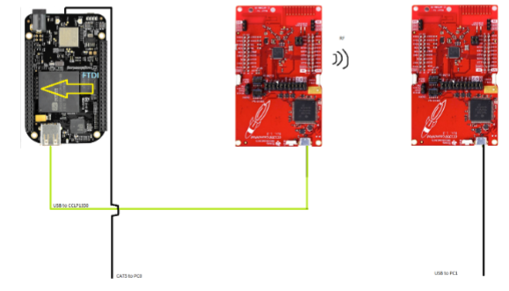
Schematics

Slide 7
Pre-requisites used in Design
Prerequisites
Commands to install prerequisites
$ sudo apt-get instal … (or)
$ git clone .... (install from src)

Slide 8
Implementation Details
Steps used in design:
How to Make Objective 1 to work?
How to make Objective 2 to work?
You can use more slides if needed

Slide 9
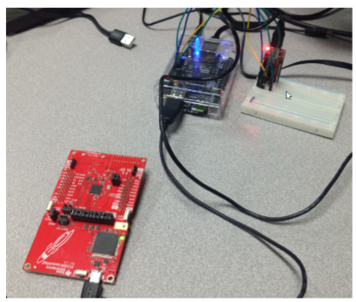
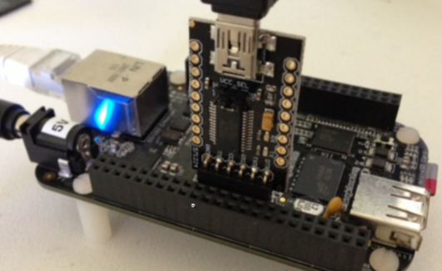
Actual project set-up

Slide 10
Demo
Video link only – don’t embed video

Slide 11
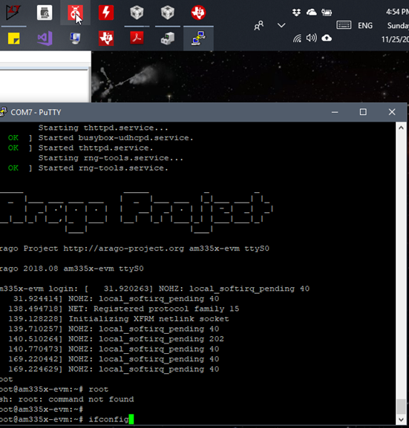
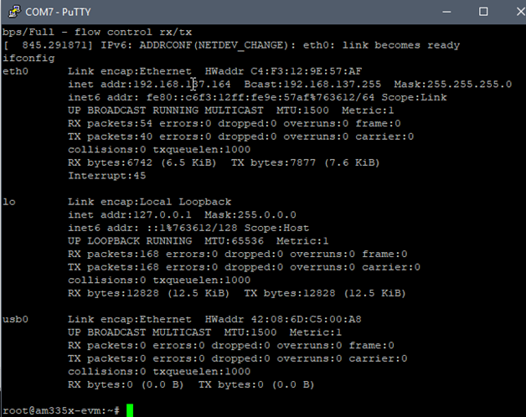
Results and Conclusions
These two pictures above show us getting the ip address of the BBB.

Slide 12
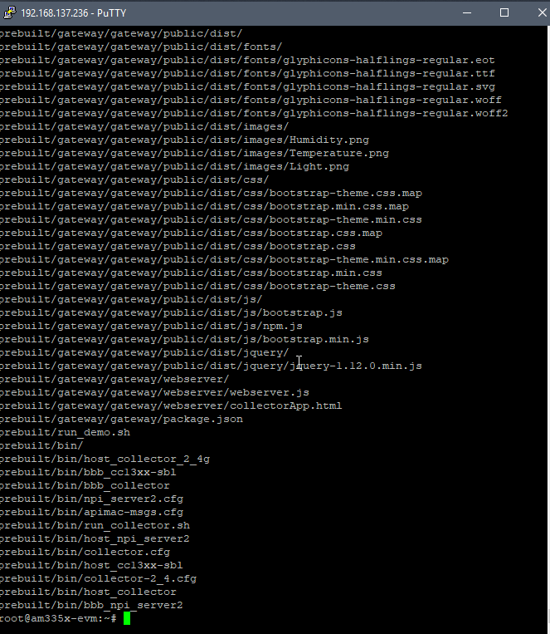
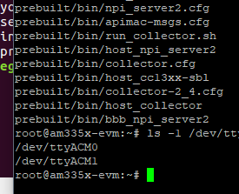
These two pictures show the building of the gateway.

Slide 13
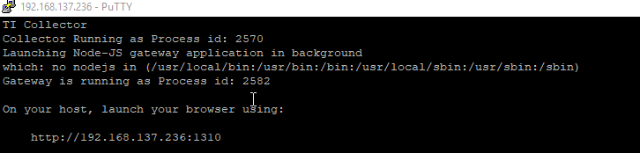
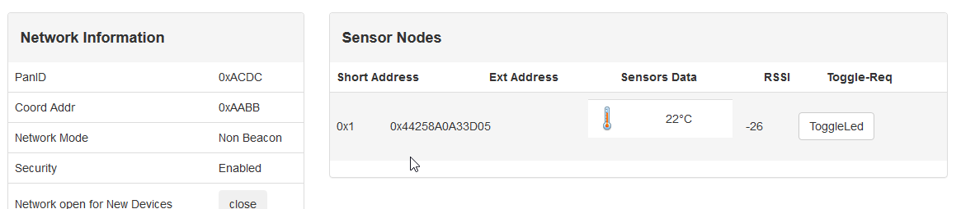
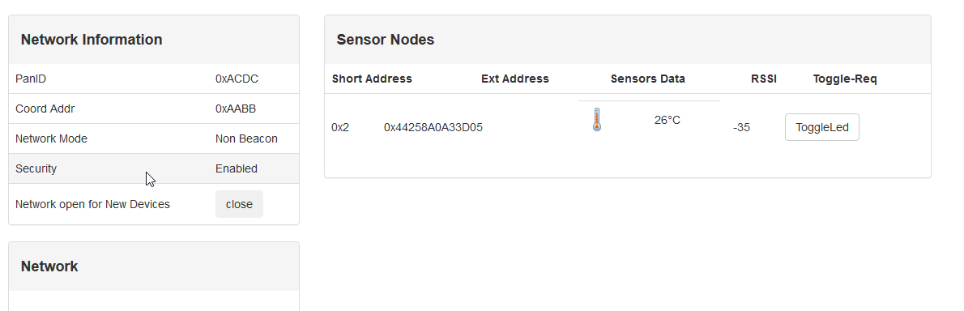
The picture above shows the ip address to login to to see the display of the sensor information

Slide 14
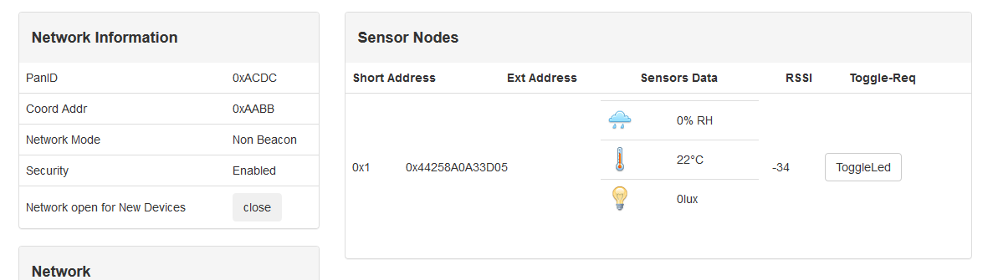
The 3 pictures listed above show the sensor data being shown on the TI 15.4 gateway. There is two temperature sensor pictures with changed data and one with lux and humidity.

Slide 15
Reference
Google
PDF’s provided
TI website and forums
StackOverflow

