Slide 1
Instructions for entrants
Please use this slide deck as a template when developing your submission for the FDA New Era of Smarter Food Safety Low- or No-Cost Tech-Enabled Traceability Challenge.
Slides 2-4 are for background information and a summary of the tech-enabled solution.
Slides 5-9 each correspond to one of the five evaluation criteria for this Challenge; please use these to explain how the tech-enabled solution addresses each criterion.
Slide 10 is an optional slide that you may choose to use to describe any future plans you have for further developing the tech-enabled solution.
Entrants are free to format the slides however they choose, so long as the headers on each of the slides are retained.
See section titled “Submitting to the Challenge” on the main Challenge webpage for full submission requirements.

Slide 2

Description of Entrant
The Traceability Internet Organization was founded to help reduce the cost of interoperability. We do this by providing free open-source software tools that allow traceability solutions to communicate with each other using standardized communication protocols and standardized data formats.

Slide 3
Summary of Concept
The Traceability Driver is a service that can be installed into an existing traceability solution that allows for the solution to become interoperable with other traceability solutions that also implement the Traceability Driver.

Slide 4
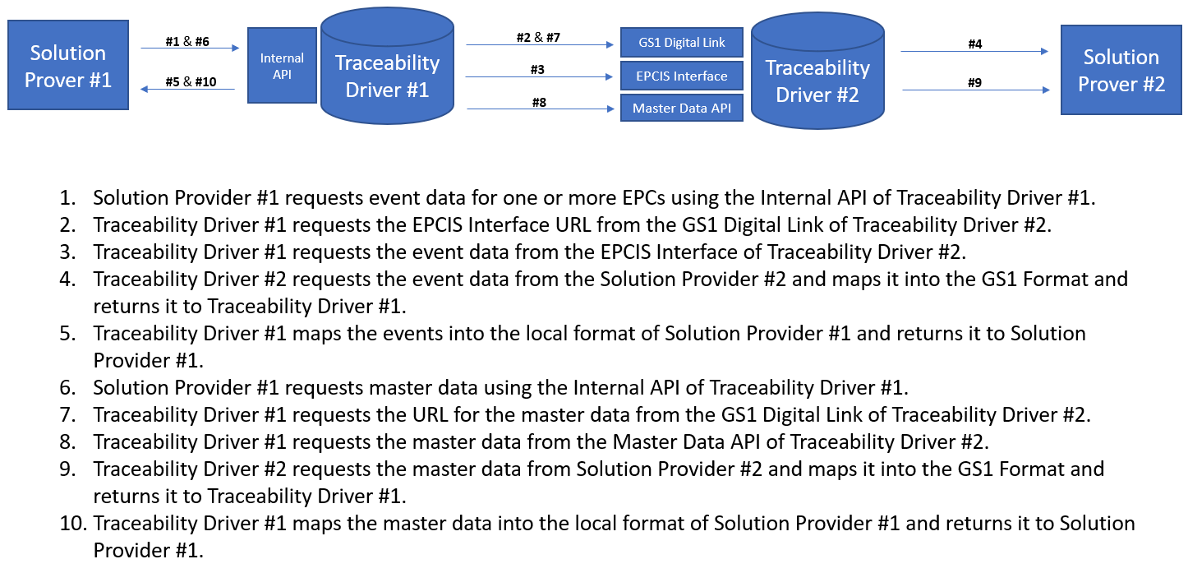
Description of Technical Design

Slide 5
Evaluation Criterion #1: Needs-based
A lack of interoperability among traceability solution providers has inflated the cost of traceability for years.
Without interoperability, supply chains are being forced to enter data into multiple buyer portals or adopt traceability solutions that their buyers use even though that traceability solution may not be a good fit or affordable for them.
What works for a retailer, will not work for a processor. By enabling interoperability, our solution allows each link in the supply chain to choose the solution that works best for them.
Our solution would reduce the cost of traceability for the entire industry.

Slide 6
Evaluation Criterion #2: Innovation
The Traceability Driver is a cross-platform that can easily be installed into any solution providers environment.
Secured with HTTPS, internal checks, and Public/Private Key Encryption.
Builds a Directory Service so solution providers can look up and connect with other solution providers.

Slide 7
Evaluation Criterion #3: Usability
The service is installed as a webservice and is compatible with Mac, Windows, and Linux.
Users only need to write a single from their internal data format to our common data models.
The Traceability Driver dramatically reduces the effort to becoming interoperable while also dramatically increasing the consistency in which the interoperable standards are implemented.

Slide 8
Evaluation Criterion #4: Affordability
The Traceability Driver Service is open source and free to use.

Slide 9
Evaluation Criterion #5: Scalability and Interoperability
The Traceability Driver Service is interoperable with any traceability system.
Compatible with Mac, Linux, and Windows.
The Traceability Driver significantly reduces the cost of interoperability for solution providers.

Slide 10
Future Plans
- We plan to continue assisting the industry in enabling interoperability by providing software and programming APIs that reduce the cost of implementing standards while also increasing the consistency in which those standards are implemented.

