Slide 1
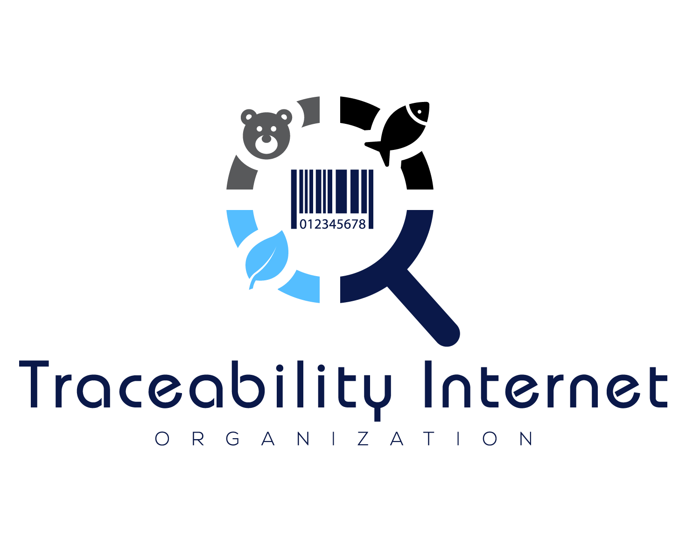
FDA Traceability Challenge Submission
Developed by: Philip L. Heggelund With help from John Heggelund and special thanks to Thomas Burke

Slide 2


Entrant
The Traceability Driver was developed to reduce the cost of interoperability. It’s an addon service that can be installed onto existing traceability solutions with minimum work and enables any traceability solution to interoperate with all other traceability solutions that install the Traceability Driver.
“The GDST supports free open-source solutions, like the Traceability Driver, that utilize creative solutions to reduce the cost of interoperability. We see tools such as the Traceability Driver accelerating not only GDST implementation, but also driving traceability across other commodities and use cases.”

Slide 3
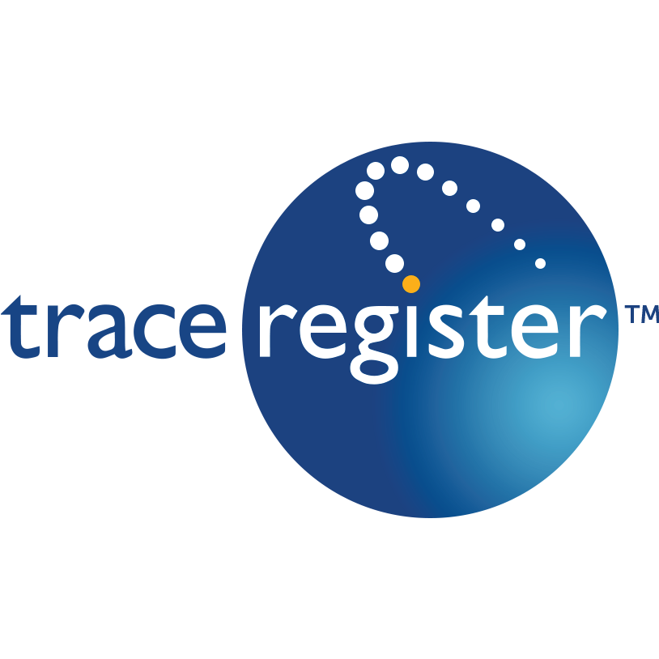

Summary of Concept
An Open Source and Freely available software tool that can be used to make an existing traceability solution interoperable using the GDST and GS1 standards.
Note that Seafood products are significant to the FTL
The Driver reduces development costs and streamlines application of existing standards.
Sometimes these standards are interpreted differently by solution providers implementing them, leading to inconsistencies in how they are implemented. This tool would assist in ensuring the standards are implemented consistently.
Every Traceability Driver enabled solution will be interoperable with each other.
Each traceability solution retains their own data model
The Traceability Driver enables interoperability through a common data model (wheel-and-spoke approach)
The tool is installed as an addon to any existing relevant traceability platform including traceability SaaS’s, ERPs, and WMSs.
Cross Platform and available on Linux, Windows, and Mac.
Privacy. The Traceability Driver does not store any of the data that is communicated through it and the Traceability Internet Organization cannot see any data communicated through the Traceability Driver. Each solution provider would host their own instance of the Traceability Driver and would have full control over it.
Below are solution providers that have already implemented or are currently working to implement the Traceability Driver…

Slide 4
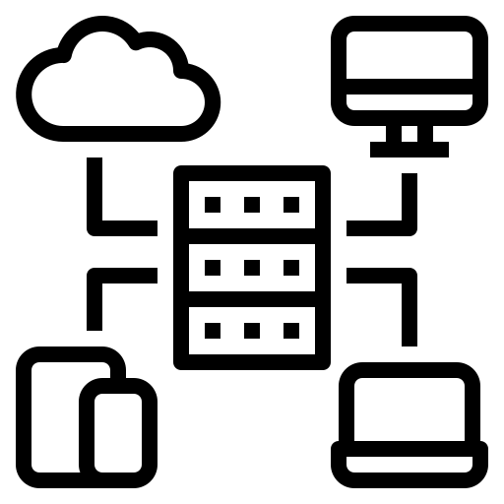
Description of Technical Design
Traceability Driver
Traceability Driver
Solution Provider
Solution Provider
GS1 Digital Link
GS1 Digital Link
EPCIS Interface
EPCIS Interface
Master Data API
Master Data API
Traceability Driver
Traceability Driver
Solution Provider
Solution Provider
GS1 Digital Link
GS1 Digital Link
EPCIS Interface
EPCIS Interface
Master Data API
Master Data API
Please see Appendix 1 and Appendix 2 for more details.

Slide 5
Evaluation Criterion #1: Needs-based
A lack of interoperability among traceability solution providers has inflated the cost of traceability and reduced data quality for years.
Without interoperability, supply chains (especially processors and producers) are being forced to enter data into multiple buyer portals or adopt traceability solutions that their buyers use even though that traceability solution may not be a good fit or affordable for them.
Different CTEs use different software products. By enabling interoperability, our solution allows each link in the supply chain to choose the solution that works best for them.
There already exists dozens, if not hundreds of traceability solutions. The industry is not lacking the perfect traceability solution. The biggest hurdle to end-to-end traceability is interoperability.
Currently most traceability solutions try to take a “one size fits all approach”, rather than specializing by CTE and value chain function.
There exists many great standards for interoperability such as GDST and EPCIS, however there is a need for software tools to assist in implementing these standards for traceability solution providers.

Slide 6
Evaluation Criterion #2: Innovation
Food companies are drowning in traceability solution options but are starving for interoperability.
Increases data quality and end-to-end traceability without introducing another standard or another traceability solution.
Open-source middleware takes traceability from PDFs to modernity in standards implementation
The Traceability Driver is a cross-platform that can easily be installed into any solution providers environment.
Utilizes existing data format and communication standards.
Secured with HTTPS, internal checks, and Public/Private Key Encryption.
HTTPS to ensure communication is secured.
Allows permissions of data on a Trading Party by Trading Party basis.
Public / Private Key using Decentralized Identifiers (DID)
Network effect creates exponential value for traceability solutions who implement the Traceability Driver.
Think social media like Facebook.
Every time someone implements the Traceability Driver, it makes the network more valuable for them, and for all the previous traceability solutions who implemented the driver.
Makes Traceability as easy as email.

Slide 7
Evaluation Criterion #3: Usability
The service is easily installed as a webservice and is compatible with Mac, Windows, and Linux.
Traceability Solution Providers just need to make a mapping between their local data model and the common data model provided.
The Traceability Driver dramatically reduces the effort to becoming interoperable while also increasing the consistency in which the interoperable standards are implemented.

Slide 8
Evaluation Criterion #4: Affordability
The Traceability Driver Service is open source and free to use.
Reduces the development costs of interoperability for solution providers.
Interoperability helps reduce costs for Food Companies
Development cost savings of interoperability for solution providers can be passed onto the food companies.
They don’t need to pay for solutions that don’t fit their needs that are pushed onto them by their buyer.
Reduces data-entry since they don’t need to enter data into multiple portals, they just enter data into their solution and their solution can now share that data with other solutions.

Slide 9
Evaluation Criterion #5: Scalability and Interoperability
Built on GS1 Standards
EPCIS
GS1 Digital Link
GS1 Web Vocab
The Traceability Driver enables any solution provider to become interoperable.
Compatible with Mac, Linux, and Windows.
Open Source and Free

Slide 10
Future Plans
We plan to continue assisting the industry in enabling interoperability by providing software and programming APIs that reduce the cost of implementing standards while also increasing the consistency in which those standards are implemented.
Through common data structures, we can develop common analytical scripts. Tools that enable FDA and others to take more quantitative approaches to tracebacks and evaluating hypotheses.
Bringing open-source methods to the traceability community will allow us to enable pathways and synergies with existing technical advancements in other sectors, such as those from the Cloud Native Computing Foundation, Linux, and/or Hyperledger.

Slide 11
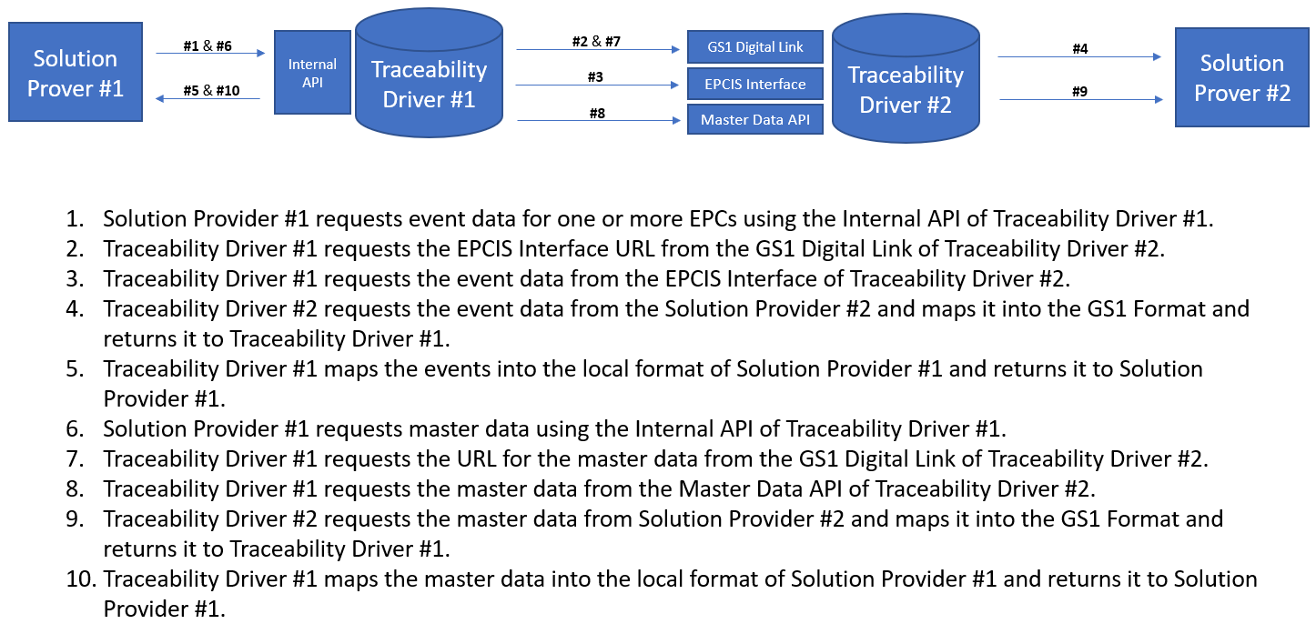
Technical Appendix 1

Slide 12
Wheel and Spoke Data Mapping Approach
Technical Appendix 2
Solution Provider #1 Data Model
Mapping
Mapping
Traceability Driver Common Data Model
Solution Provider #2 Data Model
Mapping
Mapping
Mapping
Mapping
Solution Provider #4 Data Model
Solution Provider #3 Data Model

